Slide 1
Behavioural (Health) Economics
An Introduction by Graham Lister

Slide 2
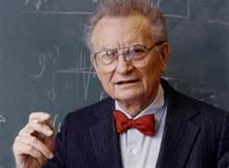
EconomicS*
Economic theory:
Free markets enable rational choice so that consumers and suppliers can optimise their utility
For rational man utility (or preferences) are expressed as willingness to pay and willingness to sell at a given price.
The sum of consumer/supplier utility will maximise benefits to society.
But Samuelson notes regulation is needed to take into account externalities (costs to society that are not costs to consumers or producers) and irrational behaviour.
* Paul A Samuelson and William D Nordhaus 2009 Economics” McGraw-Hill
Paul Samuelson 1932-2009 Nobel prize winner in economics, textbook on rational market and utility. He believed in regulated markets. He said In economics “Always go back for the second lesson”. This is it!

Slide 3
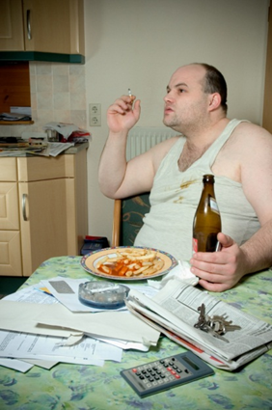
Behavioural Economics
An Introduction
This session asks:
Why do people make what seem to be irrational choices?
Can we understand real life decisions about health better?
What should policy makers do about it?
Should health be considered as a brand?
Why is social capital important?
How can social marketing help?
And how much should be spent on supporting better lifestyle choices.
Meet rational man, he knows what’s good for him and will maximise his utility, but he hasn’t got round to it yet.

Slide 4
(Health) Economic Theory
Price
To increase the quantity of good health behaviour Q
You must increase perceived value to their health
And or decrease the cost by subsidy to increase the
Price paid in money, time or effort
B
C
A
Supply
curves
E
F
D
Demand
curves
Q= Quantity
If the perceived value is increased, by better information it will increase good health behaviour from curve A to curve B
And if cost of supply is decrease from C to D
The overall effect will increase positive behaviour from E to F

Slide 5
(Health) Economic Behaviour Theory
D
C
!
Just tell them the health price they are paying
And/or increase cost of supply by taxation
Rational, economic man will maximise his utility
Health promotion is so easy

Slide 6
Or Maybe Not, Meet the Father of Behavioural Economics*
Prospect theory** upsets the idea of utility:
People are optimistic but risk averse
They over value small sure short term gains
Underestimate uncertain long term losses
Thinking Fast and Slow*** points to:
Two thought modes that govern behaviour
Fast, emotional instinctive response
Often dictates first response
Slow, logical thought often rationalises choices.
The remembered self differs from experience
People’s expectations adjust to their reality
*Daniel Kahneman Nobel Prize Lecture 2002 at http://www.nobelprize.org/nobel_prizes/economics/laureates/2002/kahnemann-lecture.pdf
**Thayer Watkins “Kahneman and Tversky's Prospect Theory” at http://www.sjsu.edu/faculty/watkins/prospect.htm
***Daniel Kahneman (2011)“Thinking Fast and Slow” Penguin Books
Daniel Kahneman, a psychologist who won the Nobel Prize for pointing out that economic choices are not so rational

Slide 7
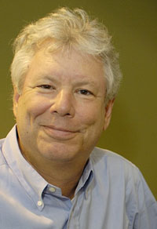
And the man who introduced us to Nudge
Nudge theory* :
Anchoring: expectations are set by immediate experience and cues such as “half price offer”.
Availability heuristic: probable outcomes are estimated from personal experience.
Representative heuristics: people search for patterns to explain the world.
Status quo bias: people prefer not to change.
Herd mentality: what do my peers do?
Choice architecture: choices are shaped by how they are framed, when/ where they are made.
*Richard Thaler and Cass R Sunstein (2008) “Nudge: Improving Decisions About Health, Wealth, and Happiness” Yale University Press.
Richard Thaler, an economist explains how psychological nudges and choice architecture can help people make better decisions

Slide 8
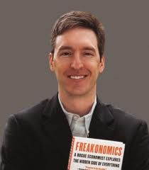
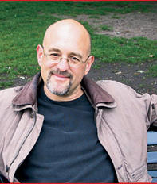
Steve Leavitt, economist who applies psychology
The “Freakonomics” and “StUmbling on Happiness” Guys
Their mix of economics/psychology/sociology provides new insights into social and economic behaviour, including health choices
Freakonomics* :
Choices are rational only if you understand the chooser’s values and context
Stumbling on Happiness**:
Our psychology gets in the way of rational decision making about the future.
* Steven D. Levitt, Stephen J. Dubner (2005) “Freakonomics: A Rogue Economist Explores the Hidden Side of Everything” William Morrow.
**Daniel Gilbert (2006) “Stumbling on Happiness” Harper Perennial.
Daniel Gilbert, psychologist who applies economics

Slide 9
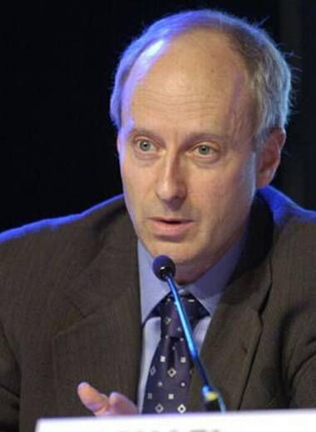
And the Author of “What Money Can’t Buy”*
Commoditising choices undermines the moral basis of society and can give choices to the rich not available to the poor and so divide us.
Commercialisation relevant to health include:
Financial incentives to change health behaviour
Advertising unhealthy products in schools
Preferential access to health services
Blood donation (in the US)
Surrogate mothers (in India)
Birth of more than one child per family(in China)
*Michael Sandel (2012) “What money can’t buy: The Moral Limits of Markets” Penguin Books also see his course ”the Global Philosopher” at www.bbc.co.uk/programmes/p03njc35
Michael Sandel a philosopher who criticises free market economics for commoditising and commercialising moral choices

Slide 10
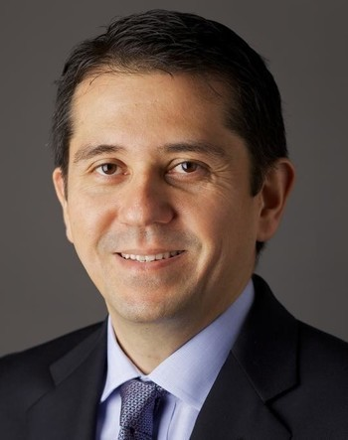
an Economist View of Leadership in an uncertain world of Brexit, Trump and Terrorism*
Moral leadership must recognise :
The world is ever more uncertain and complex leadership must address both known risks and unknown uncertainties.
Human error is inevitable; blaming people does not help to address the underlying causes.
Hindsight can be harmful by seeing outcomes as inevitable and a logical outcome of our beliefs rather than the product of an uncertain world.
While some uncertainties demand technical solutions (to known problems) others require us to adapt our thinking to address new realities.
*W Lee Howell “Four principles for leadership in an uncertain world” at https://www.weforum.org/agenda/2017/01/four-principles-for-leadership-in-an-uncertain-world
W Lee Howell Head of Global Programming, World Economic Forum Geneva draws on Behavioural Economics and Leadership Theory

Slide 11
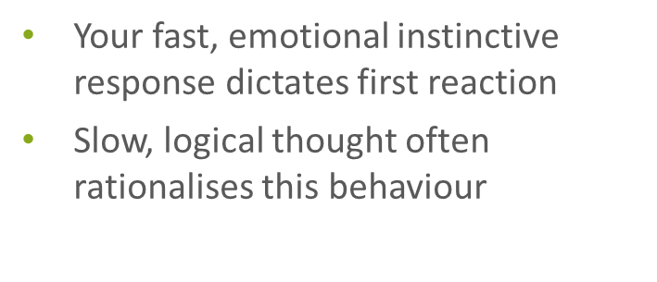
Health Responses
I read about stranger danger so I keep my child indoors. He is a bit chubby now but I am sure he will be safe.
You are optimistic but risk averse
Over value small sure short term gains
Underestimate uncertain long term loss
I cook microwave meals for my family , I don’t have time to mess about with vegetables. Anyway we have the fat gene in our family.
Your expectations of outcomes are set by immediate experience,
You search for patterns to explain the world.
My granny smoked all her life and she lived to 92, grandpa died at 60, he was a victim of his nerves, so like him I need to smoke to keep calm.

Slide 12
Health Responses
I remember I am always happy and calm when I smoke. I could stop anytime. Everyone gets out of breath at my age.
Remembered self differs from the experienced self
People’s expectations adjust to their current reality
Everyone round here has always smoked, only la di dah ponces takes any notice of all that stuff about health.
You prefer things the way they are now.
You want to fit in with your group.
You are influenced by the when, where and how options are presented.
I want my implants removed because there is 1 in 10 risk of problems or death, while removal is 85% safe.

Slide 13
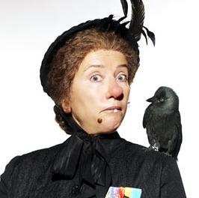
Behavioural economics show that we do not make rational choices
Why not leave it to the market?
Addictive substances rob people of choice, so limit access to drugs, alcohol, cigarettes.
Markets do not take externalities into account e.g. costs to the NHS, so tax them.
Commercial marketing distorts choice, so control advertising, specially to children.
If fines are treated as “fees to permit” they undermine moral sanctions and are divisive.
Consumers are poorly informed, so provide health information and education.
People in disadvantaged circumstances make the worst choices, so focus on them.
When is policy intervention justified and not the Nanny State?

Slide 14
what can Policy makers do?*
Other people’s behaviour matters: so address group behaviour and set up support groups.
Habits are hard to change: so don’t expect immediate results persist and follow up.
People are motivated to ‘do the right thing’: so use role models and a social movement for health.
People’s self-expectations influence how they behave: so address self esteem, encourage positive values and commitment.
People are loss-averse: so show their risk of loss but also emphasise immediate gains in their terms.
People are bad at computation when making decisions: so keep it simple and present issues in their terms giving examples.
People need to feel involved and effective to make a change: so involve them in choices and action.
Framing is important: so set out choices in the right context and in an attractive way to prompt health.
* Behavioural Economics : seven principles for policy- makers New Economic Foundation (2006) ( I added the 8th)

Slide 15
Thinking of health As A brand
Commercial marketing applies behavioural economics* :
Marketing considers: Product, Price, Promotion and Place.
Health mainly focuses on awareness and information.
Brands have positive personality – health is often gloomy.
Brands are fiercely defended (remember the Olympics)
It seems anyone can claim or imply their products are healthy from bottled water to homeopathy or alternatives to medicine.
Marketing researches customers in depth and listens carefully.
Health has a long way to go to recognise patients as customers.
Marketing use nudges and cues - health uses fudges and queues.
*See for example Wendy Gordon (1999) “Goodthinking: a Guide to Qualitative Research”
Admap Publications.
Note that the NHS Commissioning Board is currently appointing a Brand Manager

Slide 16
Health and Social Capital*
Social capital is a sociological concept that can be regarded as an aspect of behavioural economics. It affects health in many ways some good some bad.
Maintaining norms: what we do around here, it may be good or bad for health but helps define “us”.
Mobilising for action: pursuing a common cause, getting organised to cheer on or protest.
Reciprocal exchange: looking after one another, providing emotional and practical assistance.
Spreading information: sharing news and gossip, giving access to advice and services.
Linking to resources: formal and informal sources of support and organisations that can help.
Social Capital * is the framework of values and norms of behaviour that fosters bonds within community groups, bridges between groups and links with formal and informal organisations
* Rosalyn Harper (2002) “The Measurement of Social Capital in the UK” National Statistics
* Ichiro Kawachi (2010)“Social Capital and Health” Handbook of Medical Sociology Ed Bird C E et al. Vanderbilt University Press

Slide 17
Social Marketing
Social marketing applies behavioural economics through:
Customer orientation - from the decision makers’ perspective.
Insight – into the psychological triggers for action.
Theory – applying psychological/sociological/economic models.
Behavioural goals – realistic steps to improved lifestyle choices.
Segmentation – understanding client rationale and peer group.
Exchange – recognising what change means as gains and losses.
Competition – addressing marketing and addiction counter forces.
Methods mix – service improvement, awareness raising, information, advertising, nudges, pricing, individual counselling and group support.
The NSMC is a non profit community interest company dedicated to improving the effectiveness of behaviour change programmes.

Slide 18
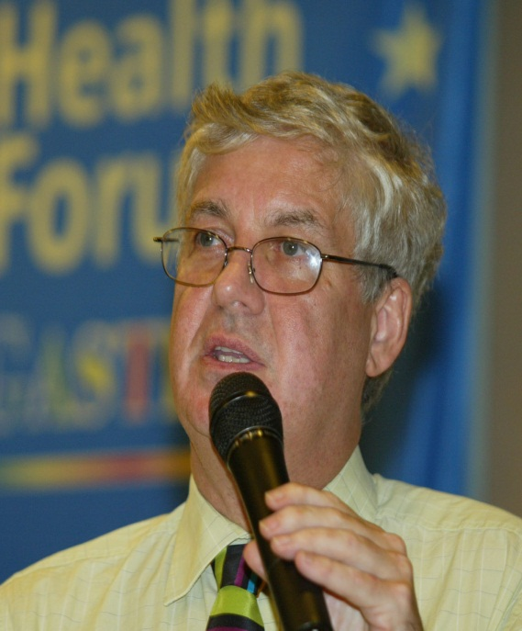
SOCIAL MARKETING ACHIEVES VfM BY APPLYING SOCIAL VALUES
Without support people make irrational choices not in their long term interests and not reflecting the full cost to society.
Behavioural economics shows why they make poor choices and how to help them.
Investment in social marketing can be justified if it achieves a social cost/ benefit ratio equal or better than other social services e.g. the NHS ~ £30,000 per QALY. VfM tools* support this evaluation.
This is not commoditising health but the reverse, applying a societal cost analysis to support public action where markets fail to reflect moral values.
*See
Graham Lister, as an economist/ sociologist, associate of the NSMC I helped to develop the VfM Tools.
http://www.building-leadership-for-health.org.uk/evaluating-behaviour-change/

Slide 19
Investing in Social Marketing*
Social marketing expenditure to improve and support healthy lifestyle choices may be justified by examining costs and benefits:
Improvements in health and social outcomes (QALYS and equity)
Reduction in future costs to society:
Social return on investment:
In each case gains must be discounted to current values and compared to total stakeholder costs as a cost/ benefit ratio
Investment may be justified if it achieves outcomes at or better than the value for money achieved by other social investments.
For health at or better than £30,000/QALY as achieved by the NHS

Slide 20
Some Issues for you to explore
Is it acceptable to persuade people to behave in ways they do not chose?
London 2012 has been called the Nudge Olympics, why?
Are organ donation rates higher in countries where they opt out or opt in?
What are the implications for the way we measure health gain (QALYs)?
How do you use peer group pressure/support for better health?
How do you translate long term health outcomes into short term risks?
Discuss the moral issues raised by incentives for healthy behaviour
Whose fault is it that disadvantaged people have the worst health?
your way around one of these issues as a basis for discussion at our next session: facts and figures as well as ideas please.

Slide 21
Further Reading
I hope no ideas have been seriously harmed by this introduction, but they have been grossly simplified, so please read further:
Daniel Kahneman Nobel Prize Lecture 2002 at http://www.nobelprize.org/nobel_prizes/economics/laureates/2002/kahnemann-lecture.pdf
Thayer Watkins “Kahneman and Tversky's Prospect Theory” at http://www.sjsu.edu/faculty/watkins/prospect.htm
Daniel Kahneman (2011)“Thinking Fast and Slow” Penguin Books
Richard Thaler and Cass R Sunstein (2008) “Nudge: Improving Decisions About Health, Wealth, and Happiness” Yale University Press.
Steven D. Levitt, Stephen J. Dubner (2005) “Freakonomics: A Rogue Economist Explores the Hidden Side of Everything” William Morrow.
Daniel Gilbert (2006) “Stumbling on Happiness” Harper Perennial
Michael Sandel (2012) “What money can’t buy: The Moral Limits of Markets” Penguin Books
Behavioural Economics : seven principles for policy- makers New Economic Foundation (2006) http://www.neweconomics.org/publications/behavioural-economics
The National Social Marketing Centre (2009) “Social Marketing Benchmark Criteria” http://thensmc.com/sites/default/files/benchmark-criteria-090910.pdf
NSMC (2011) “VfM tools” the National Social Marketing Centre http://thensmc.com/resources/vfm

