Slide 1
The WHO National Burden of Disease Tool Applied to UK Data
The WHO NBDt identifies the consequences of behaviour for long term Health outcomes in each country, measured as DALYs, YLL, YLD and Deaths
this brief Introduction will explain how the WHO NBDT works and its latest Update by the Institute for health metrics and evaluation
Graham Lister
Visiting Professor in Health and Social Care LSBU

Slide 2
The Problem of Health Cause and Effect
Health impacts from behaviour like smoking:
Usually occurs after many years of behaviour
Have an impact on many different health outcomes
Often arises from several different causes e.g. smoking and obesity both lead to heart disease.
Is inherently uncertain
Traditional methods for predicting health outcomes:
Consider only one factor at a time
Tend to take into account only a limited range of outcomes
Often fail to take into account multiple causes and time

Slide 3
The WHO National Burden of Disease Tool (BDT)
The WHO NBDT was developed by a team of 40+ international experts based on studies and data
For 26 common risk factors including:
Tobacco, alcohol, high BMI, physical inactivity, low fruit and vegetable intake, high blood pressure, high cholesterol, illicit drugs, non- use and use of ineffective methods of contraception, occupational noise, unsafe sex, outdoor air pollution and vitamin deficiency.
They established how much poor health outcome is attributable to each cause for 14 regions including
High Income European countries (including the UK)

Slide 4
Some of the Technical Language
Burden of Disease is measured in terms of
Years of Life Lost (YLL)
Years Lived with Disability (weighted for disability) YLD
Disability Adjusted Life Years (DALYs)= YLL + YLD
Weights for disability are set by an international committee
Outcomes/cause = Population Attributable Fraction
% of each outcome for each age/sex cohort
Added as a discounted DALYs
PAFs applied to UK outcome figures for each age/ sex cohort to show UK causes of Burden of Disease

Slide 5
Advantages and Disadvantages of Using the BDT
Advantages: The NBDT is not perfect but
It avoids double counting
It represents a consensus view of experts
It is reasonably comprehensive
It is internally and internationally consistent
Disadvantages: The NBDT is not perfect
It uses regional average PAFs rather than UK specific ones
It used DALYs not QALYs (they can be translated crudely)
2004 DALYs were weighted by age but not the 2010 update
It wasn’t invented here (though the WHO team had UK input)

Slide 6
What does it look like
NBDT shows outcome by cause for age/sex cohorts
For each disease in detail
E.g. a portion of smoking outcomes for men
NBDT shows 58 outcomes attributable to smoking
 |  |  |  |  | Men by age cohort
 | Disease |  |  | Total | 30-44 | 45-59 | 60-69 | 70-79 | 80+
 | Non communicable diseases |  |  | 948647 | 85531 | 225306 | 173522 | 143214 | 44194
 |  | Malignant neoplasms |  | 320936 | 12180 | 65997 | 76904 | 62621 | 18038
 |  | 1. | Mouth and oropharynx cancers | 13398 | 974 | 5151 | 3273 | 1243 | 321
 |  | 2. | Oesophagus cancer | 34563 | 1635 | 9487 | 8709 | 6490 | 1791
 |  | 3. | Stomach cancer | 5275 | 420 | 1210 | 1461 | 1432 | 430
 |  | 4. | Colon and rectum cancers | 15611 | 967 | 4185 | 4633 | 3559 | 1064
 |  | 5. | Liver cancer | 2468 | 188 | 802 | 706 | 499 | 118
 |  | 6. | Pancreas cancer | 5231 | 292 | 1644 | 1478 | 1068 | 283
 |  | 7. | Trachea, bronchus, lung cancers | 190553 | 2813 | 30652 | 43734 | 36719 | 9863

Slide 7
A Summary of NBDT Outcomes for UK
 | Leading causes of DALYs due to selected risk factors in UK
 |  |  |  |  |  |  | % total |  |  |  |  |  |  | % total |  |  |  |  |  |  |  | % total
 |  | Persons |  |  |  |  | DALYs |  |  |  | Males |  |  | DALYs |  |  |  | Females |  |  |  | DALYs
 | 1 | Tobacco |  |  |  |  | 12.6 |  |  | 1 | Tobacco |  |  | 17.5 |  |  | 1 | Tobacco |  |  |  | 7.4
 | 2 | Alcohol |  |  |  |  | 8.3 |  |  | 2 | Alcohol |  |  | 12.2 |  |  | 2 | High BP |  |  |  | 7.2
 | 3 | High blood pressure |  |  |  |  | 8.3 |  |  | 3 | High BP |  |  | 9.4 |  |  | 3 | High BMI |  |  |  | 5.9
 | 4 | High cholesterol |  |  |  |  | 6.4 |  |  | 4 | High cholesterol |  |  | 7.8 |  |  | 4 | High cholesterol |  |  |  | 5.0
 | 5 | High BMI |  |  |  |  | 6.1 |  |  | 5 | High BMI |  |  | 6.3 |  |  | 5 | Alcohol |  |  |  | 4.3
 | 6 | Physical inactivity |  |  |  |  | 2.9 |  |  | 6 | Illicit drugs |  |  | 3.5 |  |  | 6 | Physical inactivity |  |  |  | 2.6
 | 7 | Illicit drugs |  |  |  |  | 2.5 |  |  | 7 | Physical inactivity |  |  | 3.3 |  |  | 7 | Low f and v |  |  |  | 1.5
 | 8 | Low fruit and vegetable |  |  |  |  | 2.0 |  |  | 8 | Low f and v |  |  | 2.6 |  |  | 8 | Illicit drugs |  |  |  | 1.4

Slide 8
Institute for Health Metrics and Evaluation
The IHME Global Burden of Disease tool
Available at http://vizhub.healthdata.org/gbd-compare/
2010 data for UK with revised DALYS/YLLs/YLDs
No age weighting or internal discount
Therefore comparable to QALYs
Gives overall health burden or Male/Female Age breakdown
Also shows behavioural causes and disease impacts
Open this page and select United Kingdom and data
And or look at other data visualisation tools
DALYS/YLLs/YLDs

Slide 9
IHME UK DALYs 2010

Slide 10
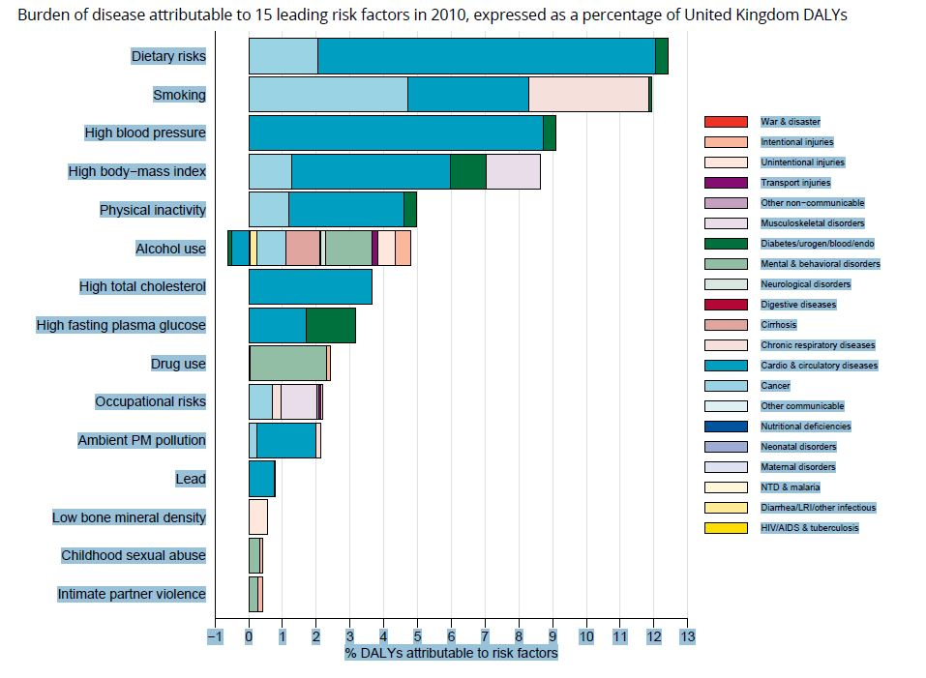
IHME Health Risk Data

Slide 11
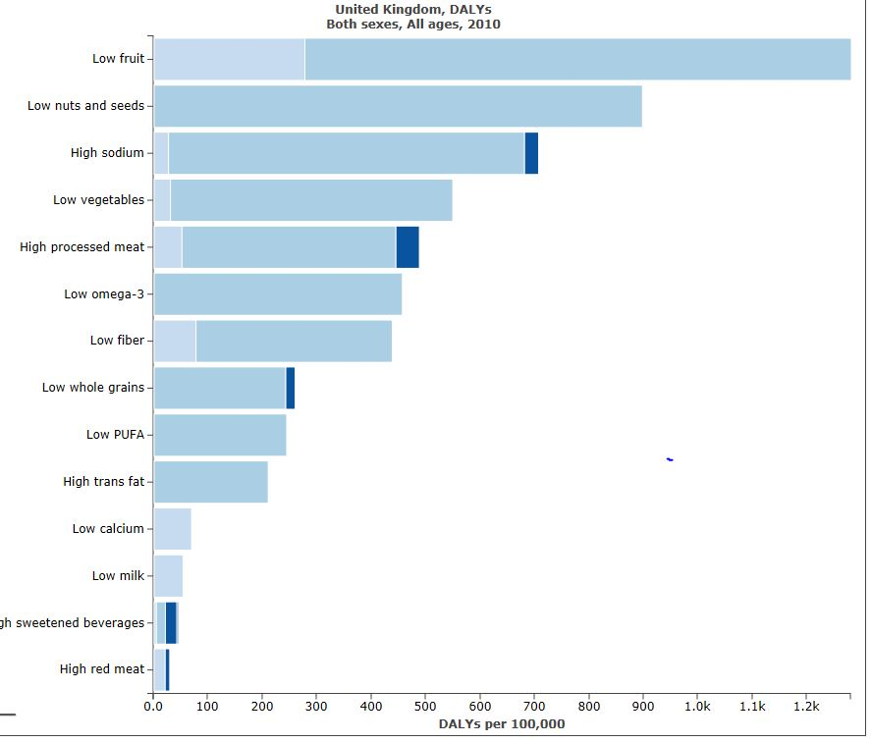
IHME Health Outcomes of Unhealthy Diet

Slide 12
Exercise
Consider the data presentations here
Or if possible go on line to view the IHME web site
At http://vizhub.healthdata.org/gbd-compare/
What do they tell us about UK health outcomes
What could you tell a patient about the risks of ill health resulting from poor diet and inactivity?

Slide 13
Next Steps
Like all elements in this toolkit the NBD tool should be examined by Public Health England
An England version could be developed
Other relevant behavioural causes could be considered
And other impacts on wellbeing e.g. social impact of obesity
Behaviour in prior years should be related to current outcomes
A pilot study in 1996 showed great potential for this
This does not have to be an expensive process, it could start with a consensus of experts on the impacts of behaviour on outcomes.

