Slide 1
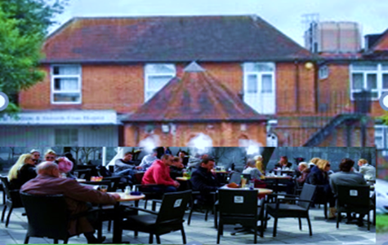
The NHS Vision of Neighbourhood Health and Care
Friends of Chalfonts and GX Hospital
Applied to South Buckinghamshire
Notes:
This section introduces the core objectives of neighbourhood health initiatives within the NHS, their alignment with the broader Long Term Plan, and the expected benefits for local communities.

Slide 2

Neighbourhood Health Policy
The Labour Party Manifesto and NHS 10 Year Plan include Neighbourhood Health as a key objective, 250 Neighbourhood Health Centres are currently planned.
This reflects long term aims to empower people to manage their own health to achieve sustainable health and care
The Buckinghamshire Oxfordshire and Berkshire West Integrated Care Strategy calls for Integrated Neighbourhood Teams working with Community Support Groups
The Friends have been suggesting steps towards this approach for 10 years
Wanless review 2002 noted the NHS would only be sustainable with full community engagement
Darzi review 2024 notes that 7% of patients with complex needs account for 46% of hospital costs
Notes:
--- These initiatives align with the NHS Long Term Plan by promoting integrated care, prevention, and patient empowerment to create a sustainable health system responsive to local needs. Image source: Microsoft 365 content library

Slide 3

Objectives
A place based approach to service delivery and leadership closer to people’s homes
Integrated Primary Care with Physical/ Mental Health and Social Care and Local Community Support
Greater focus on Prevention and Support for Wellbeing for those with complex needs
Personalised Coordinated Care that tailors support to individual needs and preferences
Providing equitable services and community support for those in greatest need
Better communications using eHealth so that neighbourhoods know their care services
Outcomes
Improved health and wellbeing
Better experience for patients & staff
Less hospital/care home stay needed
Less cost for NHS and LAs
Notes:
--- Neighbourhood health initiatives aim to deliver personalised, coordinated care close to home, improve population health, and reduce pressures on hospitals by focusing on community-based services. Image source: Microsoft 365 content library

Slide 4
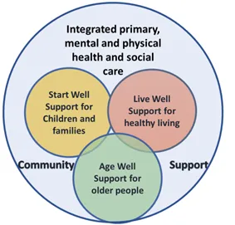
Neighbourhood Health and Care Services at the Hospital
Current and planned services include:
Rapid Response and Intermediate Care Team
Providing urgent care for patients in crisis, allowing them to remain safely in their own homes and empowering their recovery.
Health Visitor and School Nursing Services
Providing guidance and support for families with young children and school children to empower tham to achieve better physical and mental health
Clinics and services for patients:
Including earwax removal, physiotherapy, ultrasound scans, warfarin management, audiology, diabetes control,.,
Current plans include support for patients with a range of needs
Colorectal surgery, ENT (Ear Nose and Throat), Vascular surgery, Ophthalmology (enhanced Services), Paediatrics, Haematology, Warfarin, Diabetes care, Tissue Viability, Abdominal Aortic Aneurysm (AAA), Cardiology, Podiatry, Continence, Community Neuro Rehabilitation, Pulmonary Rehabilitation, MSK Therapy and Physio service
New services at the hospital will soon include:
Community Wellbeing Hub
Integrated Neighbourhood Team for Fragile people
Social Prescribing service
All Primary Care and Community Service need to work together with local community groups as a partnership to create an Integrated Neighbourhood Health and Wellbeing Centre.
Notes:
--- Neighbourhood health initiatives aim to deliver personalised, coordinated care close to home, improve population health, and reduce pressures on hospitals by focusing on community-based services. Image source: Microsoft 365 content library

Slide 5
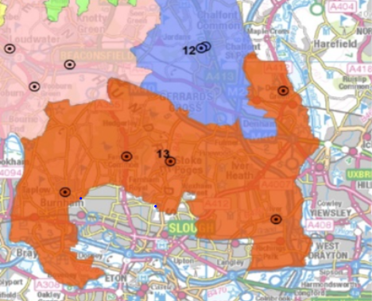
The South Buckinghamshire Neighbourhood
A small Town and Villages in Buckinghamshire County Council (BCC) with commuting to London
80,00 people served by 2 Primary Care Networks (PCNs) and Chalfonts and GX Community Hospital
Chalfonts PCN serves: Gerrards Cross Town (8,500), Chalfont St Peter(13,600), Chalfont St Giles (8,000), and Hedgerley (900) villages.
South Bucks PCN serves: Denham, (8,000), Iver (7,500), Fulmer (500). Jordans and Seer Green (3,000), Richings Park (6,000) Wexham (4,000), Farnham (7,000) and Stoke Poges (4,000)
Patient use BHT services at High Wycombe and Amersham Community Diagnostic Centre as well as the nearby Frimley Health Wexham Park Hospital
Mental health services are provided by a team from Oxford Health NHS Trust (OHT), High Wycombe
Characteristics include:
A somewhat older age profile .
High incomes low relative deprivation
About 400 community support groups
Good access to green spaces
Notes:
--- Engaging local communities in decision-making builds trust, ensures services meet real needs, and encourages active participation in health and care. Image source: Microsoft 365 content library

Slide 6
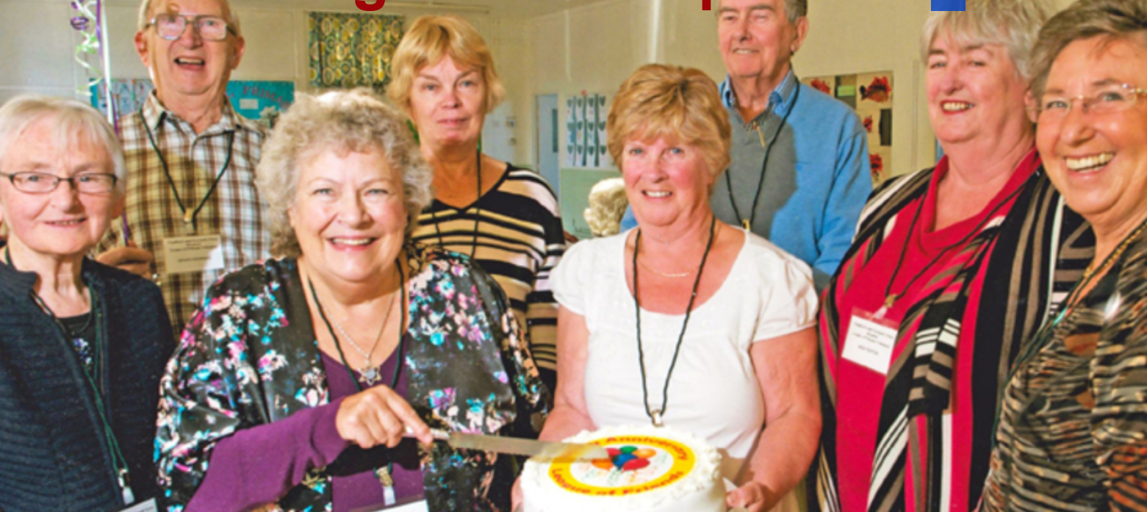
Friends Suggestions
For 10 years we have sought Partnership with Community Groups
Suggestions and offers of support here have included:
A Community Wellbeing Hub and Drop in Café
Frailty Support
Social Prescribing
Local Provision of Health checks
Community support for mental health wellbeing
A Start Well Hub
Support for disability access to arts, sports etc Breathe Easy Support Group
A Joint Pain self-help support group
Support for those with post-natal depression.
Self-care support for people with diabetes.
Integrated care for carers network
Support for hospice at home services
An eHealth and Wellbeing Centre.
Support for people discharged from hospital .
Facilities for staff such as a common room
Support to improve access to Amersham CDC
We are delighted to work in partnership
With BHT, BCC, PCNs & Community orgs for:
A Community Wellbeing Hub led by the Buckinghamshire Community Wellbeing Hub
Integrated Neighbourhood Team for people with Frailty Led by our PCNs
Social Prescribers and support groups
Notes:
--- Partnership working across sectors ensures that services are holistic, addressing social as well as health needs, and maximising resources for community benefit. Image source: Microsoft 365 content library

Slide 7
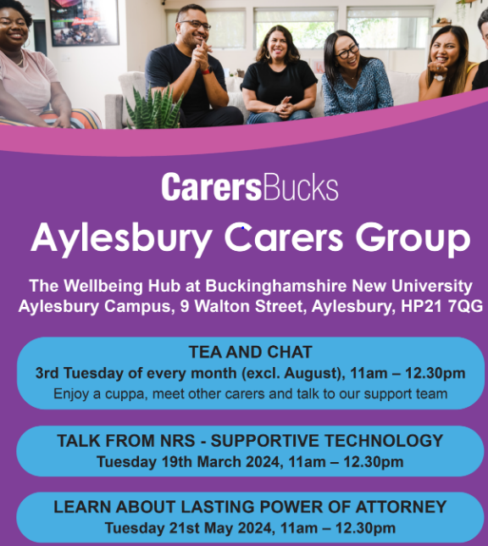
The Community Wellbeing Hub could provide space for:
Multi agency early intervention, prevention and support from co located health, social care and VCSE partners
Possible partners identified by Claire Tilson at the Friends AGM
Carers Bucks
Alzheimer’s Society
Adult Social Care
Integrated Neighbourhood Teams
Community Dieticians
Oxford Health Mental Health Services
Social Prescribed Activity Groups
BHT Health Coaching Team
Age Concern GX Plus
Free Blood Pressure Checks
Health & Wellbeing Events
Signposting & Support
Training & Education for students
.
The Community Hub works with health and social care providers and community support groups for wellbeing and health of all
Notes:
--- ICSs bring together health and care organisations to plan and deliver joined-up services, breaking down traditional barriers to improve health outcomes at a local level. Image source: Microsoft 365 content library

Slide 8
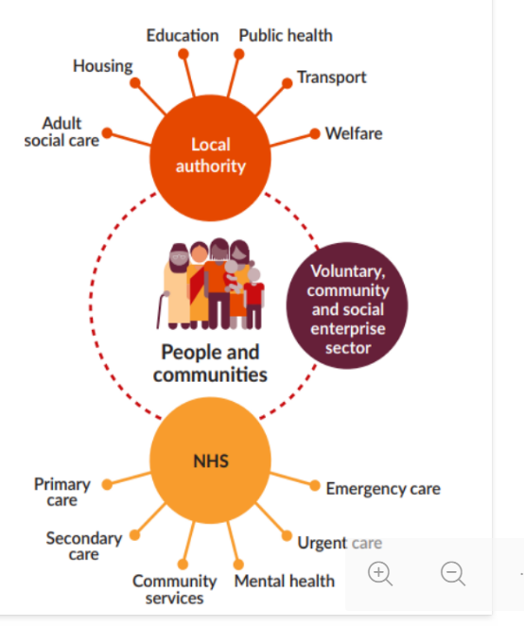
Integrated Neighbourhood Teams deliver integrated personal care closer to home for Fragile people (usually 85+ with complex needs)
Multi agency early intervention, prevention and support from health, social care and VCSE
Possible partners identified by Natalie Judson at the Friends AGM
Voluntary, Community and Social Enterprises
Local Authority Service
Adult Social Care
Housing
Education
Public Health
Transport
Welfare
NHS
Primary Care
Hospital Care
Community Services
Mental Health
Urgent Care
Emergency Care
.
Integrated Neighbourhood Team works in partnership with health and social care providers and community support groups for the wellbeing and health of frail patients
Notes:
--- ICSs bring together health and care organisations to plan and deliver joined-up services, breaking down traditional barriers to improve health outcomes at a local level. Image source: Microsoft 365 content library

Slide 9
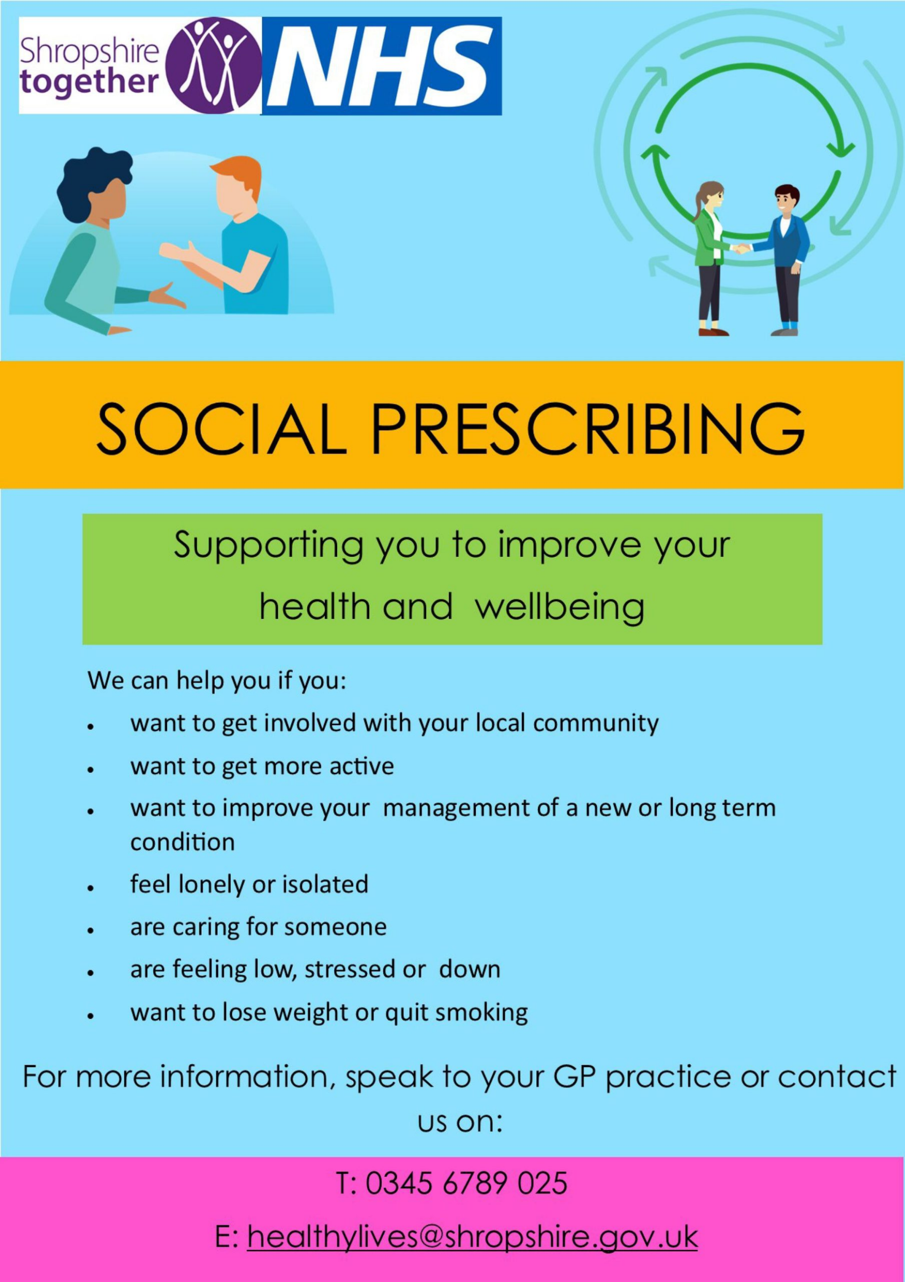

Social Prescribing guides people to community support groups to help them manage their mental physical and social wellbeing This may include:
Voluntary, Community & Social Enterprises offering:
Befriending and understanding
Activity like walking football or bowls
Shared experience perhaps of illness
Memory Cafe
Support for shopping or transport
Sometimes financial help
Access to health and Social Care Services
is a computer system/ app that helps health and social prescribers to link patients to local community groups and services.
.
Social prescribing is a partnership between the primary care team community support groups and other care providers
Notes:
--- ICSs bring together health and care organisations to plan and deliver joined-up services, breaking down traditional barriers to improve health outcomes at a local level. Image source: Microsoft 365 content library

Slide 10

Community Wellbeing Hub Integrated Neighbourhood Teams and Social Prescribing all require a partnership culture They all engage with:
Voluntary, Community & Social Enterprises (VSCE) and groups
Physical & Mental Health Services
Social Care Services
And others
could be useful to all three
.
This needs Teamwork and:
Empathy and listening skills
A shared understanding of patient/ client needs
Knowledge of available resources
Trust in one another
Clarity as to client facing roles and team leadership
Notes:
--- ICSs bring together health and care organisations to plan and deliver joined-up services, breaking down traditional barriers to improve health outcomes at a local level. Image source: Microsoft 365 content library

Slide 11

Neighbourhood Partnership must include all those working for the health and wellbeing of the local community This will include:
Nurses ANPs and other health and care services at the Chalfont & GX Hospital
Local Town and Parish Councils
Community and patient support groups
Pharmacy and dental professionals
Police and Education staff
Informal and other Carers
And many others
We all need to work together
.
This may be difficult because:
Organisational boundaries between BHT/BCC/OHT/FHT/PCNs/Community
Professional Team leadership from HQs
Lack of clear local leadership
Patient confidentiality and info sharing
The changing nature of Patient Care Plans
Staffing and resource constraints
Require wider commitment to change
Notes:
--- ICSs bring together health and care organisations to plan and deliver joined-up services, breaking down traditional barriers to improve health outcomes at a local level. Image source: Microsoft 365 content library

Slide 12
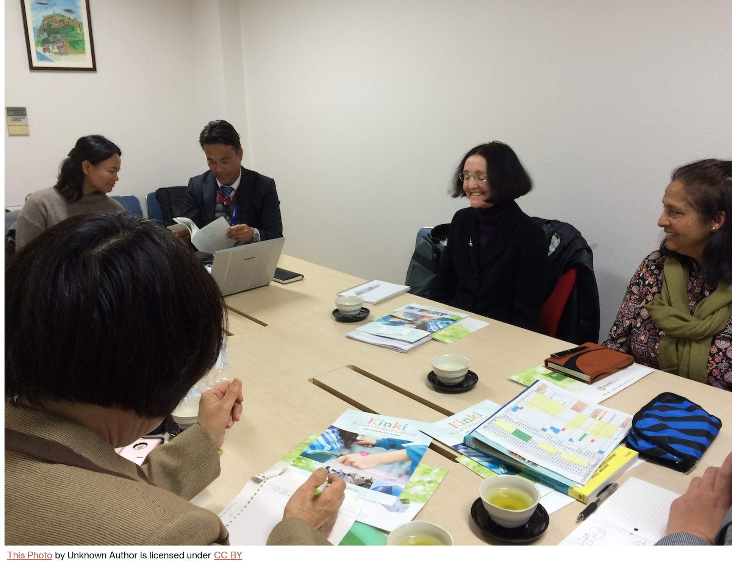
Neighbourhood health: the idea isn’t radical but implementing it would be: As the King’s Fund point out here:
Community Health, Social Care and Mental health teams are directed by heads of profession from headquarters
Can these teams also contribute as partners in supporting local health and wellbeing?
While values of integrated patient centred care are shared, the local teams must decide how this should affect their behaviour in practice.
Personalised care plans, supporting patient choice and healthy behaviour can improve health and patient experience, while reducing costs, but this will depend on how it is delivered.
Community support groups are seen as important partners for health and wellbeing but do they have the resources, will and skills this will require?
.
We need to rethink our partnership issues together, as examples:
How and when should community information or personalised care plans be passed for one team e.g. RRIC to another e.g. INT for Frailty
Who will decide priorities for use of resources
How can partnership issues be resolved locally
How will community organisations be engaged
How will the idea of a Neighbourhood Centre for Health and Wellbeing be communicated to the public
Notes:
--- ICSs bring together health and care organisations to plan and deliver joined-up services, breaking down traditional barriers to improve health outcomes at a local level. Image source: Microsoft 365 content library

Slide 13

Can we take this opportunity to establish our own Neighbourhood Health and Wellbeing Centre?
We suggest thinking about:
How all local Health & Care staff are recognised as neighbourhood partners
How all local services work together as partners and how the partnership is led
How community groups and the public are informed, engaged and supported
How teamwork and knowledge of roles of staff and community groups is shared
How Joy will be developed and used to include all our neighbourhood resources
How much we will lose if we don’t grasp this opportunity
Priorities and costs/benefits of next steps
.
We need to think through together
What works and what doesn’t?
What are the barriers & obstacles?
What should we try?
How will we know if it works?
Notes:
--- ICSs bring together health and care organisations to plan and deliver joined-up services, breaking down traditional barriers to improve health outcomes at a local level. Image source: Microsoft 365 content library

Slide 14
References
Buckinghamshire, Oxfordshire and Berkshire West Integrated Care Partnership: Integrated Care Strategy integrated-care-strategy.pdf
“Develop strong integrated neighbourhood teams so that people’s needs can be met in local communities.” “These include local councils, social care support, hospitals, emergency services, GP practices, dentists, mental health providers, care homes, and many voluntary, community and social enterprise organisations.”
Friends of the Chalfonts and GX Hospital
https://www.friendscandgxhosp.online/
have suggested steps to support community engagement and improve health and wellbeing
Labour Party Manifesto 2024: Our Plan to Change Britain Change – The Labour Party “we will trial Neighbourhood Health Centres, by bringing together existing services such as family doctors, district nurses, care workers, physiotherapists, palliative care, and mental health specialists under one roof”
NHS Neighbourhood health guidelines Neighbourhood health guidelines 2025/26 calls for “visible clinical and professional leadership and management, at both system and place level, supported through the effective clinical and care professional leadership framework. This includes working in partnership with communities”
Chancellor of the Exchequer Budget Statement November 2025 Included the announcement of plans to provide 250 Neighbourhood Health Centres

