Slide 1
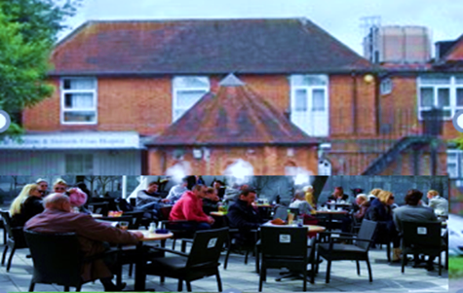
The NHS Vision of Neighbourhood Health and Care
Friends of Chalfonts and GX Hospital
Applied to South Buckinghamshire
Notes:
This section introduces the core objectives of neighbourhood health initiatives within the NHS, their alignment with the broader Long Term Plan, and the expected benefits for local communities.

Slide 2

Neighbourhood Health Policy
The Labour Party Manifesto and shortly to be published NHS 10 Year Plan include Neighbourhood Health as a key objective
This reflects long term aims to empower people to manage their own health to achieve sustainable health and care
The Buckinghamshire Oxfordshire and Berkshire West Integrated Care Strategy calls for Integrated Neighbourhood Teams working with Community Support Groups
The Friends have been suggesting steps towards this approach for 10 years
Wanless review 2002 noted the NHS would only be sustainable with full community engagement
Darzi review 2024 notes that 7% of patients with complex needs account for 46% of hospital costs
Notes:
--- These initiatives align with the NHS Long Term Plan by promoting integrated care, prevention, and patient empowerment to create a sustainable health system responsive to local needs. Image source: Microsoft 365 content library

Slide 3

Objectives
A place based approach to service delivery and leadership closer to people’s homes
Integrated Physical/ Mental Health and Social Care with Local Community Support
Greater focus on Prevention and Support for Wellbeing for those with complex needs
Personalised Coordinated Care that tailors support to individual needs and preferences
Providing equitable services and community support for those in greatest need
Better communications using eHealth so that neighbourhoods know their care services
Outcomes
Better experience for patients & staff
Less hospital or care home stay needed
Notes:
--- Neighbourhood health initiatives aim to deliver personalised, coordinated care close to home, improve population health, and reduce pressures on hospitals by focusing on community-based services. Image source: Microsoft 365 content library

Slide 4
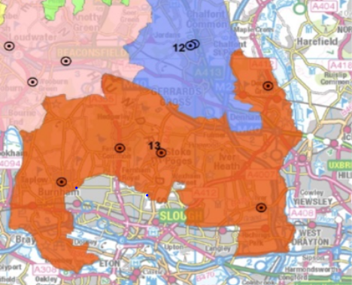
The South Buckinghamshire Neighbourhood
A neighbourhood of a small Town and Villages
Served by 2 Primary Care Networks and the Chalfonts and GX Community Hospital
Chalfonts PCN serves: Chalfont St Peter(13,000), Chalfont St Giles (6,700), Gerrards Cross (8,400), Hedgerly (800).
South Bucks PCN serves: Denham, (8,000), Iver (7,500), Fulmer (500). Jordans and Seer Green (3,000), Richings Park (6,000) Wexham (4,000), Farnham (7,000) and Stoke Poges (4,000)
The Community Hospital serves 80,000 people
Patient also use Wexham Park Secondary Hospital & Amersham Community Diagnostic Centre
Characteristics include:
A somewhat older age profile .
High incomes low relative deprivation
About 400 community support groups
Good access to green spaces
Poor access to mental health services
Notes:
--- Engaging local communities in decision-making builds trust, ensures services meet real needs, and encourages active participation in health and care. Image source: Microsoft 365 content library

Slide 5
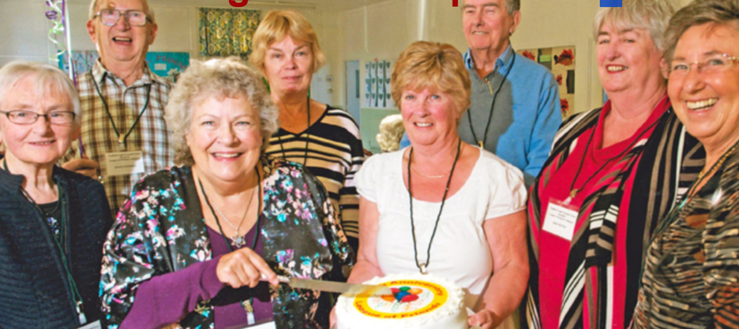
Friends Suggestions
For 10 years we have sought Partnership
Suggestions and offers of support have included:
A Community Wellbeing Hub and Drop in Café
Frailty Support
Social Prescribing
Local Provision of Health checks
Community support for mental health wellbeing
A Start Well Hub
Support for disability access to arts, sports etc Breathe Easy Support Group
A Joint Pain self-help support group
Support for those at risk of post-natal depression.
Self-care support for people with diabetes.
Integrated care for carers network
Support for hospice at home services
An eHealth and Wellbeing Centre.
Support for people discharged from hospital .
Facilities for staff such as a common room
Support to improve access to Amersham CDC
We are delighted to work in partnership
With BHT, BCC, PCNs & Community orgs for:
A Community Wellbeing Hub led by the Bucks Health & Social Care Academy
Integrated Neighbourhood Team for people with Frailty Led by our PCNs
Social Prescribing link workers
Notes:
--- Partnership working across sectors ensures that services are holistic, addressing social as well as health needs, and maximising resources for community benefit. Image source: Microsoft 365 content library

Slide 6
The Community Wellbeing Hub could provide space for:
Multi agency early intervention, prevention and support from co located health, social care and VCSE partners
Possible partners identified by Claire Tilson at the Friends AGM
Carers Bucks
Alzheimer’s Society
Adult Social Care
Integrated Neighbourhood Teams
Community Dieticians
Oxford Health Mental Health Services
Social Prescribed Activity Groups
BHT Health Coaching Team
Age Concern GX Plus
Free Blood Pressure Checks
Health & Wellbeing Events
Signposting & Support
Training & Education for students
.
The Community Hub works with health and social care providers and community support groups for wellbeing and health of all
Notes:
--- ICSs bring together health and care organisations to plan and deliver joined-up services, breaking down traditional barriers to improve health outcomes at a local level. Image source: Microsoft 365 content library

Slide 7
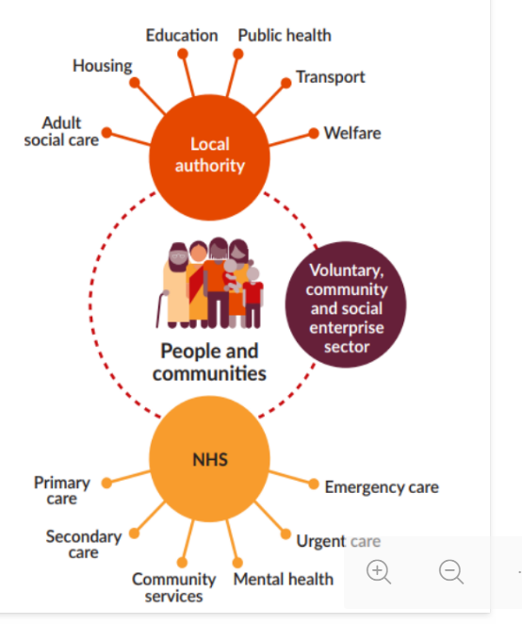
Integrated Neighbourhood Teams deliver integrated personal care closer to home for Fragile people (usually 85+ with complex needs)
Multi agency early intervention, prevention and support from health, social care and VCSE
Possible partners identified by Natalie Judson at the Friends AGM
Voluntary, Community and Social Enterprises
Local Authority Service
Adult Social Care
Housing
Education
Public Health
Transport
Welfare
NHS
Primary Care
Hospital Care
Community Services
Mental Health
Urgent Care
Emergency Care
.
Integrated Neighbourhood Team works in partnership with health and social care providers and community support groups for the wellbeing and health of frail patients
Notes:
--- ICSs bring together health and care organisations to plan and deliver joined-up services, breaking down traditional barriers to improve health outcomes at a local level. Image source: Microsoft 365 content library

Slide 8
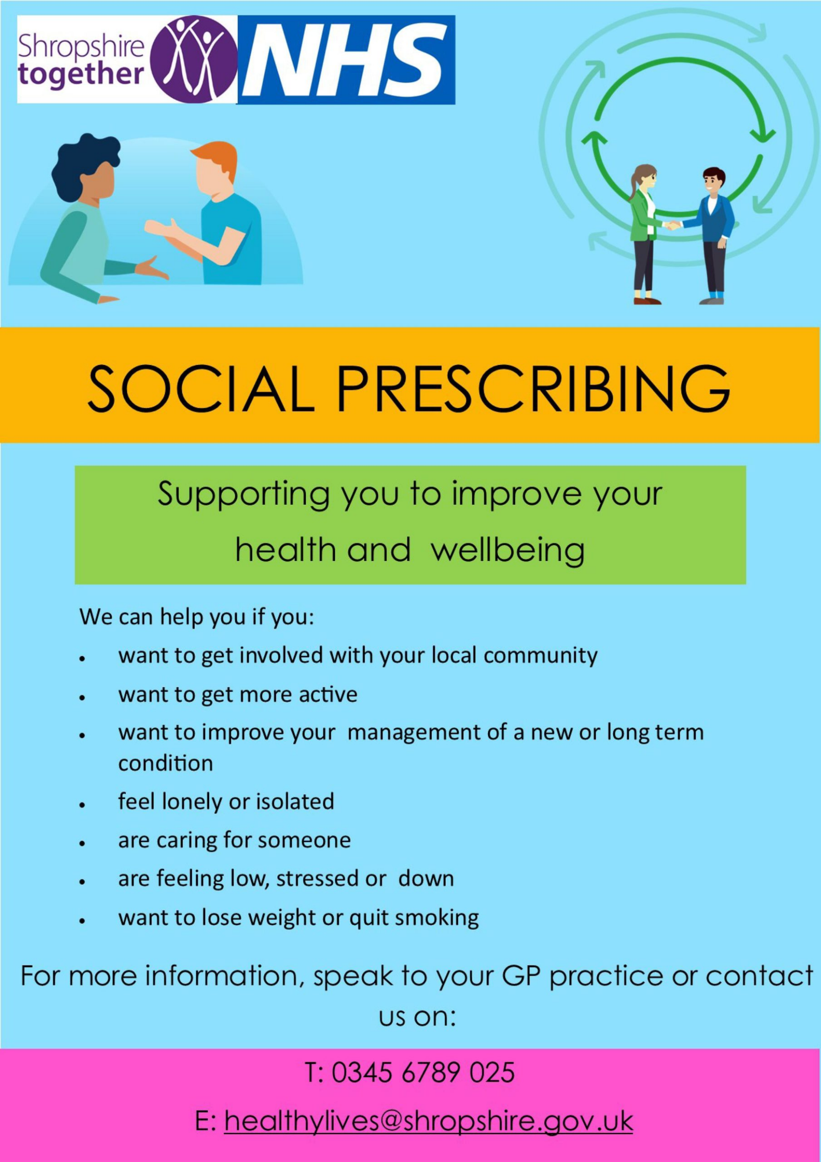

Social Prescribing guides people to community support groups to help them manage their mental physical and social wellbeing This may include:
Voluntary, Community & Social Enterprises offering:
Befriending and understanding
Activity like walking football or bowls
Shared experience perhaps of illness
Memory Cafe
Support for shopping or transport
Sometimes financial help
Access to health and Social Care Services
is a computer system/ app that helps health and social prescribers to link patients to local community groups and services.
.
Social prescribing is a partnership between the primary care team community support groups and other care providers
Notes:
--- ICSs bring together health and care organisations to plan and deliver joined-up services, breaking down traditional barriers to improve health outcomes at a local level. Image source: Microsoft 365 content library

Slide 9

Community Wellbeing Hub Integrated Neighbourhood Teams and Social Prescribing all require a partnership culture They all engage with:
Voluntary, Community & Social Enterprises (VSCE) and groups
Physical & Mental Health Services
Social Care Services
And others
could be useful to all three
.
This needs Teamwork and:
Empathy and listening skills
A shared understanding of patient/ client needs
Knowledge of available resources
Trust in one another
Clarity as to client facing roles and team leadership
Notes:
--- ICSs bring together health and care organisations to plan and deliver joined-up services, breaking down traditional barriers to improve health outcomes at a local level. Image source: Microsoft 365 content library

Slide 10

Next Steps toward Neighbourhood Health and Care by the South Bucks Partnership for Health & Wellbeing
We suggest thinking about:
How the three elements work together as partners and how the partnership is led
How teamwork and knowledge of roles of staff and community groups is developed
How community groups are informed, engaged and supported
How listening skills are developed and applied by lead patient/client contacts
How all local Health & Care staff are engaged with neighbourhood services
How Joy will be developed and used to include all our neighbourhood resources
How we communicate health and wellbeing messages with local communities
Priorities and costs/benefits of our next steps
.
We need to think through together
What works and what doesn’t?
What are the barriers & obstacles?
What should we try?
How will we know if it works?
Notes:
--- ICSs bring together health and care organisations to plan and deliver joined-up services, breaking down traditional barriers to improve health outcomes at a local level. Image source: Microsoft 365 content library

