Slide 1

An Introduction to Community Health and Wellbeing, Hubs Integrated Neighbourhood Teams and Social Prescribing
The Friends of The Chalfonts and Gerrards Cross Community Hospital
This presentation provides a background to help us consider together with our Primary Care Networks, Buckinghamshire NHS Healthcare Trust, Buckinghamshire County Council and our Community Organisations how we might develop as a Community Hub for Health and Wellbeing

Slide 2
Introduction
This presentation asks:
  What does health and wellbeing mean for the communities we serve.
  How can a community hub for wellbeing support community health
  How can Integrated Neighbourhood Teams (INTs) and Social Prescribing be supported.
It is hoped that this will provide a common starting point for some exchange of ideas and experience in developing a local approach to a Community Hub for Health and Wellbeing, INTs and Social Prescribing.
This presentation provides links to many resources for training in specific areas, these include the recently formed Academy for Social Prescribing here
Community Wellbeing Hubs, Integrated Neighbourhood Teams and Social Prescribing all attempt to address whole person needs in an integrated way. And it is also important these functions are themselves well coordinated.

Slide 3
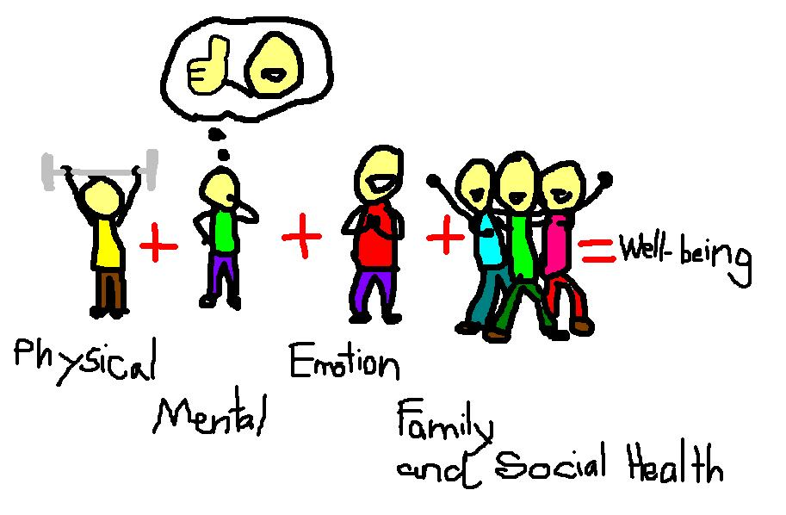
What is Health and
Wellbeing?
Health is defined in the World Health Organisation constitution as:
  A state of complete physical, social and mental well-being, and not merely the absence of disease or infirmity.
There is no internationally agreed definition of wellbeing but:
  Physical, mental, emotional and community wellbeing gives every individual the capability to manage health conditions and risks, cope with normal stresses of life, find purpose and happiness, work productively and fruitfully, make a contribution to and draw support from family, community and their home and natural environment.
Take a moment to think how you would define health and wellbeing for yourself and the people you serve?

Slide 4
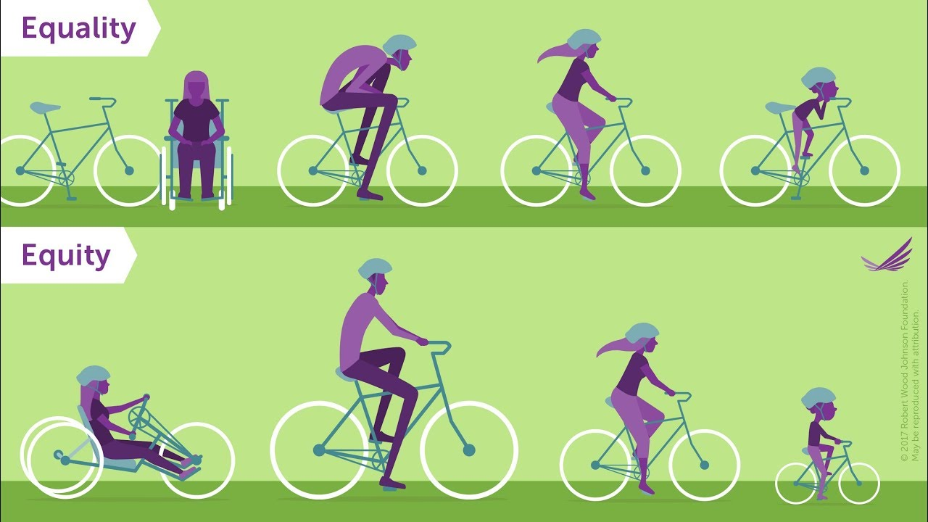
Capability Theory
Developed by Amartya Sen, Martha Nussbaum and others from 1979
Underlies UK Wellbeing Measures and WHO wellbeing policy
Stresses freedom to pursue wellbeing as seen by individuals and groups
E.g. provide resources – bikes
Giving freedom - capability to travel
To enable agency – taking part in community
Support functioning – social community activity
Enhancing utility – wellbeing
And equity of outcomes
Matched to individual needs and preferences
Capability theory also applies to communities, it shows the need for local Co-production not top down one size fits all solutions : for the NHS guide to engaging individuals and communities in planning care services see here

Slide 5

Personalised Care Planning
Capability theory underlines the need to engage patients in addressing their individual needs and preferences by:
  Personalised Care Planning see here
This means giving them the same choice and control over their mental and physical health and wellbeing that they have come to expect in every other aspect of their life.
This is a renewed relationship between health and care professionals those they care for and their community
It also requires integrated health and social care provision.

Slide 6


Integrated Health and Social Care for Wellbeing
Integrated care creates social value, health and wellbeing see here
  A whole person-centred care service from one team.
This goes further than LA/NHS cooperation
  It requires community engagement in co-production of: advice, social support self-care, activity and neighbourhood schemes
  Thoughtful redesign of: housing, advice and support services, community spaces, transport, access to high street and shops and much more.
  And recognition of arts and cultural elements of health and wellbeing
It can also save time and money, better spent for the patient/client
  See Local Government Association resources here And NHS resources here

Slide 7

What Enables Health and Wellbeing?
Things that support health and wellbeing may include:
  Family and social support, health and social services, community engagement, education, housing, environment, employment, physical and financial security, music, sport, art and culture.
These are personal and social judgements about what we value
  It is important to think through goals with individuals and communities to assess the wider health, wellbeing, social and cultural factors that are valued, see examples of reports by Croydon LA here and Liverpool CCG here
Community is a mainstay of wellbeing: most often defined in terms of location.
  But people are also members of communities of: faith, ethnicity, interest, political affiliation, hobbies and many other factors. A balanced approach to community development must recognise, different affiliations within a multi cultural community.
Discussion what will improve health and wellbeing in our community?

Slide 8
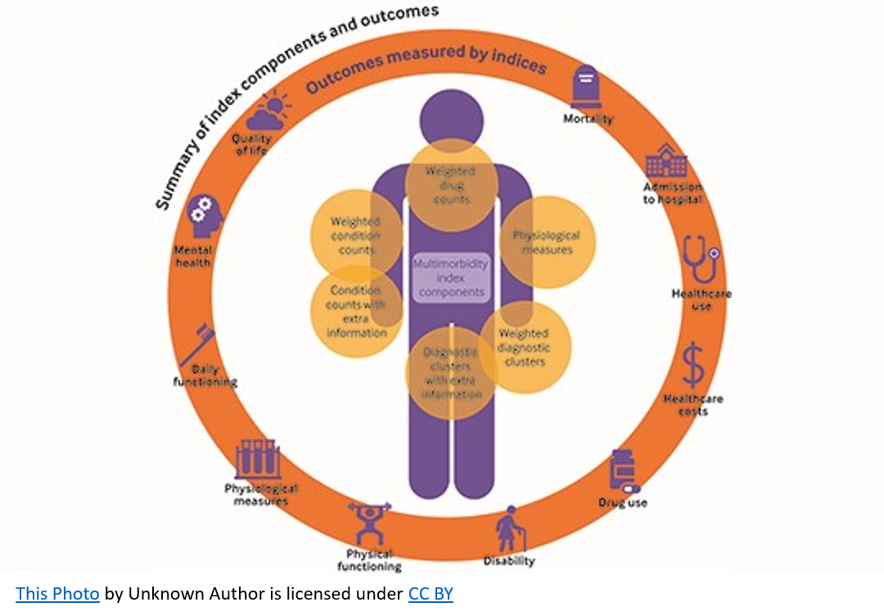
Measuring Personal Health and Wellbeing
Measuring your personal health may start with an NHS health check available from your GP for those between 69 and 74 every 5 years, it is an important way of assessing risk of heart and kidney disease, diabetes ot stroke, and for those over 65 signs of dementia.
While important for managing health risks and reducing long term NHS costs, use of NHS Health Checks has declined in recent years from 40% to 30%, other countries such as Denmark have been more successful in providing health checks, including assessment of physical and mental wellbeing (using the WBWEMS tools see later)
Providing opportunities for people in our community to check their health risks and discuss mental wellbeing and social care needs, such as social isolation could be a very important tool for improving community health and wellbeing
Discussion how such services could be provided for our local community?

Slide 9

Measuring the Level and Quality of Health Outcomes
The impact of illness or accident and improvement achieved by treatment is assessed in terms of years of life lost or saved and the quality of life enjoyed.
This is measured in Quality Adjusted Life Years (QALYs) calculated by estimating years of life remaining for a patient following a particular treatment or intervention, weighting each year with a quality-of-life score (on 0 to 1 scale).
The Treasury Department Green Book suggests that each QALY improvement in health outcomes achieved should be valued at £70,000 in 2025
This provides a baseline for assessing the cost effectiveness of health treatments reflecting both the impact on mortality and quality of life

Slide 10
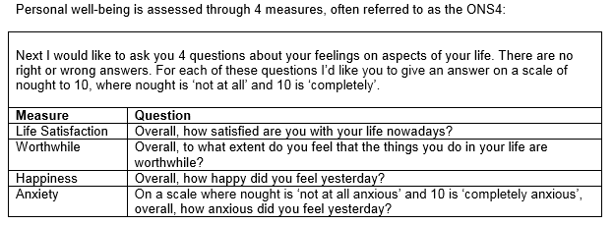
Measuring Wellbeing At National and Local Levels
The Office of National Statistics measure their interpretation of wellbeing using 4 questions from the Annual Population Survey (APS) - sample size 320,000.
You can find the 2019 -2021 National result and by Local Authority Area here
  This shows a sharp decline in wellbeing due to Covid
Review the scores for your area of the country using this resource.

Slide 11
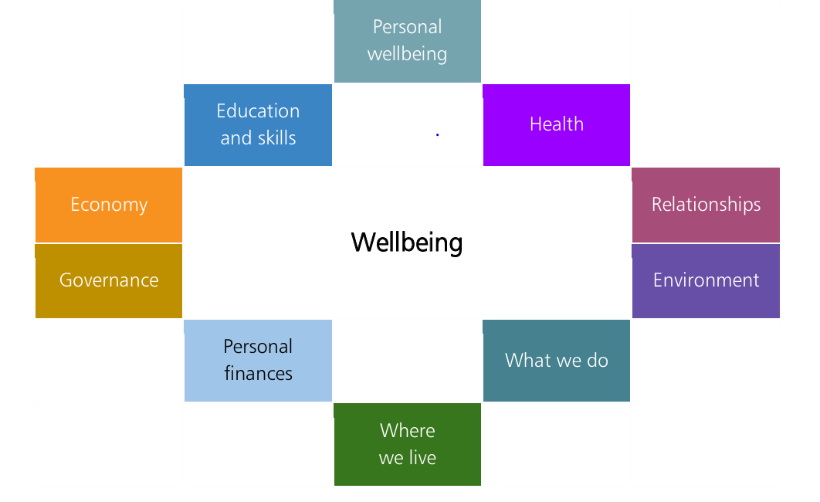
Measures of Wellbeing
The UK Treasury Guidance of 2022 here
Suggests 10 determinants of wellbeing
Can be measured as WELLBYs
  A Wellby is a wellbeing adjusted year
  it equates to a one-point
  change in life satisfaction
  on a 0-10 scale, per person per year.
The Treasury Guidance suggest
  A Wellby has been valued at £13,000
  In Social Cost/Benefit terms at 2019 values
There are many different measures of Life Satisfaction
See “What Works for Wellbeing” here

Slide 12
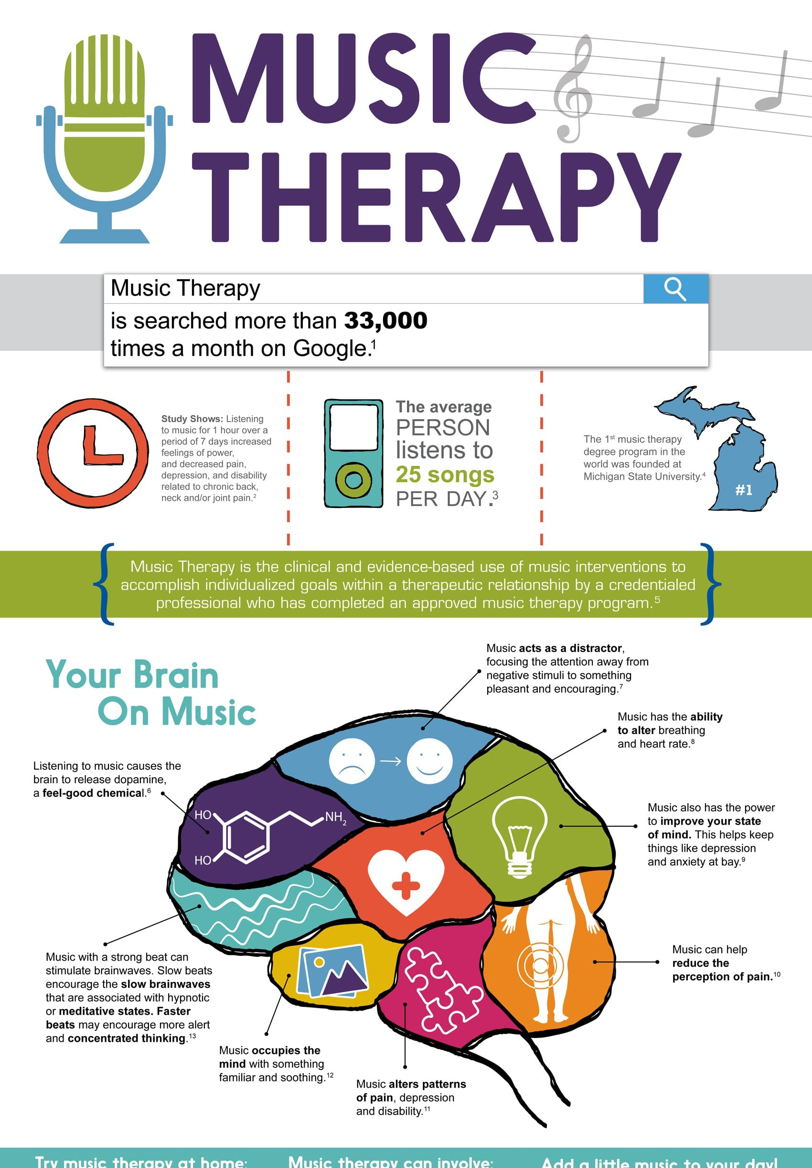

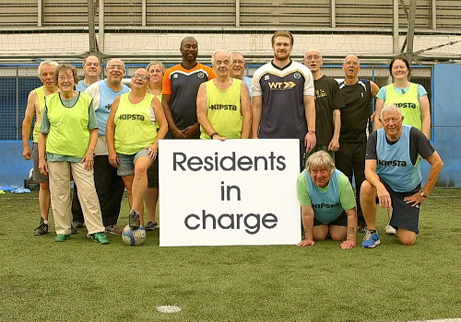
Arts, Sports the Environment and Wellbeing
The arts, sports, social and physical environment which bring people together as communities, are crucial to wellbeing.
Engagement in these fields is important to the health of people who don’t just need to return home but need to return to active life .
Initiatives in these fields support health and wellbeing as an element of community social values, e.g.:
  National Alliance for Arts, Health and Wellbeing here
  Sport England Research on Psychological Health and Wellbeing here
  NHS England Healthy New Towns Initiative here
  Recent research on the health impact of the arts and culture by Daisy Fancourt at UCL shows a wide range of benefits here

Slide 13
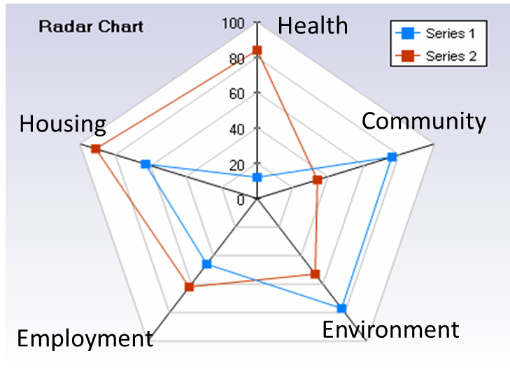
Approaches to Community Health and Wellbeing
A “Radar Chart” provides a way of comparing strategies for addressing a range of factors affecting health and wellbeing for a community
This does not imply a trade off between different aspects of wellbeing but provides a visual metaphor
What would our Radar Chart look like?
A guide to measuring wellbeing agreed by the What Works Centre for Wellbeing can be found here
What would you suggest are the key determinants of health and wellbeing for our community?

Slide 14

What is Social Capital:
Does it support Health and Wellbeing?
Social capital is the framework of values and norms that fosters trust and cooperation in personal relationships, social networks, and with civil organisations and leaders see here – it is part of what defines who we are.
Social capital is essential to health, wellbeing and equity
  Most care (70%) is provided by family and community resources
  Most behaviour is determined by community norms (what people like us do)
  Advice may change health behaviour but social support is what sustains it
  Equity (respecting individuals needs) requires community trust and engagement
  Low social capital results in greater loneliness, poor health and wellbeing
For an example of a project to develop social capital (integration) for new migrant women see here for Age UK guidelines on loneliness see here.
For the NHS Confederation initiative on social capital (value) see here

Slide 15
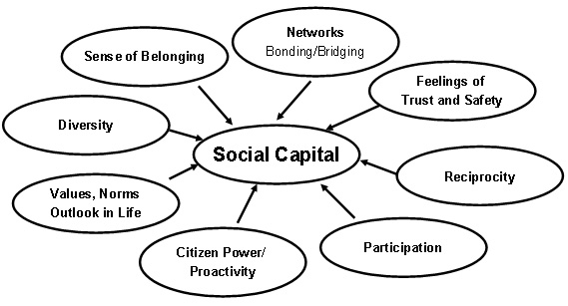
Measures of Social Capital
Social capital was measured by ONS in 2019
Based on 5 questions in APS asking degree to which people:
  feel that people in their neighbourhood can be trusted
  feel that people around where they live are willing to help their neighbours
  feel that people in their neighbourhood do not get along with each other
  feel like they belong to their neighbourhood
  feel safe walking alone in their local area after dark
The findings summarised here include
  Most people felt positively about their neighbourhood. trusted others and felt a sense of belonging to their neighbourhood, people felt others were willing to help their neighbours and felt safe walking alone in their local area after dark. However social capital seems to be declining as trust in others decreases and trust in social media increases.
  Those with higher levels of social capital tended to live in rural areas, have better environmental conditions, were retired, identified their ethnicity as “White” or “Asian” and were from higher income socio-economic groups.
  Review trends shown by these measures and relate to your personal experience.

Slide 16
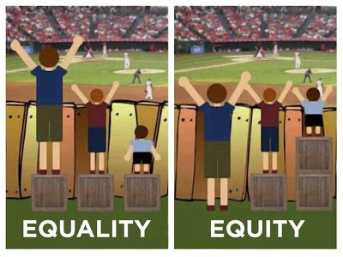
Why is Improving Equity in Health and Wellbeing Important?
Reducing inequity in health and wellbeing is a target for LAs and NHS. But progress has been slow, health and lifestyle support groups and services are taken up most actively by higher income groups, and lower income groups are more likely to smoke, eat junk food and take drugs, alcohol consumption increases with income but people with low incomes are more likely to die of alcohol related causes.
With the result that people living in the poorest neighbourhoods will on average die 7 years earlier than people living in the richest neighbourhoods.
See the 2010 White Paper Equity and Excellence: Liberating the NHS here

Slide 17
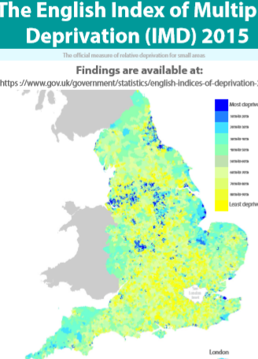
Measuring Impact on Equity
Equity impact can be measured as % of patient/clients from most disadvantaged local areas (LSOAs)* as shown by the Index of Multiple Deprivation (IMD) see here
IMD measures a combination of:
  Income Deprivation
  Employment Deprivation
  Education, Skills and Training Deprivation
  Health Deprivation and Disability
  Crime
  Barriers to Housing and Services
  Living Environment Deprivation
The IMD is useful for urban areas but is less useful in rural areas, an index of rural deprivation is also available see here. But objections have been raised because such measures seem to assume that communities are deficient in some ways. It is stressed that each community has its own values which should be recognised by coproduction of wellbeing see the report “Hard to Reach or Easy to Ignore” here.
The needs and aspirations of other disadvantaged groups such as: isolated individuals, some ethnic minorities, travellers, people with disabilities and LGBTQ people may be more relevant to addressing equity in our communities than measures based on locality.
*Lower Super Output Areas (small areas with populations of 1,000 – 1,500 people)

Slide 18

Developing a Community Health and Wellbeing Hub
The NHS Long Term Plan see here was developed through a process of consultation and learning from local “Vanguard Projects”.
These included the Buckinghamshire, Oxfordshire and West Berkshire (BOB) strategy for Integrated Care, which envisages Community Hubs for Health and Wellbeing providing personal care closer to home for 125-150,000 people and local integrated health and social care teams serving 30-50,000 people here.
The Marlow and Thame Hubs show how “hospital at home” and “day hospital” provision can be delivered including: Community Assessment and Treatment Services, Rapid Response Intermediate Care and Community, Mental Health and Social Care Coordination see the evaluation report here.
In areas serving 50-80,00 people integrated teams offer health and social care support with Primary Care Networks providing INTs and Social Prescribing see here.
Early consultation on these plans encouraged the Friends of Chalfonts and Gerrards Cross Community Hospital to consider how community action could support a Community Hub, INTs and Social Prescribing for our communities
  Our hospital is at the centre of the border of South Bucks and Chiltern (pop 160,000)
  Local Primary Care Networks (Chalfonts serves 31,000, South Bucks serves 50,000 patients)

Slide 19
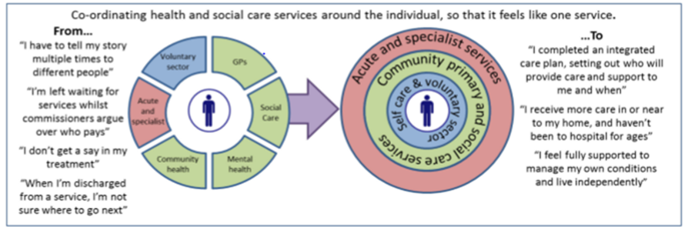
A Community Hub for Health and Wellbeing
Providing “Hospital at Home” and “Day Hospital” services closer to people’s home
  Serving populations of 125-150,000 people (e.g. South Bucks and Chiltern Districts)
Community Wellbeing Hub for physical and mental health and community support
Integrated Neighbourhood Teams: and Social Prescribing
  Serving communities of 30-50,000 people (e. g. catchment of our local PCNs)
See “1.1 A neighbourhood heslth service” in the NHS Ten Year Plan for England here

Slide 20

Potential for Community Action
The Joint Strategic Needs Assessment (JSNA) is produced by Local Authorities and Clinical Commissioning Groups working through a joint Health and Wellbeing Board to assess current and future health, care and wellbeing needs of the local community. It is also a starting point for considering the need for community action for health and wellbeing.
For Buckinghamshire the JSNA analysis for each area can be found here
A “Life Course” approach - thinking through needs and resources at each stage of life is helped by the NHS Choices web site here showing the location of current support groups and services.
For the catchment area of our community hospital and Primary Care Networks serving Gerrards Cross and the Chalfonts and South Bucks an analysis showed key gaps in current community support groups here
To illustrate the cost effectiveness of community action a further review of evidence showed the likely beneficial impacts on demand and costs here

Slide 21

Buckinghamshire Community Wellbeing Hubs
Buckinghamshire Health and Social Care Academy has supported the development of Community Wellbeing Hubs across the county. It was partnered by NHS England, Buckinghamshire Healthcare Trust, Berkshire University, Buckinghamshire New University, Buckinghamshire County Council, Fed Bucks and Buckinghamshire College Group.
In 2024 Buckinghamshire Community Wellbeing Hub (BCWH) became an independent charity It provides places for physical and mental health and social care professionals, Voluntary, Community and Social Enterprise (VCSE) providers to collaborate and co-locate services to improve health and wellbeing and share lessons learnt .
BCWH has co-designed and delivered Community Wellbeing hubs in Aylesbury and High Wycombe to benefit the learner and local citizens.
It has recently been acclaimed as the ‘Health Creating Community Space of the Year’ by The Health Creation Alliance.
BCWH jas now opened a Community Wellbeing Hub at our hospital in partnership with BHT, BCC, local primary healthcare providers and the Friends

Slide 22

The Community Hub as a focal point for Coordination and Communication
.
NHS primary care has undergone major changes in recent years
We must now use the NHS App, expect a range of health professionals to call us for phone consultations, and use local pharmacies for minor illness.
We could also look after our own health and wellbeing better with the help of the many community groups and voluntary organisations available
If only we had better knowledge of local services and community support
And they knew and understood our needs and were better coordinated
We hope our Community Wellbeing Hub can help address these issues
As a meeting point for health and care staff and community providers

Slide 23
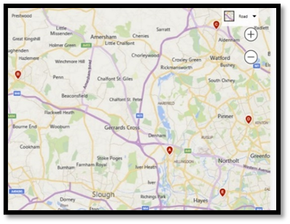
We are varied communities of villages, small towns and many diverse interest
.
The role of a Community Hub is not confined to one space
It must serve communities defined by common interests as well as location.
It must partner with groups based in different locations or in their homes
The Hub can bring teamwork and cooperation to serve all
And will work with existing community facilities and local groups
Of which there are a great many across the Chalfonts and South Bucks see here

Slide 24

A Digital Health and Wellbeing Hub
National and County plans for integrated care also stress the growing need to enable people to use digital services
  To monitor and manage health and care including personal alarms, fall sensors, devices for people prone to wandering and health monitors that can communicate with GP and other health services, see the Bucks CC website here
  To use mobile phone “apps” like the NHS Health Apps Library here and the Joy app see here
  To find websites and resources relevant to particular conditions, see for example the MIND A-Z of resources for Mental Health here and our list of resources on this page
  In future “hospital at home” services will use monitoring and communication devices to support patients, it is vital to help people use such IT see here
Our Community Wellbeing Hub could help provide a human face to technology by guiding people in the use of digital services or helping them find support.
In our community it would be helpful to provide an eHealth centre, with computers and equipment for patients and perhaps staff (see RCN page here)

Slide 25
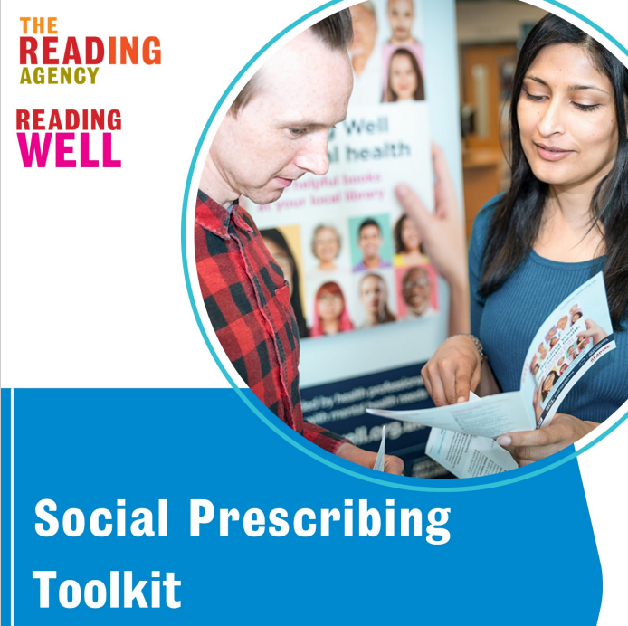
The Community Hub as a focus for Working with Community Groups, Libraries and local businesses
.
There are some 500 local organisations and groups many of which have already shown interest in befriending.
During the Covid Pandemic volunteers at libraries in Gerrards Cross, Chalfont St Peter, Chalfont St Giles and Farnham have helped provide tests and information. They could also be encouraged to use the toolkit available here at to join a local network for community health and wellbeing. They could also provide access to ehealth resources.
The Hub could also engage local businesses for example providing better information on the services provided by pharmacies and promoting healthy eating aisles in supermarkets and lower sugar options in coffee shops.

Slide 26


Introducing INTs and Social Prescribing
Social Prescribing and INTs may be called upon to perform many different roles
  Dealing with multi-morbidity, mental confusion, older patients and sometimes youth health, working with communities and social care services
Experience suggests it is essential to agree priorities
Possible steps in Chalfonts and Gerrards Cross based on University of Westminster guide “Making Sense of Social Prescribing” here
  Establish leadership – steering group and operational lead
  Engage local organisations - to share an understanding of SP
  Agree objectives and priorities - roles, processes and location
  Set up evaluation - describe, measure and value costs and outcomes
  Recruit and train the team – and first link worker (s) – learn from others
  Year 1 tasks – community contacts/self referral /signposts/priority cases
  Develop community befriending – review and improve your SP system

Slide 27
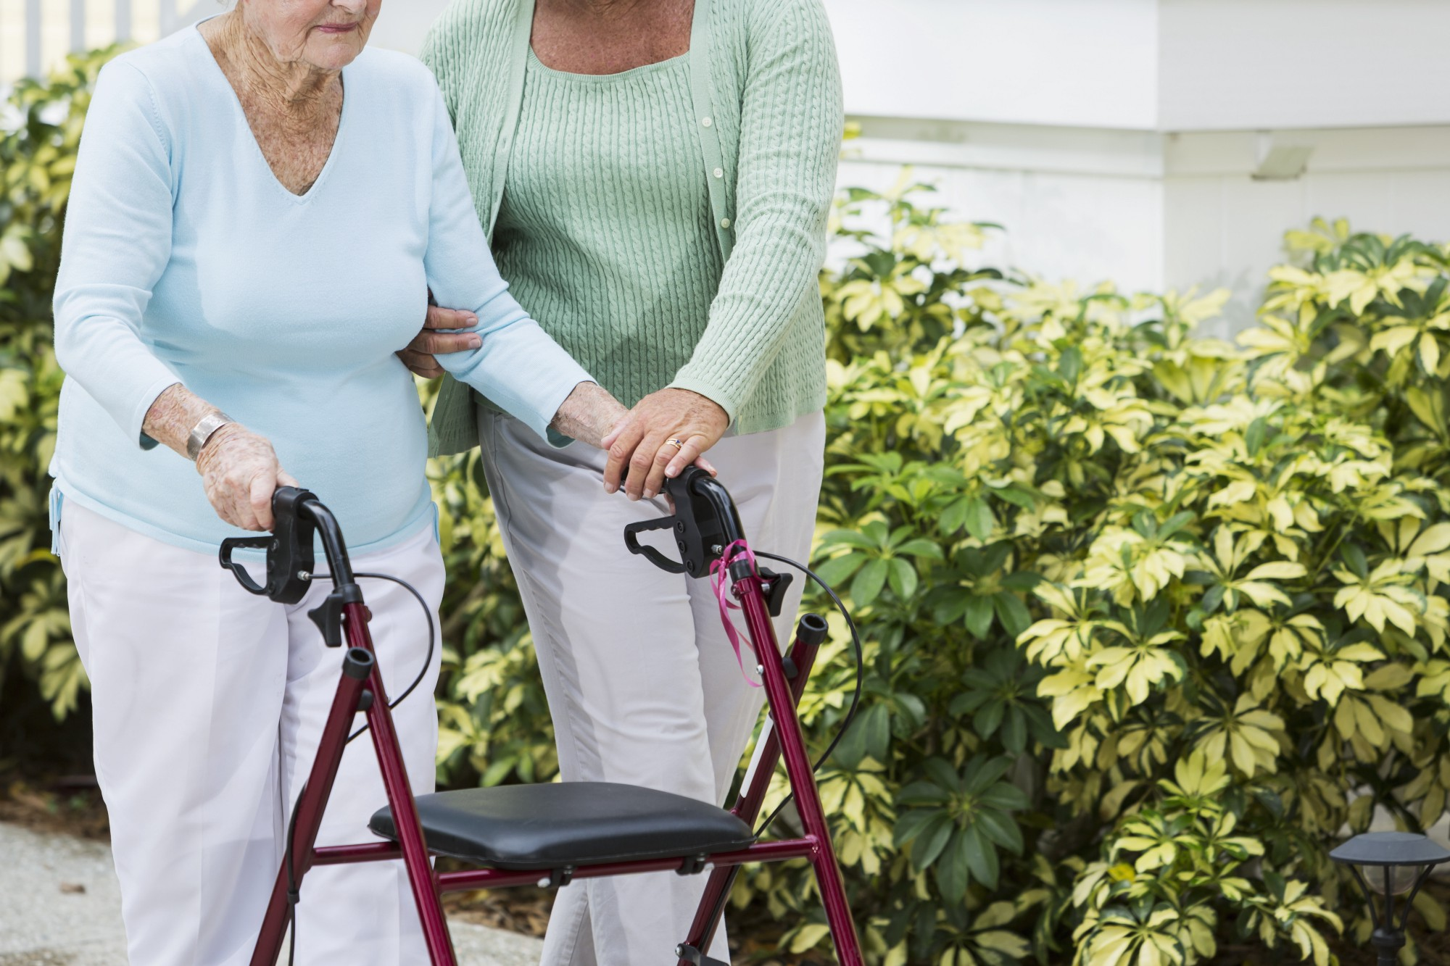
Integrated Neighbourhood Team Support for People who are Frail
Frailty refers to a person’s mental and physical resilience, or their ability to bounce back and recover from events like illness and injury for example from chronic diseases or falls see here. It may be due to complex physical or mental health issues.
Frailty can arise from many conditions e.g.: age related muscle loss, diabetes, heart failure and arthritis, depression, social isolation see here
Around 7-10% of people aged over 65 live with frailty. This rises to between 25% and a 50% for those aged over 85 see here.
Frail patients use GP and hospital services at 5 times the average rate and account for more than 1/3rd of GP appointments. But Frailty can also lead to social isolation avoiding contact with services or community groups.
A Frailty Support INT Team as proposed by the Chalfonts and South Bucks PCNs can be of great value in addressing their health and care needs to ensure they receive integrated care and community support reflecting their whole person needs.

Slide 28
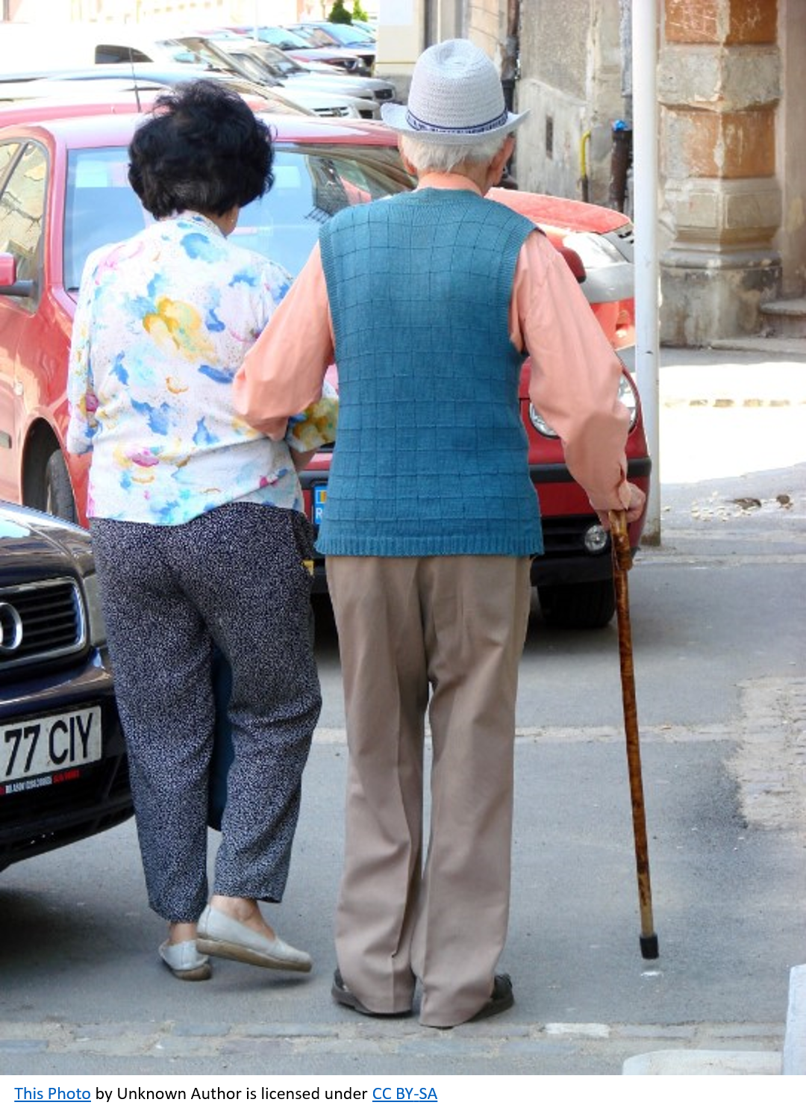
Identifying and establishing a Lead Contacts for Frailty
Frailty often results from a combination of factors and require a team approach to address a range of health and social issues and needs. Priority may be given to those with multiple hospital admissions but equally isolated individuals avoiding services may also be identified.
An essential starting point is always a constructive conversation with the patient and family or carers to listen to their needs as they see them.
A lead contact is required who can can develop a relationship with the client/ patient and who also has a good understanding of the roles and resources of other INt members. In complex cases this may be a care coordinator, in most cases, it will be member of the team with listening skills
A Lead Contact is not necessarily the most senior member of the team, it is the person with the closest relationship with the patient/client. A GP or a Geriatrician may need to approve use of resources to meet patient needs.

Slide 29

Social Prescribing for Health and Social Care
The success of the NHS means that more patients/clients are older, many with complex mix of physical and mental health and social care needs.
This and the financial and staffing difficulties of health and care services puts an increasing strain on LA/NHS staff and the people they care for.
Social Prescribing is part of a transformation towards whole person care
  Developing partnership with community groups to co-produce health see here
  Communication to raise awareness of health issues and resources e.g. see here
  Helping patient discharged from hospital and/or with complex needs see here
  Supporting patient choice, e.g. for Personal Care Budgets see here
  In the longer term operating within an Accountable Care Budget see here

Slide 30
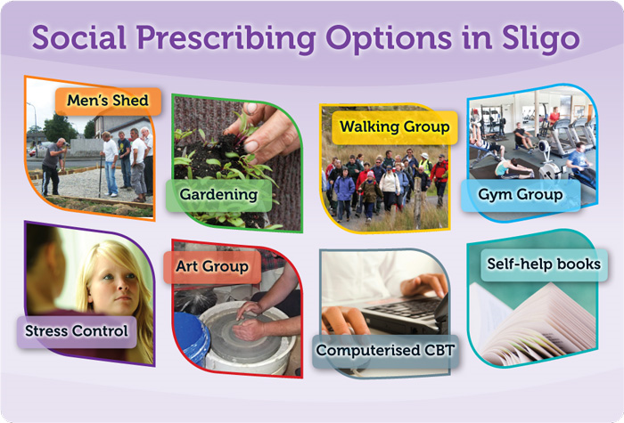
Towards Social Prescribing
Social Prescribing helps people find the community support needed to manage their mental, physical and social health.
It can take many forms including:
  Self referral - online or with leaflets maybe prompted by Making Every Contact Count
  Maybe just recommending books from the Library see the Reading Well scheme here
  Simple signposting by a member of the team or community support group see here
  Referral to a Link Worker from a GP, Discharge Interview, AHP or Nurse Appointment
  Link Worker holds an open conversation to understand their needs and preferences
  The client (not patient) may be introduced to a group by a community befriender
  In some cases the client may need support by a Link Worker or a social case worker
  In other cases (e.g. bereavement) they may need help to find their motive (joy in life)
  Sometimes support from health trainers may be appropriate
See “Driving forward social prescribing: A framework for Allied Health Professionals” here

Slide 31

Hints for Social Prescribing
From the University of Westminster International Conference on Social Prescribing:
  The team need a shared understanding of the people to be helped and SP process f
  Evaluation is essential, following signposts, service use and outcomes see here
  A written Social Prescription form helps reassure and engage the client
  In year 1 referral to Link Workers was from GPs only but this might be extended
  It is important to involve and consult local organisations and support groups
  The list of support groups and their capacity will change and must be managed
  Such groups need support and resources from Local Authorities and others
  A non-clinical setting (e.g. a community café) is better site for Social Prescribing
  Social Prescribing can also develop community support capacity see here
  Training is required for the team as well as the individual Link Workers see here
  Open questioning, listening skills and empathy are essential see here
  It helps to share experience particularly in helping people with mental and physical problems sometimes compounded by low motivation see here

Slide 32

Teamwork for INTs and Social Prescribing
INTs and Social Prescribing require a culture change focussed on self-care and healthy behaviour.
It requires team work with NHS, LAs and volunteers:
  GPs who may refer people to INTs, Link Workers or Community support groups
  Lead contacts or link workers who may meet the client 3-6 times
  Signposting from Making Every Contact Count to Social Prescribing
  A Care Coordinator may help people link with Befrienders in Community Groups
  Signposting by Hospital Discharge Teams, Nurses and Allied Health Professionals
  The Social Care Reablement Team, see here may also play an important role
  And in some cases Health Trainer Service support may be appropriate
The team includes physical and mental health and social care professionals, community groups and organisations at village, county and national levels. It is vital to coordinate their roles as a team.

Slide 33

Active Signposting for INTs and Social Prescribing
Active signposting is much more than simply providing:
  A reading list, leaflet, web site, address, email or other details
Depending on the client’s needs it will involve,
  Helping the client choose the support they need
  Contacting the provider and setting up a meeting or appointment
  Arranging for a support service or “befriender” to accompany the client
  Following up to check on the clients response to the service or support group
This approach needs to be understood and shared by the PCN team
  Including GPs, Community Nurses, Receptionists and other staff
  The Integrated Health and Social Care Team and Hospital Discharge teams
  The Community Groups working with the PCN
Training for primary care groups can be found here and funding for this type of training from NHS England is referenced here

Slide 34

Sharing Knowledge and Understanding in INTs and Social Prescribing
JOY is an online Social Prescribing system to connect health and care providers with local service and Community Support Groups see here
It can also be used by local INTs to refer patient/clients to other professionals and refer or signpost them to Community Support Groups
It requires information about each local service provider and relevant community groups and can share information about patient client needs
It is essential service providers should not only share the roles of team members, they also need to know and understand one another
It provides a marketplace for support groups and services and an important component of our community health and wellbeing
Use of JOY by our INTs and Social Prescribers also needs Team Work

Slide 35

Listening Skills for INTs and Social Prescribing
The art of INT working and Social Prescribing requires skills in questioning and active listening, a constructive conversation with clear purpose to help clients find their answers:
  It should build rapport, trust and understanding in a confidential exchange
  And must establish the appropriate level, timing and rhythm of the exchange
  Open questions allow the client to explore their issues at their own pace
  The Link Worker can then help the client find their life plan with practical options
While some clients will require limited signposting and support
Others will require more time to reflect and gain confidence
Social Prescribing is neither Social Work nor Psychotherapy
  But lessons can be learnt from these professions see videos here and here
  Better still talk to Social Prescribers to share experience see the video here
  And run your own Samaritan’s course on listening skills here

Slide 36
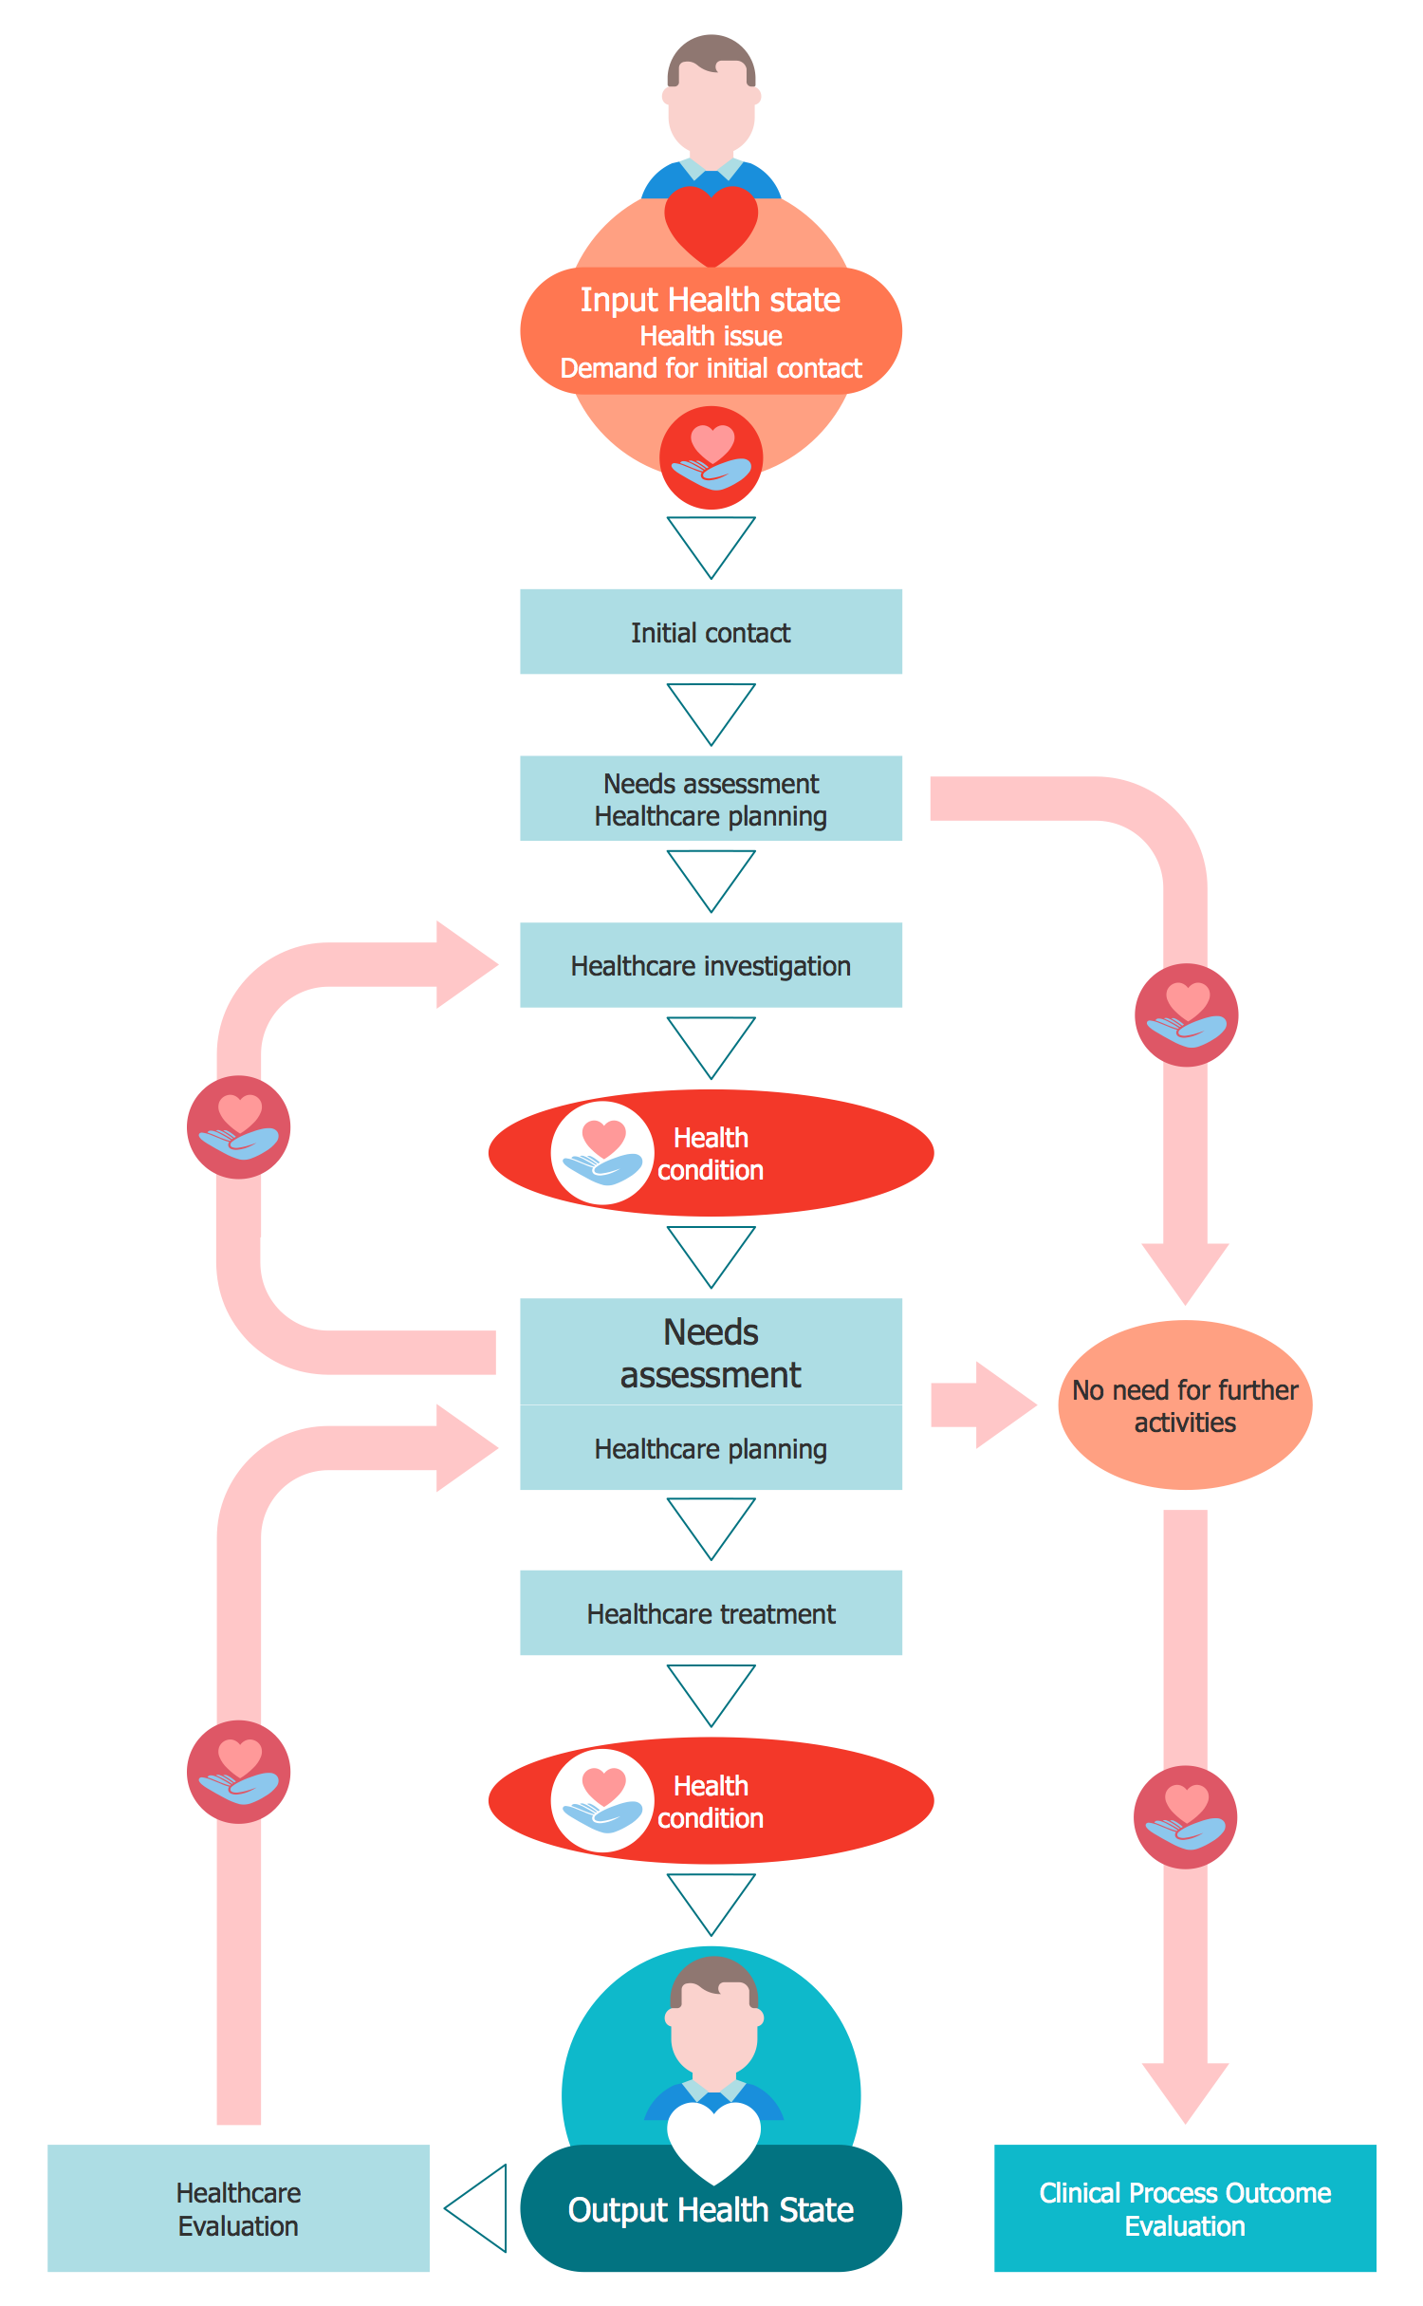
Continuity of Care INTs and Social Prescribing
Continuity of Care is a basic strength of UK Primary Care, requiring
  A continuing relationship with a GP service which manages patient health and care
  Maintenance of long term, unified patient records accessible to patients
  Relationships amongst providers of health and care services to ensure
  Smooth transition and good communication between providers and with patients
Continuity of Care (CC) faces challenges due to
  Complex needs and services for ageing population and more patient choice
  Failure to bridge gaps between health - social care services - VCSE
  Changes in GP contracts, greater movement of GPs and more part time work
The Lead Contact/ Care coordinator or Link Worker may play a role in:
  Maintaining relationships with relevant health and care providers and VCSE
  Helping patients make decisions on health and care and lifestyle choices
  Enhancing patient records to reflect health and social care needs and choices
These role must be agreed within the PCN see here

Slide 37


Common Issues: 1 Weight/Diet/Activity
Being obese is the most obvious and common health issue
  It affects nearly 1/3rd of adults and causes over £6 bn NHS cost and £27bn social costs
  Open questioning shows people are often embarrassed by their weight
  Being obese can make it harder to take up diet and exercise regimes
  Which are often promoted by images of slim young people
Signposting should show that diet and activity groups are for people like us
Obesity is a complex personal issue and certainly not a a simple process of just signing up to a diet or fitness class
A Link Worker may need to help clients find their own path to healthier weight
And the self-assurance needed to set out on their path.
  The NHS Weight Loss Plan can be found here local groups that help people find activities that suit them and local commercial weight loss groups are listed in the local directory

Slide 38

2 Addiction – Alcohol/Drugs/Tobacco
Addiction can take many forms and has many causes
  It is said that addiction enters when self-love is lost.
  Loss of identity (a sense of self) can give way to an addiction identity
  It can result in people turning to many things including – opioids, food, gambling…
The essential first step is for the client to recognise their problem
  More direct prompting may be needed (after entering dialogue by open questioning)
  Local NHS Alcohol Support resources here
  Local Drug Addiction Services from the FRANK web site here
  Local NHS Smokefree services here
Advice may help change behaviour in the short term, but
  Group support helps develop self esteem and maintain behaviour in the longer term
A link worker can help connect clients to such services and groups, but also
  To help clients sense of self-worth see the NHS Moodzone-raising self-esteem here

Slide 39

3 Social Isolation and Clients who feels lost
Bereavement, depression or loneliness can lead to
  A feeling of aimlessness, loss of joy in life, being lost….
The issue is not just what they should do but why do anything
This is a difficult conversation, the client needs help to find
  Perhaps their purpose or faith and how they can connect to others
This may lead a lead contact or Link Worker to suggest:
  Bereavement counselling or other forms of group support see here
  And help to find volunteering opportunities, adult education, their cause
See NHS resources for bereavement here, depression here and loneliness in older people here also see Bucks Adult Learning here

Slide 40
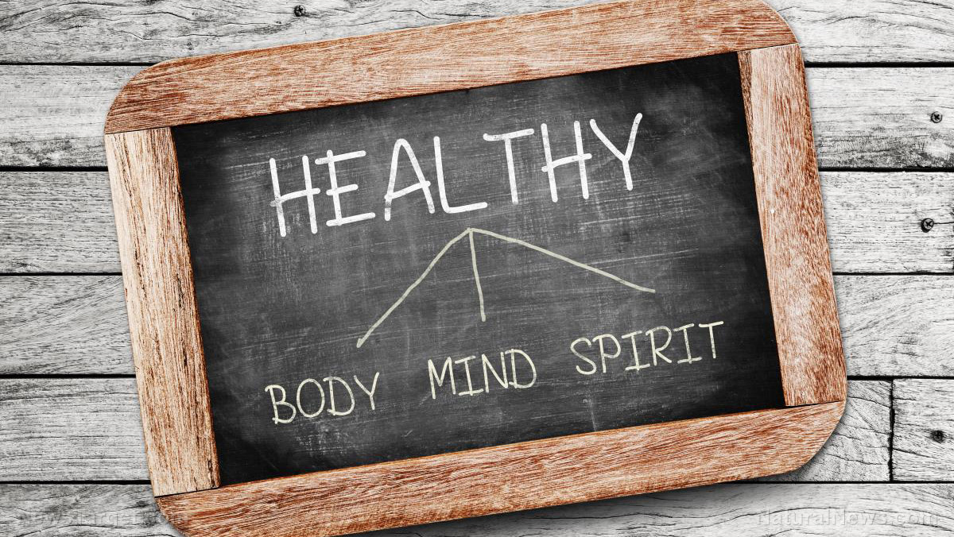
4 Mind/Body/Spirit – Health
Link Workers need to listen to the language of their client
  Some focus on physical issues, others on the mind, some may refer to spiritual health
This can provide clues for guidance towards different forms of support
  Healthy mind and body disciplines such as Yoga, Pilates or Tai Chi may be useful
  Exploration of anxiety and stress and perhaps mindfulness may help some
  While a faith community can be an important resource for others.
See NHS Mindfulness here NHS Yoga and Pilates Videos here NHS Guide to Chaplaincy Care here and a guide to spiritual care for all staff from NHS Scotland here and resources for Mind and Spirit from Credible Minds here
  It is not suggested that Link Workers should act in a chaplaincy role or lead clients in any of these directions but should follow the needs of their clients.
  And while Chalfonts and Gerrards Cross religious groups play a very important role in our communities their support and groups are not dependant on participants beliefs.

Slide 41
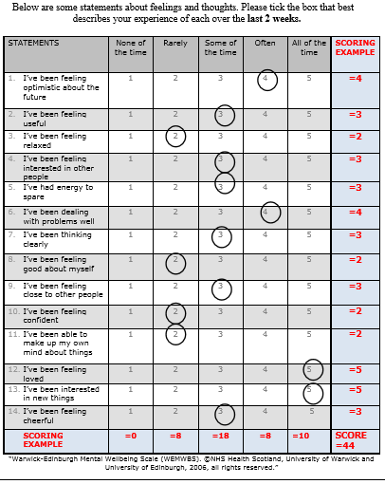
5 Mental Wellbeing, Frailty and Social Prescribing
Many clients may need help to address their mental wellbeing issues
The Warwick-Edinburgh Mental Well-being Scale - WEMWBS can help clients express their feelings. Originally developed to assess population mental wellbeing but the Scottish Association for Mental Health shows how this can be used as a self assessment tool see here
There is also a short form SWEMWBS using 7 questions. Note that use of these measures is free but you need to register to use them
Other resources for people with mental wellbeing issues include the NHS Mood self assessment tool here and resources on the Bucks Live Well Stay Well site here and the Every Mind Matters resources here

Slide 42
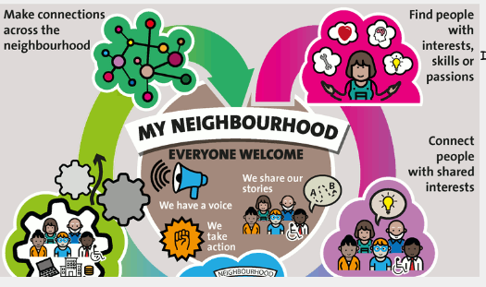
Community Engagement for INTs and Social Prescribing
Social Prescribing and INTs require co-production with communities
  It is important to understand social geography – how communities define themselves
  Groups who define themselves by: place, faith, interests, needs, activities
  Based on mutual trust, listening to and supporting local leaders see here
  To find specialist services for people with long term conditions see NHS Services A-Z here
Team Leaders needs skills in Asset Based Community Development (ABCD)
  Recognizing and working with local resources: creating a community support network
  Leaders, active citizens, natural environment, halls and local issues and passions
  For PH England example see here and for training and other resources see here
  Community Impact Bucks show this approach in North Bucks see here

Slide 43

Community Action for INTs and Social Prescribing
Practical steps that can be supported by Social Prescribing and INTs include:
  Working with community groups to develop befriending services
  Providing an eHealth centre to show people how to use online resources
  Extend Making Every Contact Count - culture change to increase health awareness
    E.g. Library Volunteers – Reading Well Scheme - Services for Older People –NHS Healthchecks
  Engage local businesses in health and wellbeing
    E.g. Healthy Eating Aisles, Dementia Friendly (no black mats, safe spaces ), Healthy Workplace
  Work with other healthcare providers
    E.g. Healthy Living Pharmacies, Healthy Living Opticians and Local Care Homes
  Collaboration with Town or Parish Councils to maintain and grow Community Groups
    E.g. Engaging with our local Town and Parish Councils through the Community Board
Resources to support such steps include
  NHS guide to resources on befriending here and MECC here my evaluation for NHS England here, NHS Healthcheck here, Healthy Eating Guide here the Alzheimer’s Society guide to dementia friendly communities here , Stay Well Pharmacy campaign here Healthy Living Opticians are at an earlier stage see here, NHS Guide to Enhancing Health in Care Homes here Community Impact Bucks here, Healthy Town Guide here

Slide 44
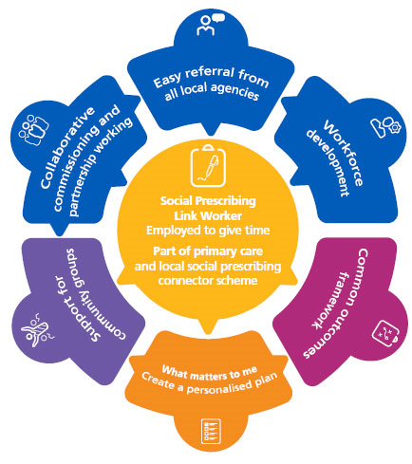
Evaluating Personalised Care
Community Wellbeing and personalised care is seen by NHS England as essential for health
Evaluation is needed at 3 levels:
  Quality of Service: clients, health and care providers and local organisations response – does it help them?
  NHS costs: what does it cost and how much is saved in terms of reduced GP and A&E demand/attendance
  Social Impact: what costs and other impacts are borne by all stakeholders and what is the value of benefits to society in terms of health and wellbeing
“A review of the evidence assessing impact of social prescribing on healthcare demand and cost implications” by Polley et al (2017) here showed reductions in NHS demand and costs and positive Social Return on Investment. Other studies show positive client and community response.
For more guidance on socio economic evaluation for health and wellbeing see my course here.
See NHS England standard Model of Social Prescribing here

Slide 45
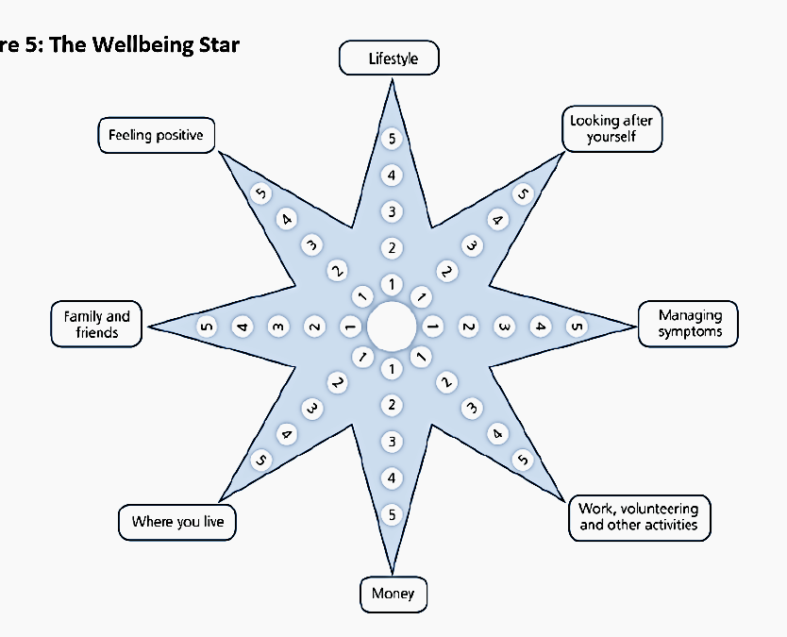
Evaluating Impact on Clients The Wellbeing Star
In East Merton see here this Outcome Star was used to evaluate impact on 8 factors from 1 not thinking about it to 5 as good as it can be (see Mackeith 2011 here )
The factors considered were:
  Lifestyle
  Looking after yourself
  Managing symptoms
  Work, volunteering and other activities
  Money
  Where you live
  Family and friends
  Feeling positive
This draws on a Capability Theory approach introduced earlier

Slide 46
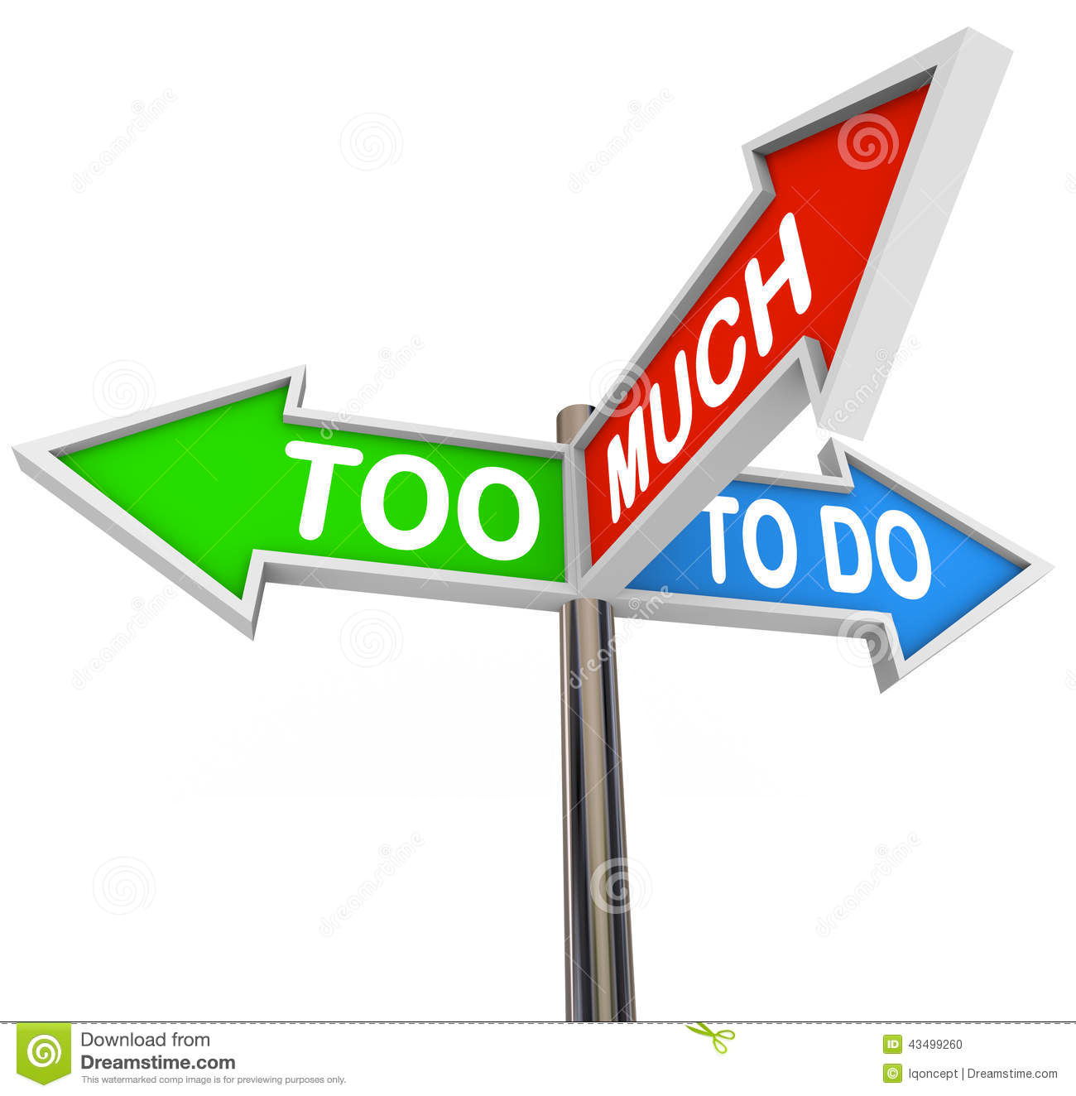
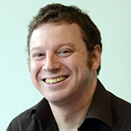
A Word of Caution
Professor Daniel Frings*, has been conducting a national study of Social Prescribing. He reminded us that while SP has been very successful:
  It is important to have a realistic understanding of what one Link Worker can achieve
  The Link Worker need the support of a team of Colleagues and Community Volunteers
  Inappropriate referrals (people who are not ready for help) can clog the system
  And it is essential to take into account the impact on community groups
Our local PCN has worked with Prevention Matters see here who reminded us** of the importance of teamwork and Chiltern District Council see here who support Community Groups through Community Impact Bucks see here
  * At the League of Friends AGM 5th Nov 2019
  ** At the League of Friends SP Meeting with Local Groups 17th Oct 2019

Slide 47
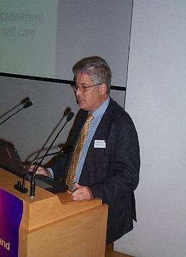
Some conclusions What do you think?
Lessons I learnt from my students when teaching as visiting professor of Health and Social Care at London South Bank University, include:
  Community Wellbeing Hubs, Social Prescribing and INTs are not “Silver Bullets” but
  They are important steps in the transformation of health and social care services
  Towards health promotion and personal engagement in managing health and wellbeing
  This requires teamwork by health and care staff focussed on whole person care
  It requires better skills in listening to patient/clients and improved communication
  Coupled with use of technology to support patients and carers
  This can engage and empower individuals and communities and reduce NHS costs.

