Slide 1

Social Return on Investment and Values for Money for Greenwich MECC
Graham Lister
Visiting Professor
London South Bank University

Slide 2
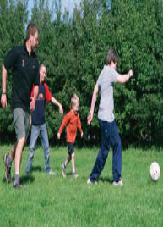
The Context:
LAs and CCGs work with communities in Health and Wellbeing Boards to achieve national and local objectives. :
To improve health promotion and health services to increase healthy life expectancy and wellbeing
To reduce inequity and
To improve the Value for Money of services
The Legislative Framework for this is set out in:
Health and Social Care Act 2012
Public Services (Social Value Act) 2012
Care Act 2014
Against this background PHE asked me to help examine ways of evaluating the Value for Money of MECC

Slide 3

Values for money
Return on Investment may mean:
Cost Offset ~ cost per £ saved
Cost effectiveness ~ cost/ outcome
Cost consequences ~ cost/ multiple outcome
Cost-utility ~ cost/weighted outcomes
Cost benefit ~ cost/ £ economic value
Social Return on Investment ~ total social cost compared to value to society improved.
Value means benefits to society = Wellbeing
Reflecting social values in other words “Values for Money”

Slide 4
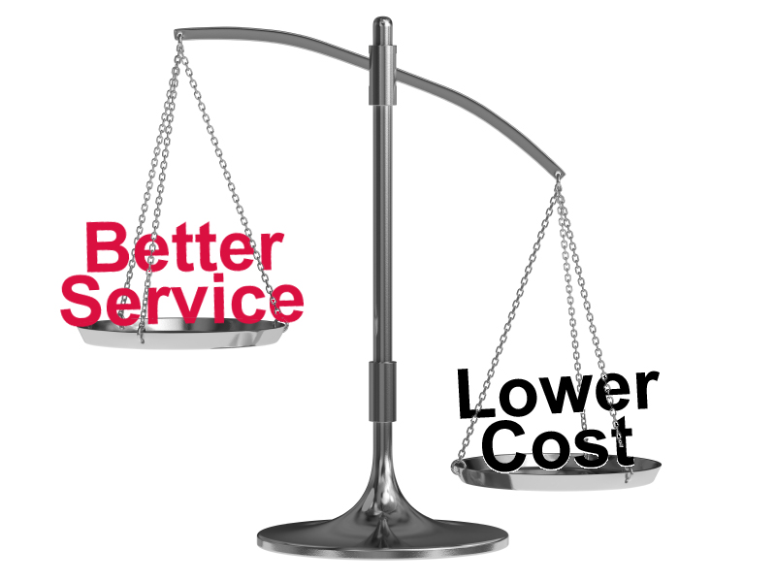
Basic Values for Money
Getting high values for low cost
Is obviously good value for money
And if high cost produces low values
This is obviously poor value for money
But most schemes have intermediate costs/benefits
A cost benefit ratio shows how much it is worth spending for each 1 unit of value but PHE and NICE views differ as to what this ratio should be
Value for Money analysis is always a comparison
Value and cost added compared to the next best or do nothing
The Incremental Cost Utility Ratio INCUR
And Incremental Social Return on Investment

Slide 5

Measuring Health Benefits
QALYs = Quality Adjusted Life Years
Years of life are weighted between 0-1
Depending on the quality of life
As perceived by patients but
It depends who you ask and when
There are many different QALY tables
EuroQols provide a standard approach like DALYs
DALYs = disability adjusted life years
Used by WHO for burden of disease
DALYs = Years of Life Lost (YLL) + Years Lived with Disability (YLD) weighted by experts 0-1
But original WHO DALYs included age weights
DALYS produced by the Institute of Health Metrics and Evaluation are not age weighted like QALYs
Margaret Chan
Notes:
5

Slide 6
Cost /Benefit Ratio
NICE
£20,000
per QALY
Cost /Benefit
Ratio
High benefit
√
PHE
£60,000
per QALY
Low cost
X
High cost
Cost /Benefit Ratio
Low benefit
Notes:
6

Slide 7
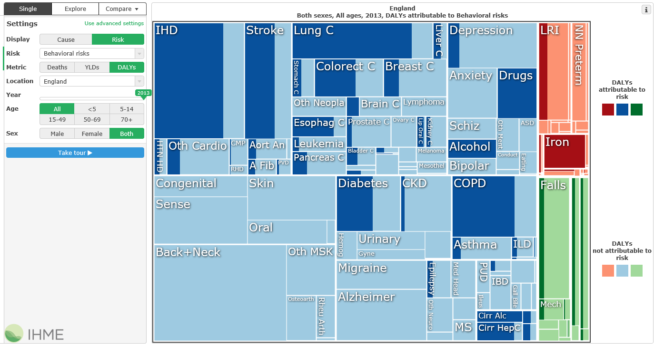
IHME Burden of Disease Model Applied to England: impact of all behavioural factors

Slide 8
VfM outcomes from Health England
Category | Type of Intervention | HELP Utility Score | Net cost per QALY
Alcohol | Increase tax by 5% | 11.30 % | -£5,267
Smoking | Increase tax by 5% | 9.62 % | -£2,951
Smoking | National Media Campaign | 9.46 % | -£2,663
Diet, activity, obesity | National Media Campaign | 9.09 % | -£3,290
Smoking | Brief Intervention in GP practices | 8.98 % | -£1,799
Alcohol | Brief Intervention in GP practices | 8.70 % | -£750
Diet, activity, obesity | Brief Intervention in GP practices | 8.63 % | -£2,151
Smoking | Nicotine Replacement Therapy | 8.25 % | -£563
STI / teen pregnancy | Screening and Treatment | 7.38 % | £370
Diet, activity, obesity | School based education | 7.25 % | £599
STI / teen pregnancy | School based education condoms | 6.00 % | £4,965
Statins | Use for primary prevention | 4.26 % | £9,858
Mental health | Assessment + support for carers | 0.95 % | £35,264
Mental health | Screening retirees for depression | 0.12 % | £70,120
VfM | 29/09/2011 | www.thensmc.com
Taken From “Health England Leading Prioritisation: HELP” by Matrix Consulting

Slide 9
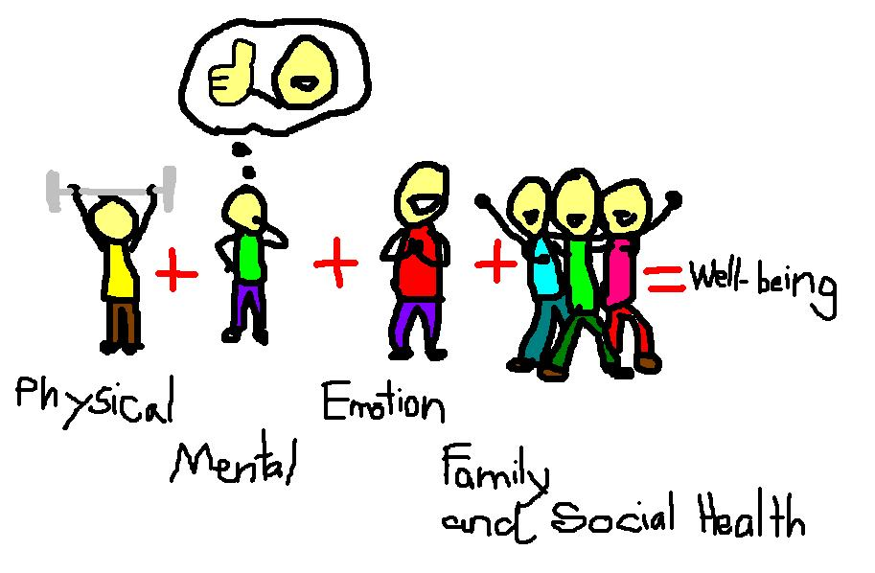
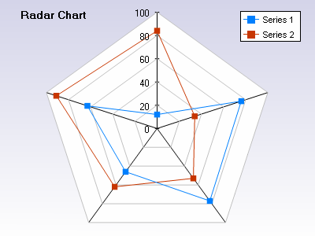
What is Wellbeing?
No simple definition
Physical, mental, emotional and community wellbeing enables every individual to manage lifestyle health risks, cope with normal stresses of life, find purpose and happiness, work productively and fruitfully, make a contribution to and draw support from family, community and their home and natural environment.
Many dimensions
Local issues and priorities
Defined with stakeholders
As basis for action
To address key issues
Evaluated in terms of SROI
Health
Equity
Social
Capital
Environment
Employment

Slide 10

What is social capital? Is it part of wellbeing?
Social capital is the framework of values and norms that fosters bonds within community groups, bridges between groups and links with formal and informal organisations*
Behaviour both depends on and builds social capital
By recognising and influencing existing group norms
By forming social groups to support behaviour change persistence
By providing links to social support from community and services
Social capital is essential to wellbeing and equity
Most care (70%) is from family and community resources
Most behaviour is determined by social norms
* Rosalyn Harper (2002) “The Measurement of Social Capital in the UK” National Statistics

Slide 11
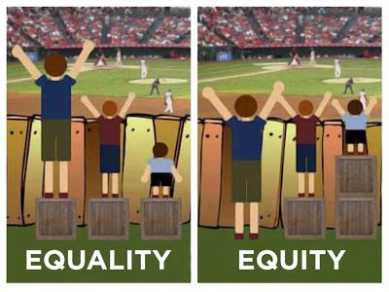
Why is improving equity important for wellbeing?
It is morally wrong to allow disadvantage to determine outcomes - so equity is an objective of health and wellbeing
People in the most deprived areas, have a life expectancy 3-4 years less than those in the least deprived areas, about 2 years less than the average they also score lower wellbeing
Reducing inequity in health and wellbeing is also a social value and a target for Local Authorities and NHS.

Slide 12

The process of evaluation
Consult stakeholders
Understand their perspectives and values
Describe the process of health and wellbeing improvement
Consider intended and unintended consequences
Establish a baseline or alternative for comparison
Develop ways of measuring and valuing outcomes
Identify key performance indicators
Not just financial costs but social values
Demonstrate a range of outcomes and values
Show sensitivity of results to key assumptions
Create a dialogue to review outcomes

Slide 13
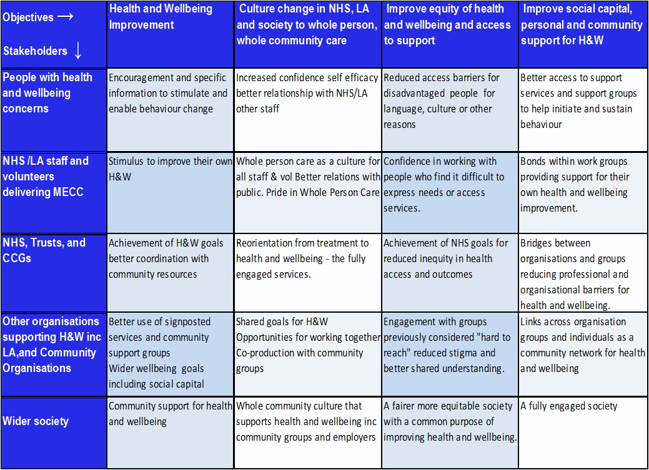
Social impact matrix for MECC
VfM | 29/09/2011 | www.thensmc.com

Slide 14
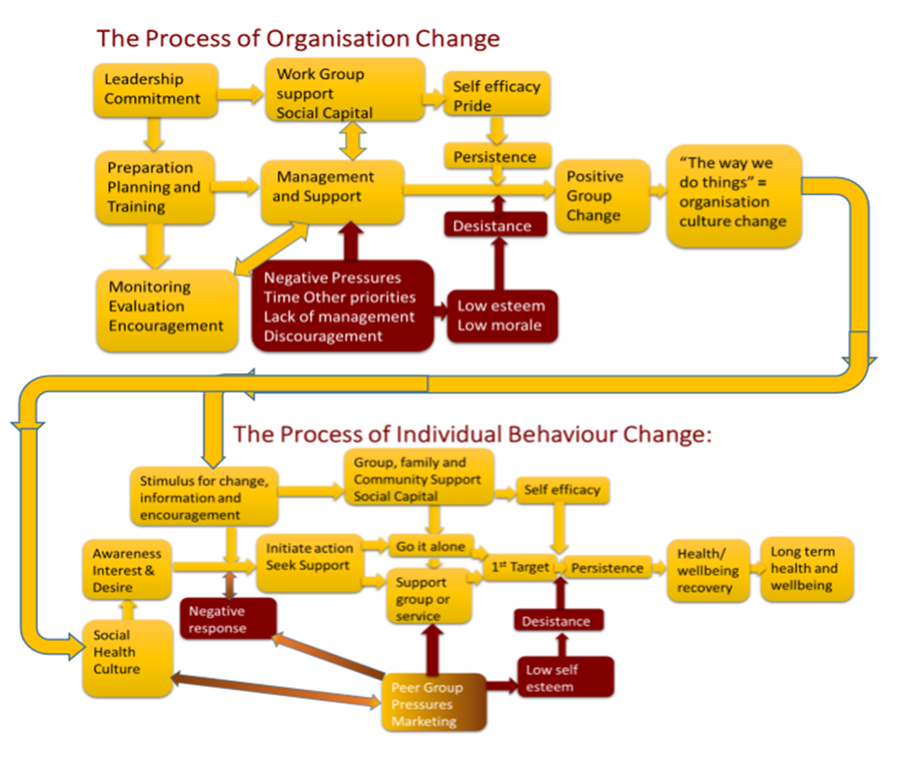
Process Map MECC

Slide 15
Intended and Unintended Outcomes
Intended
Unintended
Workforce engagement in health and wellbeing
Increased morale, self worth
Encouragement for behaviour change
Better patient experience
Public engagement and social groups to encourage others
Lack of leadership and management lowers value
Staff feel engagement worthless
Patients feel pressure to conform to stereotype
Patients feel demeaned
Feeling outcast and isolated undervalued
Notes:
15

Slide 16
Describe impacts before you measure them
Qualitative and quantitative evaluations are equally important
You have to be able to describe impacts to measure them.
And you have to understand them from the client’s perspective
But you need to describe and value them systematically
The social impact matrix and the causal chain analysis
Help to identify key performance indicators
That reflect client and other stakeholder values
You must engage with the clients to ensure you have understood their perspectives for both qualitative and quantitative evaluations

Slide 17
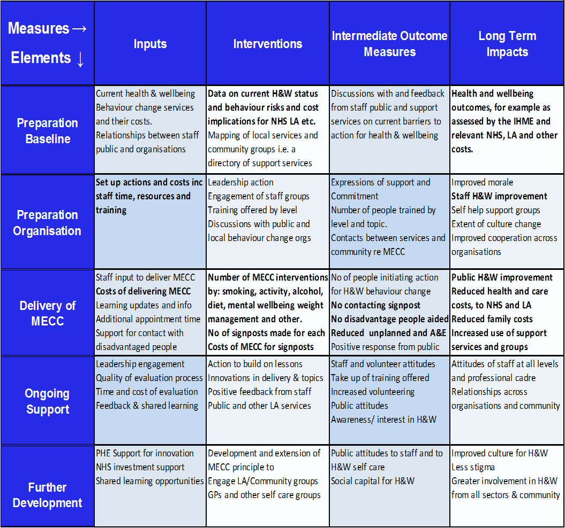
Logic and data model for MECC

Slide 18
Evidence, Estimates and Assumptions
No randomised control trials for behaviour change.
Evidence is lacking for persistence and health recovery
Except for smoking and limited evidence for alcohol
So we seek evidence for defensible assumptions.
Often drawing on consensus estimates from experience
Key evidence/estimates required include:
What is full cost of intervention
How many people will be influenced
What is the short term impact on behaviour
With and without intervention
What are the likely long term impacts on behaviour
What health and wellbeing outcomes are expected

Slide 19

Costs of Intervention
Planning/preparation costs –
Spread over project lifetime e.g. 5 years
Include training but exclude VAT (transfer to Govt)
Cost of intervention –
Include management and
Impact on operating costs e.g. are length of consults increased
Cost increases arising for other stakeholders -
Cost to patients or public – transport, other
Marginal costs to signposted services from referrals

Slide 20

People influenced
Staff trained and number who act on this training
To intervene with public
To change their own attitudes and behaviour
Number of contacts with public applying MECC
By type of intervention- Brief or Very Brief
By topic – Smoking, Alcohol, Activity, Mental Wellbeing, Diet, Community Support, Weight Management, Other
By age/sex if relevant
Number signposted to support services
By type of service or support group

Slide 21

Short term impact on behaviour
Immediate impacts on behaviour
Positive responses to intervention
Intention to change behaviour
Take up of signposted support services/groups
First steps e.g. dry Wednesday, give it up for baby
What would happen without MECC
Estimates of current trends in behaviour change
People using support services e.g. smoking cessation
People going it alone (e.g. using ecigarettes)

Slide 22

Long term Impacts on Behaviour
Behaviour change attempts often fail e.g.
About 50% of smokers get to target using support services
Without support about 17% get to 4 week target
Many behaviour changes do not persist e.g.
For every seven, “4 week smoking quitter” reported
Only one will not resume smoking in 12 months
After this about 1% per year take up smoking again
Most people do not spring back to full health e.g.
Young people recover health after smoking
Middle aged and older people only recover 50%
Impacts may last for rest of life
This depend on age and
Social capital - support from family, friends and society

Slide 23

Health Outcomes Expected
Health Outcomes (from IHME) caused by behaviour
Assumed to arise from behaviours 20 years prior
Gives estimate of impact of 1 life year of behaviour
In terms of DALYs equivalent to – QALYs
Multiplier applied to current behaviour change
Adjust for short/long term persistence + health recovery
Discounted over lifetime by Social Time Preference Rate
PHE suggest STPR= 1.5%, Treasury 3.5%, NICE 1.5% - 6%
DALY/QALY improvement valued at recommended rate
PHE = £60,000 per QALY, NICE=£20,000 per QALY

Slide 24

Wellbeing Outcomes Expected
Cost savings to NHS, LAs, CJS, families estimated from
Costs by cause for behaviour allocated by
Estimate of changes in behaviour
Adjusted for Long Run Marginal Cost impact
NHS=100%, LA=25/50/85% Criminal Justice =85%
Value of Community Group Support
Estimated from HACT Social Values DataBank
But also note impact on persistence
Value for Disadvantaged est from Health England
U = e(-0.0000586x C + 0.0435987 x R + 0.119895x D) e = base of natural logarithm, C= cost per QALY, R= % benefiting, D=% of benefit to most disadvantaged 20%
PHE agrees weighting is valid NICE do not accept this

Slide 25
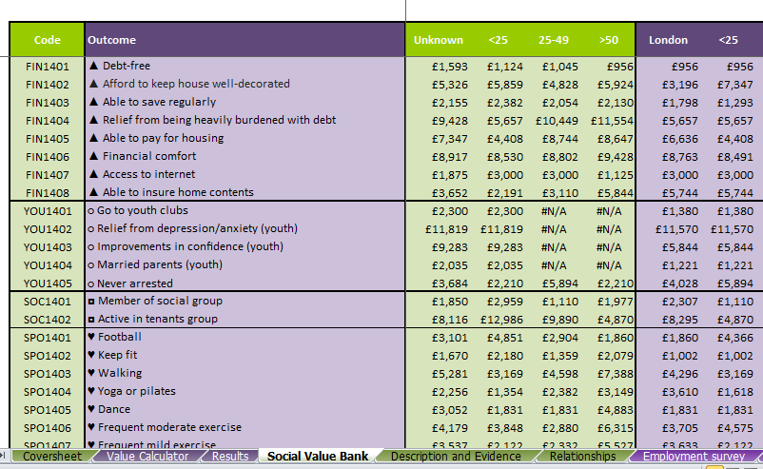
HACT Social Values databank

Slide 26

Recognising Uncertainty
Most health and wellbeing data is uncertain
Behaviour change is particularly difficult to predict, and
Long term future projections even more so
With many causes and consequences
Often based on assumptions, so
Recognise uncertainty and estimate ranges of values
Establish confidence interval (probability of outcome)
Perform sensitivity analysis
Test outcomes when assumptions change
Don’t pretend precise knowledge

Slide 27
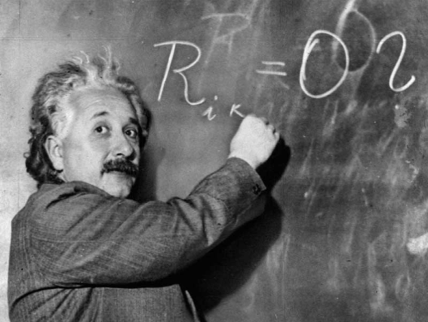
Values for Money for MECC
It is not an exact science
Long term impacts require consensus
On the assumptions and values applied
What is important is a shared understanding
Of the goals, process evidence and assumptions
Values for money provides a common language
The MECC evaluation tool is simply a mechanism
It applies values and assumptions and explains the evidence
To your cost and impact data
But you need to own the assumptions or change them

Slide 28

Applying thinking to Wessex MECC
Identify and engage stakeholders
Public, Staff, Local Authorities, NHS Leadership
Clarify goals and what they mean for stakeholders
Plot your process of behaviour change at each level
Thinking about intended and unintended outcomes
Develop your logic and data model
Recognising data to be measured and factors to assess

Slide 29
An Evaluation tool for Wessex MECC
Review goals and assumption you want to apply
And redesign a tool to meet your needs
Collect data as far as possible e. g.
Cost of preparing for and implementing MECC
Cost impact of MECC delivery for NHS and others
Survey of staff trained in MECC delivery e. g.
Impact on morale, personal health behaviours
MECC encounters, quality of contact, signposts (by type)
Survey of public receiving MECC encounters
Quality of contact, impact on intentions, behaviour change
Survey of signposted services and support groups

Slide 30
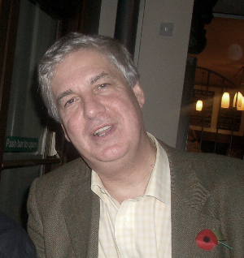
I hope this helps
To explain the MECC VfM process and tool
To raise questions I hope I can answer
To show how it might be adapted to your needs
More detailed training material plus links to sources
And a range of other VfM tools (incl Wessex HTS)
Can be found on my web site at
www.building-leadership-for-health.org.uk
Look at pages on Evaluating Behaviour Change

