Slide 1
Evaluating Behaviour Change for Health and Wellbeing
Graham Lister
Visiting Professor
London South Bank University
Senior Associate NSMC
24 April 2016

Slide 2

Introduction:
This material is set out in 4 sections:
  Understanding Values for Money
  Measuring and valuing health gains
  Understanding and measuring wellbeing
  The process of evaluation
It is suggested that participants should also visit key web sites such as the IHME and HACT and should explore the use of the NSMC ready reckoner tools for evaluating:
  Smoking cessation,
  Alcohol harm reduction
  Weight control, diet and activity
  Bowel Cancer survey response
  Breast feeding continuation

Slide 3
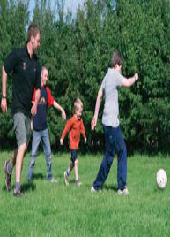
1. The Context:
LAs and CCGs work with communities in Health and Wellbeing Boards to achieve national and local objectives. :
  To improve health promotion and health services to increase healthy life expectancy and wellbeing
  To reduce inequity and
  To improve the Value for Money of services
The Legislative Framework for this is set out in:
  Health and Social Care Act 2012
  Public Services (Social Value Act) 2012
  Care Act 2014

Slide 4

1. Values for money
Value for Money may mean:
  Cost Offset ~ cost per £ saved
  Cost effectiveness ~ cost/ outcome
  Cost consequences ~ cost/ multiple outcome
  Cost-utility ~ cost/weighted outcomes ~ cost per QALY
  Cost benefit ~ cost/ £ economic value
  Social Return on Investment ~ total social cost compared to value to society improved.
Value means benefits to society reflecting social values and priorities in other words “Values for Money”
While it is important to try to measure values, qualitative studies that describe the impact of interventions are also vital

Slide 5
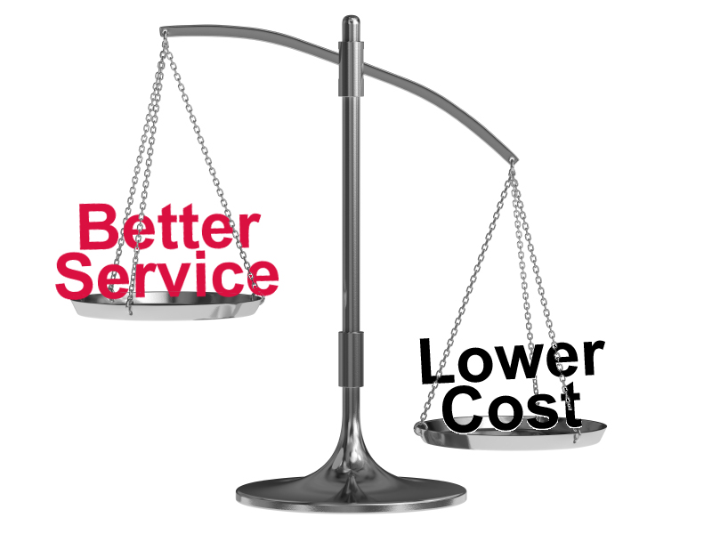
1. Basic Values for Money
Getting high values for low cost
  Is obviously good value for money
And if high cost produces low values
  This is obviously poor value for money
But most schemes have intermediate costs/benefits
  A cost/benefit ratio shows how much is worth spending for 1 unit of benefit
Values for Money analysis is always a comparison
  Value and cost added compared to the next best or do nothing baseline
  The Incremental Cost Utility Ratio INCUR

Slide 6
1. Cost /Benefit Ratio
£20,000
per QALY
Cost /Benefit
Ratio
High benefit
√
£60,000
per QALY
Low cost
X
High cost
Cost /Benefit Ratio
Low benefit
Notes:
6

Slide 7

1. Understanding Costs in Evaluation
Cost to all stakeholders should be estimated
  E.g. to LAs, NHS, community groups and individuals
Costs considered in economic evaluation include:
  Set up costs spread over the life of the intervention
    E.g. Training, capital investment and equipment
  Annual operating and management costs
    E.g. Hand out materials, management, time spent which could be used in other ways (opportunity costs) office and other space used, travel costs.
Some financial costs are not included:
  E.g. VAT (transfer cost), research and evaluation costs, allocated overheads that would not be reduced without the project

Slide 8

1. Understanding Savings in Evaluation
Behaviour change often produces future savings
  E.g. to LAs, NHS, families, communities, employers
Savings include:
  NHS: treatment and care costs
  LA and other: social care, crime, fires, litter costs
  Families: alcohol, cigarettes, informal care
  Employers: loss of productivity e.g. fag breaks, sickness
Future costs that are not considered include:
  Increased cost of treatment and care for people who live longer as a result of behaviour change (such costs can be estimated but are not considered as negative outcomes).

Slide 9
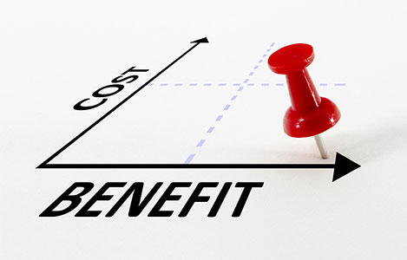
1. Understanding Benefits in Evaluation
Benefits to all stakeholders should be estimated
  E.g. to LAs, NHS, families, communities, employers
Benefits include:
  Health = Quality Adjusted Life Years (QALYs)
  Wellbeing = Improved Life Satisfaction / Social Capital
  Resulting cost reductions for NHS/LA/Employers/Families
Benefits are estimated from intermediate outcomes:
  E.g. 4 Week smoking quitter target, reduced alcohol consumption, activity increase, joining a support group, take up of a referral.

Slide 10

1. Using a Ready Reckoner
Measures of costs and short term benefits
  Can be entered into a NSMC VfM ready reckoner
  To calculate the long term costs and benefits
  Based on estimates and assumptions from studies
  And consultations with experts in each field
Outcome measures reported as requested by experts:
  Incremental Cost Utility Ratio (Cost per QALY), Social Return on Investment (SROI), Deaths averted, Odds Ratio (health outcome compared to baseline),Numbers Needed to Treat (how many people would need to be helped for every death averted).
  Sensitivity Analysis (range of outcomes resulting from changes in key assumptions), Outcomes weighted for impact on equity.
See NSMC ready reckoners and training materials at
  http://thensmc.com/resources/vfm
  http://www.building-leadership-for-health.org.uk
Concepts used in tools are explained in the following slides

Slide 11

2. Measuring Health Benefits
QALYs = Quality Adjusted Life Years
  Years of life are weighted between 0-1
  Depending on the quality of life
  As perceived by patients but
  It depends who you ask and when
  There are many different QALY tables
DALYs = disability adjusted life years
  Used by WHO for burden of disease
  DALYs = Years of Life Lost (YLL) + Years Lived with Disability (YLD) weighted by experts 0-1
  But original WHO DALYs included age weights
Margaret Chan
NICE now suggest a value of £20,00 per QALY but PHE suggest a value of £60,000 as the basis for evaluation
Notes:
11

Slide 12

2. QALYS: The EuroQol
EuroQol developed by researchers, from seven centres in England, Finland, the Netherlands, Norway and Sweden
EQ-5D™ gives a standardised measure of health outcome.
Based on patient perceptions but with standardised weights
It is becoming the accepted standard which has the advantages of patient centred but with consistent values
Explore the Euroqol network and EQ5D at:
  http://www.euroqol.org/

Slide 13

2. EQ 5D (3 or 5 levels)
The Best
Dimensions:
  mobility, self care, usual activities, pain/discomfort, anxiety/depression
3-5 levels:
  no problems, slight problems, moderate problems, severe problems, and extreme problems
Visual analogue scale:
  ‘the best health you can imagine’ - ‘the worst health you can imagine’
There is a tool for translating EQ5D scores e.g. 13223 into QALY outcomes
The worst

Slide 14
2. Examples of EuroQol 5 D Scores and Outcomes
Health State | Description | Valuation
11111 | No Problems | 1.000
11221 | No problems walking about; no problems with self-care; some problems with performing usual activities; some pain or discomfort; not anxious or depressed | 0.760
22222 | Some problems walking about; some problems washing or dressing self; some problems with performing usual activities; moderate pain or discomfort; moderately anxious or depressed | 0.516
12321 | No problems walking about; some problems washing or dressing self; unable to perform usual activities; some pain or discomfort; not anxious or depressed | 0.329
21123 | Some problems walking about; no problems with self-care; no problems with performing usual activities; moderate pain or discomfort; extremely anxious or depressed | 0.222
23322 | Some problems walking about, unable to wash or dress self, unable to perform usual activities, moderate pain or discomfort, moderately anxious or depressed | 0.079
33332 | Confined to bed; unable to wash or dress self; unable to perform usual activities; extreme pain or discomfort; moderately anxious or depressed | -0.429

Slide 15

2. Intermediate Measures
  For most interventions you cannot measure final outcomes
  You may record that the person initiated behaviour change
  Or achieved a first target, say quitting smoking for 4 weeks
But you do not know the long term impacts, you need to know :
  If change is initiated will first targets be met
    This depends on support and how change is achieved
    E.g. using smoking cessation services 50% succeed, others 17%
  What is the intermediate measure:
    Some intermediate measures are better indicators of behaviour change
    E.g. only 14% of self declared 4 week quitters still not smoking after 1 year
    But 24% of CO tested quitters will still not smoke after 1 year
  If so will change will persist in the longer term
    This depends on community and groups support
    E.g. ~healthy eating groups increase success rates of slimmers
  The extent to which full health will be recovered
    This depends on age and the extent of harm already inflicted
    E.g. up to 35 years smokers usually recover full health over 50s only50%

Slide 16
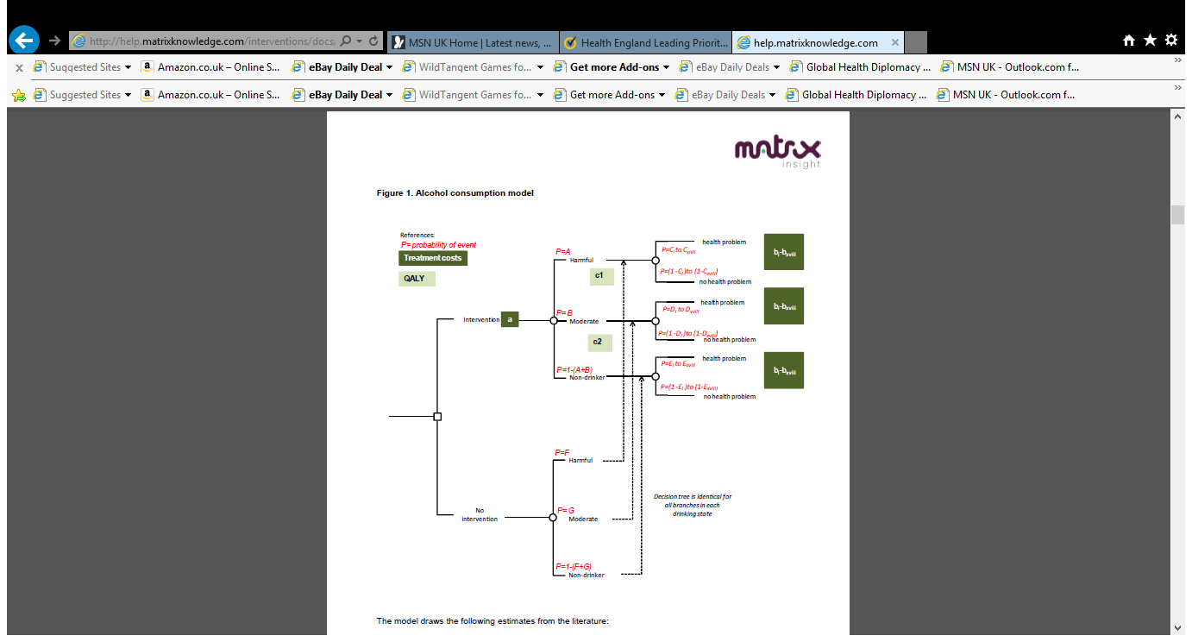
2. Linking Risks to Health Outcomes
Estimate probable impact of behaviour on each health outcome
To establish the total impact of behaviour risk on QALY outcomes
But remember outcomes may arise 40 years after risk behaviour
Example Health England review of Alcohol impact by

Slide 17
2. VfM Outcomes from Health England
Note the Utility score is explained later, Net cost is after savings to NHS
Category | Type of Intervention | HELP Utility Score | Net cost per QALY
Alcohol | Increase tax by 5% | 11.30 % | -£5,267
Smoking | Increase tax by 5% | 9.62 % | -£2,951
Smoking | National Media Campaign | 9.46 % | -£2,663
Diet, activity, obesity | National Media Campaign | 9.09 % | -£3,290
Smoking | Brief Intervention in GP practices | 8.98 % | -£1,799
Alcohol | Brief Intervention in GP practices | 8.70 % | -£750
Diet, activity, obesity | Brief Intervention in GP practices | 8.63 % | -£2,151
Smoking | Nicotine Replacement Therapy | 8.25 % | -£563
STI / teen pregnancy | Screening and Treatment | 7.38 % | £370
Diet, activity, obesity | School based education | 7.25 % | £599
STI / teen pregnancy | School based education condoms | 6.00 % | £4,965
Statins | Use for primary prevention | 4.26 % | £9,858
Mental health | Assessment + support for carers | 0.95 % | £35,264
Mental health | Screening retirees for depression | 0.12 % | £70,120
VfM | 29/09/2011 | www.thensmc.com
Taken From “Health England Leading Prioritisation: HELP” by Matrix Consulting

Slide 18
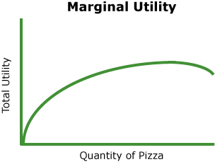
2. Measuring the Value of Health Outcomes
Utility is an economist way of describing how an outcome is valued
  A utility curve shows how value (satisfaction) changes with quantity
  E.g. we may love first slice of Pizza but after 10 we may not be so keen
  Showing this as a logarithmic function is just a way of describing a curve
Health England Utility Score (see previous)
  Based on survey of 99 Public Health decision makers (mostly DPH)
  Asking them to consider 1117 PH investment decisions
  Varying: VfM, % of all people benefiting, % disadvantaged benefiting
  U = e(-0.0000586x C + 0.0435987 x R + 0.119895x D) e = base of natural logarithm, C= cost /QALY, R= % benefiting, D=%disadvantaged
  Gives Health England utility score using values of PH decision makers balancing: VfM, number benefiting and impact on disadvantage
Public Health Values of an intervention depends on VfM, the number of people who could benefit and the impact on equity
  Matrix Insight (2009) “Prioritising investments in preventative health” Health England

Slide 19

2. Practical Application of DALYs and QALYs by IHME
IHME DALYs are not age weighted and apply to England 2013
  DALYs reduced ~ QALYs gained
For each health outcome by age/sex they estimate;
  The proportion of DALYs, YLL, YLD attributable to risk factors
  (This is known as the Population Attributable Fraction)
Risk factors include:
  Tobacco Smoke, Alcohol, Drug use, Sub optimal breast feeding, Diet (14 factors), Low Activity, Sexual abuse, Unsafe Sex, High BMI, High Blood pressure
  DALY estimates by outcomes include Anxiety and Depression
Take a tour of the data available at:
  http://vizhub.healthdata.org/gbd-compare/

Slide 20
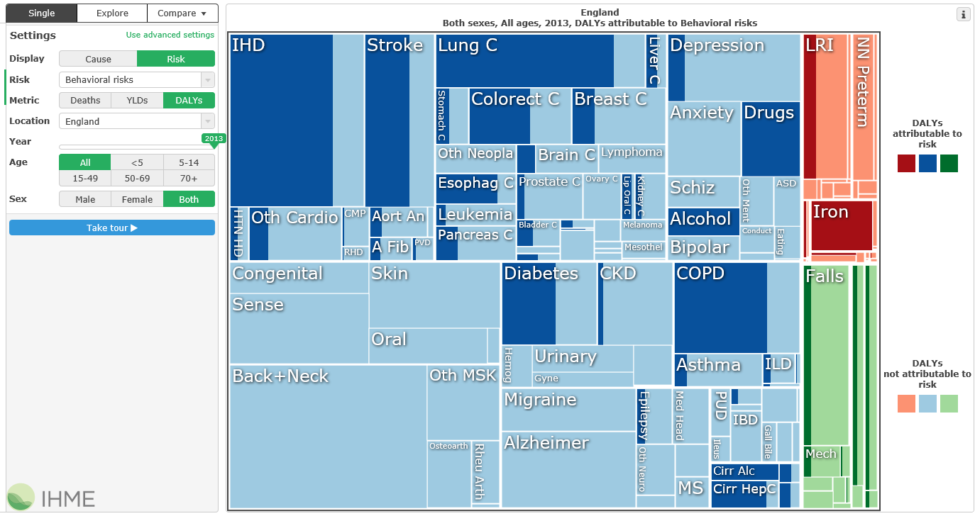
2. IHME Burden of Disease Model Applied to England: all behavioural factors 2013

Slide 21
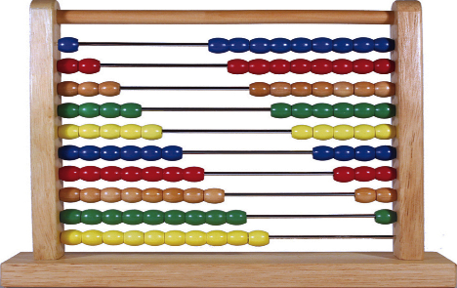
2. Risks Outcomes and Cost/ Savings Impacts
IHME analysis provides estimates by cause, age and sex of:
  DALYs = Disability Adjusted Life Years unweighted =-QALYs
  YLD= Years Lived with Disability = basis for allocating care costs
  YLD under 65= basis for allocating employment related costs
  YLL= Years of Life Lost and Deaths by age gives premature deaths
NHS England Programme budgets and National Statistics analysis of Local Authority Expenditure and Criminal Justice Costs shows:
  Costs to NHS linked to each outcome and risk factor = potential savings
  Cost to LA and Local Services = potential savings
See
  https://www.england.nhs.uk/resources/resources-for-ccgs/prog-budgeting/
  https://www.gov.uk/government/statistics/local-authority-revenue-expenditure-and-financing-england-2014-to-2015-budget

Slide 22
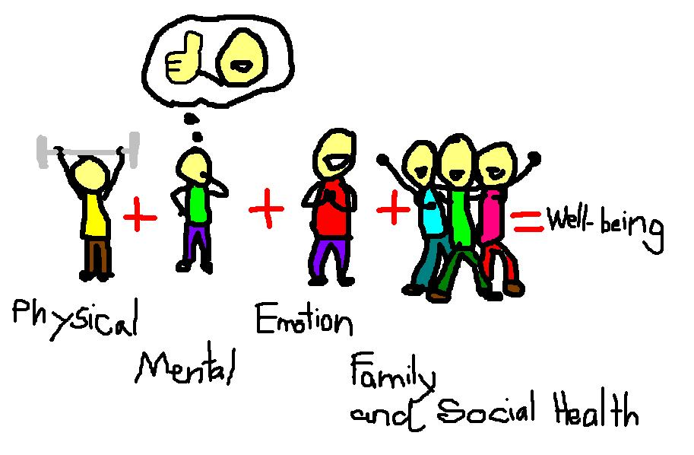
3. What is Wellbeing?
No simple definition*
  Physical, mental, emotional and community wellbeing enables every individual to manage lifestyle health risks, cope with normal stresses of life, find purpose and happiness, work productively and fruitfully, make a contribution to and draw support from family, community and their home and natural environment.
Many dimensions
  Issues and priorities, defined with stakeholders
  Things that improve life satisfaction might include:
    Physical and mental health, emotional contentment, family and social support, housing, environment, art and culture, employment, education
  *For definitions of wellbeing visit National Wellbeing Institute Australia web site
    See http://nwia.idwellness.org/2011/02/28/definitions-of-wellbeing-quality-of-life-and-wellness/

Slide 23

3. Health and Wellbeing: Mental Wellbeing
Physical and Mental Health are elements of wellbeing
Mental Wellbeing can be measured:
  Using the Warwick-Edinburgh Mental Wellbeing Scale (WEMWBS)
  http://www2.warwick.ac.uk/fac/med/research/platform/wemwbs/
  However this does not produce a QALY compatible estimate
An alternative is to estimate health impacts from IHME
  Anxiety related health outcomes provide an estimate of impacts
  This is not as comprehensive nor suitable for individual assessment
Interventions aimed at addressing mental health:
  Often show very high cost per QALY for diagnosed medical conditions
  But much better value for money when early signs of poor mental wellbeing are addressed

Slide 24
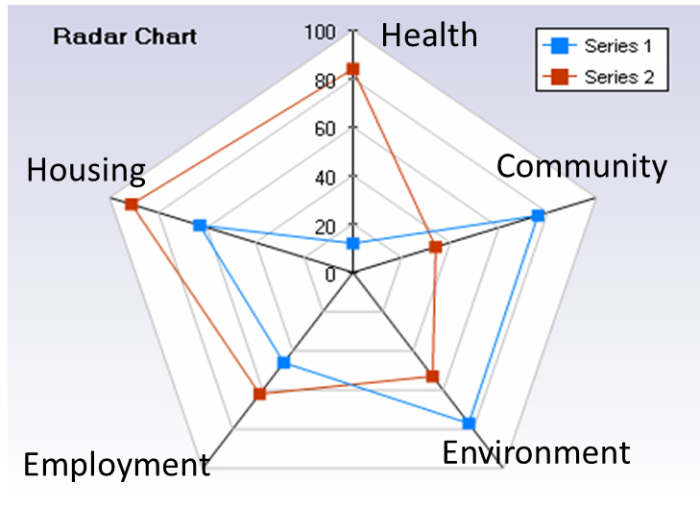
3. A Practical Approach to Wellbeing
A “Radar Chart” provides a way of comparing strategies for addressing a range of factors affecting wellbeing
This does not involve a trade off between different aspects of wellbeing but provides a visual metaphor
To clarify strategic options
Evaluated locally in terms of
  Adding to Life Satisfaction
  Enabling mutual benefit
  Improving equity
  Achieving social values

Slide 25
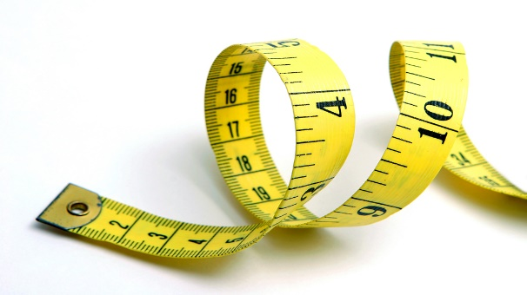
3. Measuring Wellbeing : Social Return on Investment
Wellbeing is measured in terms of Social Return on Investment
  Value to society per unit of total social investment
Developed in USA in late 1990s
  To evaluate social enterprises with non profit aims
A European Network formed in 2004
  To develop consistent approach and methodology
New Economic Foundation UK 2004/5
  SROI Primer and Methodology published 2004
Cabinet Office supports guide and network 2009
  Guide to SROI for Wellbeing Programmes 2013/2015
See New Economic Foundation resources and network for SROI
  http://www.neweconomics.org/publications/entry/a-guide-to-social-return-on-investment
  http://www.neweconomics.org/publications/by/well-being

Slide 26

3. What is social capital:
Is it part of wellbeing?
Social capital is the framework of values and norms that fosters bonds within community groups, bridges between groups and links with formal and informal organisations*
Behaviour both depends on and builds social capital
  By recognising and influencing existing group norms
  By forming social groups to support behaviour change persistence
  By providing links to social support from community and services
Social capital is essential to health, wellbeing and equity
  Most care (70%) is from community resources
  Most behaviour is determined by community norms
  Equity requires community trust and engagement
* Rosalyn Harper (2002) “The Measurement of Social Capital in the UK” National Statistics

Slide 27
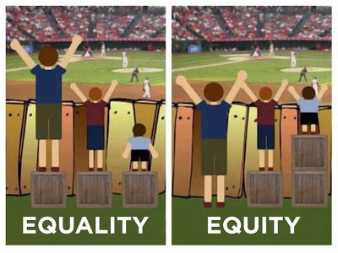
3. Why is improving equity important for wellbeing?
It is morally wrong to allow disadvantage to determine outcomes - so equity is an objective of health and wellbeing
People in the most deprived areas, have a life expectancy 3-4 years less than those in the least deprived areas, about 2 years less than the average they also score lower wellbeing outcomes
Reducing inequality in health and wellbeing is also a social value and a target for Local Authorities and NHS.

Slide 28
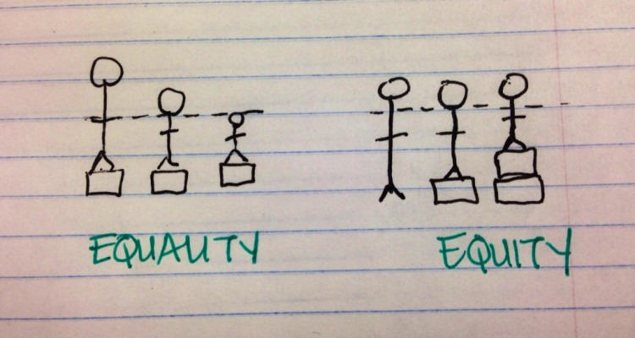
3. Measuring and Valuing
Impact on Equity
PHE guidance suggests outcomes can be weighted for equity: by estimating access for most disadvantaged 20%
  See David Glover, John Henderson (2010) "Quantifying health impacts of government policies A how-to guide to quantifying the health impacts of government policies" Department of Health
A weight for equity can be derived by comparing the Health England utility score given by the estimated % in the most disadvantaged quintile with the utility score that would be found if this were 20%.
This gives a positive weight if more than 20% of beneficiaries are from the most disadvantaged quintile and a negative weight if there are less than 20%, i.e. service less accessible to most disadvantaged.

Slide 29
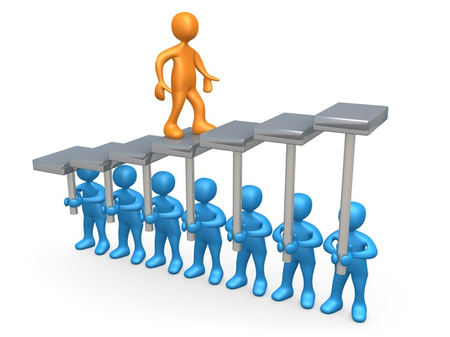
3. Is Integrated Health and Social Care Important for Wellbeing?
Integrated care creates social value and wellbeing
This goes further than LA/NHS cooperation
  It requires community engagement in co-production of advice, support and neighbourhood schemes
  Thoughtful redesign of: housing, advice and support services, community spaces, transport, access to high street and shops.
  Community, communication and contact
  See LGA resources
  http://www.local.gov.uk/health-wellbeing-and-adult-social-care/-/journal_content/56/10180/4060433/ARTICLE

Slide 30

3. Are Arts, Sports and the Environment important for Wellbeing?
Arts, sport and other activities create meaning and purpose to life as well as providing mental and physical stimulus
They support a sense of community and create social capital
The social and physical environment that shapes our understanding of ourselves and our community is described in Welsh as Cynefin
Initiatives in these fields support health and wellbeing as fundamental social values, see as examples:
  National Alliance for Arts, Health and Wellbeing
    http://www.artshealthandwellbeing.org.uk/
  Sport England Research on Psychological Health and Wellbeing
    http://archiortenve.spgland.org/research/value_of_sport_monitor/psychological_health.aspx
  NHS England Healthy New Towns Initiative
    https://www.england.nhs.uk/ourwork/innovation/healthy-new-towns/
  Cynefin projects in Wales encompass: wellbeing, community, art and environment
    http://www.cynefinwales.org.uk/about-us.html

Slide 31

3. Valuing Wellbeing in SROI
Social Values have been estimated by Daniel Fujiwara
  Based analysis of British Household Survey (35,000 people)
  Relating behaviour to Life Satisfaction Scores
  To value wellbeing arising from social and community factors
  In terms of increase in household incomes
  Producing an equivalent increase in Life Satisfaction Score
Values for a wide range of wellbeing factors are set out in
  The Housing Associations' Charitable Trust Social Values Bank
  By Lizzie Trotter, Jim Vine, Matt Leach, Daniel Fujiwara
  http://www.hact.org.uk/social-value-bank

Slide 32
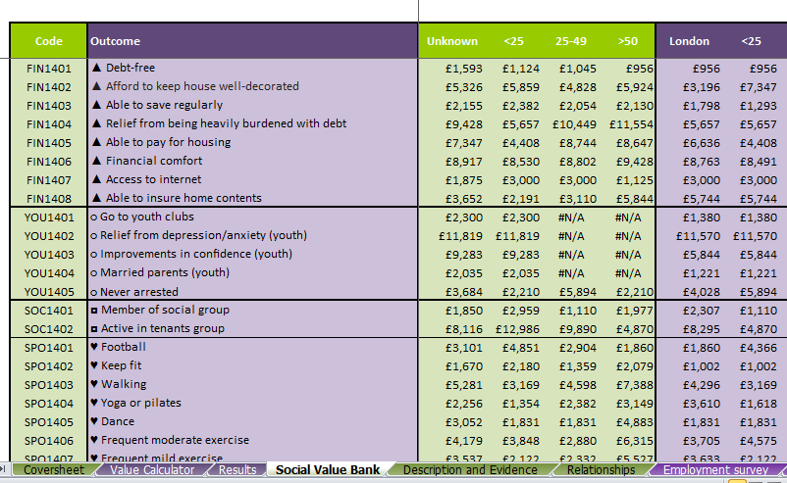
3. Wellbeing Values from HACT Social Values Bank

Slide 33

4. The process of evaluation
Consult stakeholders
  Social Impact Matrix identifies stakeholder objectives
Describe the process of health and wellbeing improvement
  A Process Map describes intended and unintended outcomes
Develop ways of measuring and valuing outcomes
  A Logic and Data model shows comparison with baseline
  And measures of costs outcomes and social values
Demonstrate a range of outcomes and values
  Using a ready reckoner VfM tool adapted for your project
  Sensitivity Analysis shows effect of varying key assumptions

Slide 34
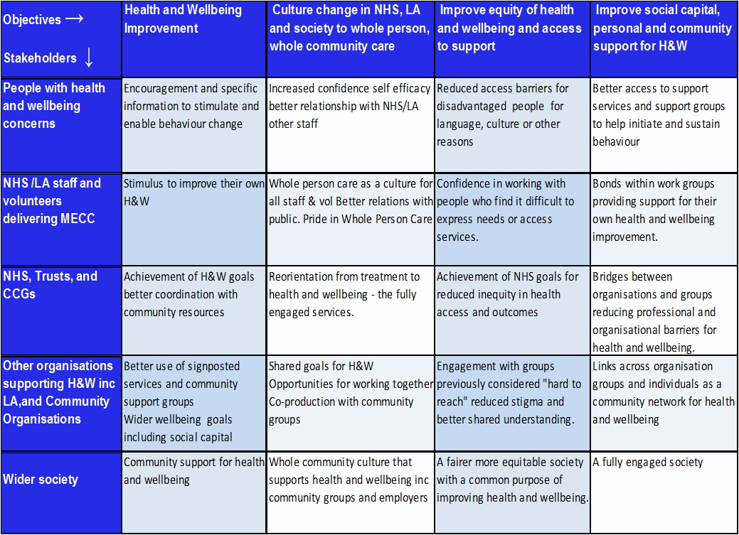
4. Social impact matrix for MECC
VfM | 29/09/2011 | www.thensmc.com

Slide 35
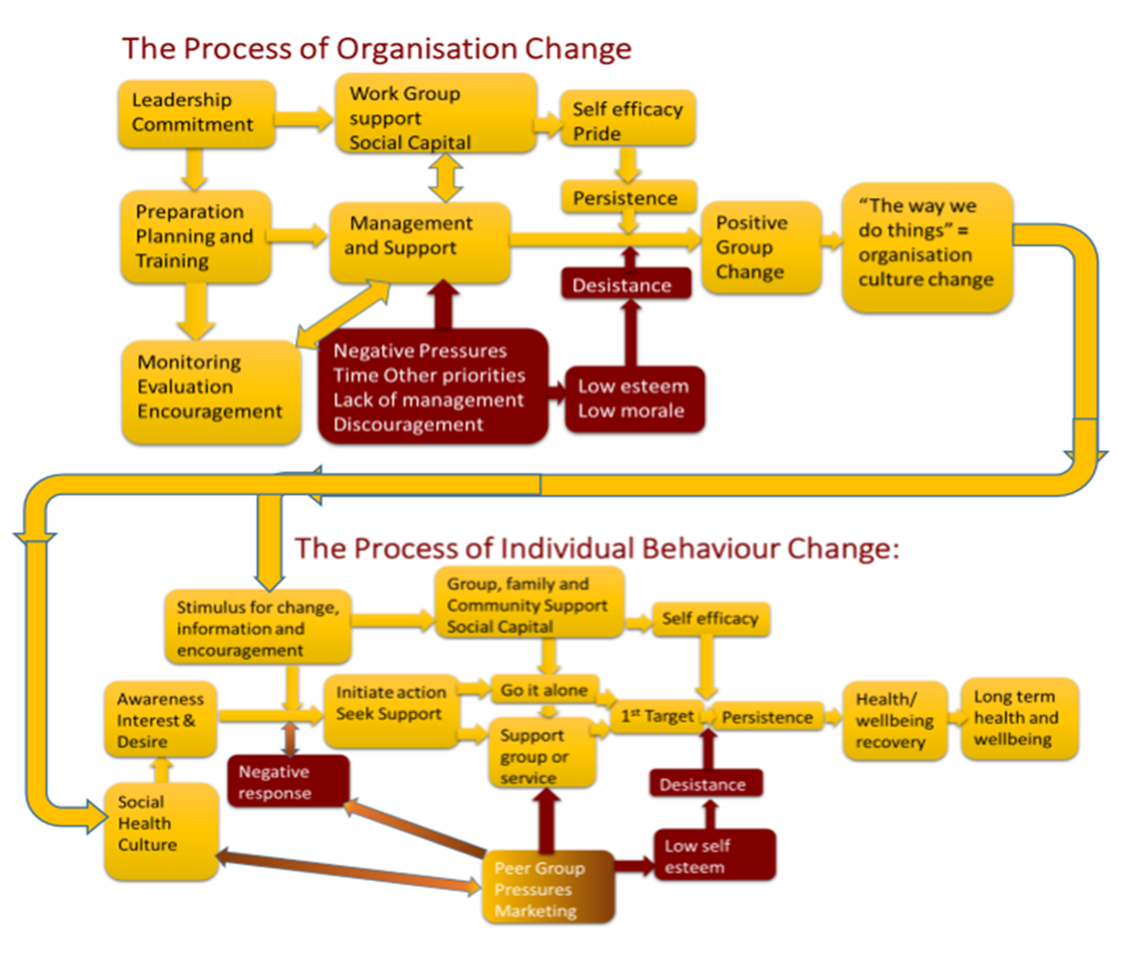
4. Process Map for MECC

Slide 36
4. Intended and Unintended Outcomes of Behaviour Change
Intended
Unintended
Weight, diet and activity awareness
Reduced drinking due to price controls
Better social integration through volunteers
Early cancer detection and prevention
Reduce smoking in young women
Stigma for people who do not conform to norms
More preloading or maybe switch to drugs
Existing community leaders feel bypassed
Increased patient anxiety and pressure on GPs
Smoking becomes a signal of identity for some
Notes:
36

Slide 37
4. The Behaviour Change Funnel
Health and wellbeing outcomes depend on both initiation and persistence of behaviour change
Initiate Change ~ 15% - 30%
Reach first target
  20%-50%
Persist at 1 year 15%
Persist over 5 years 5%
Long term Health and Wellbeing
Support
G
Go it alone
Give Up
Desistance

Slide 38
4. Describe impacts before you measure them
  Qualitative and quantitative evaluations are equally important
  You have to be able to describe impacts to measure them.
  And you have to understand them from the client’s perspective
But you need to describe and value them systematically
  The social impact matrix and the causal chain analysis
  Help to identify key performance indicators
  That reflect client and other stakeholder values
You must engage with the clients
  To ensure you have understood their perspectives.
Set out the factors to be described and/or measured
  Using a Logic and Data Model

Slide 39
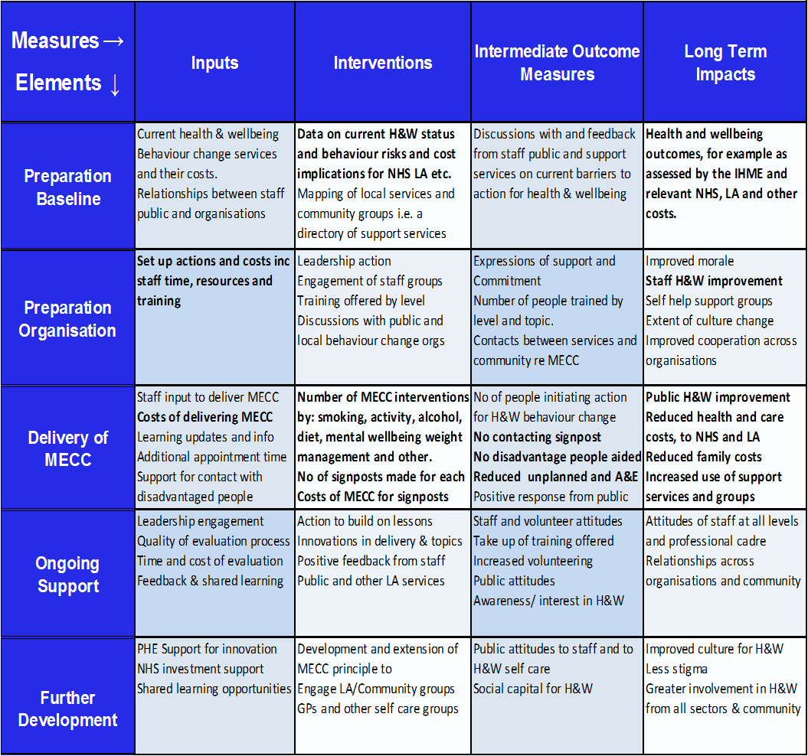
4. Logic and data model for MECC

Slide 40

4. Comparing lifetime costs and benefits
To compare costs and benefits occurring at different times
We discount future cost or benefits to current values
Because future costs are less valued so they are discounted
Benefits now are more valued than future promises
This is called the social time preference rate
The Treasury Green Book guides public investment methods
  They set discount rates for future costs at 3.5%
DH guidance suggest a social time preference rate for QALYs
  Of 1.5% for future QALY gains
NICE suggest using 1.5% and 6% as discount rates
  For sensitivity analysis (see next)
PS don’t worry about maths this will be calculated for you

Slide 41

4. Sensitivity Analysis
Most health and wellbeing data is uncertain
Behaviour change is particularly difficult to predict, and
Long term future projections even more so
With many causes and consequences
Often based on assumptions, so
Recognise uncertainty and estimate ranges of values
  By varying key estimates and assumptions such as
  Discount rates, persistence rates, long term impacts

Slide 42
4. The Ready Reckoner Tools
The concepts explained here, used by the Tools are complex
  They were developed by consulting 50 leading experts
  And overseen by an expert panel who guided the development
  They are updated as new evidence emerges (noted in the Tools)
However, the use of these tools is extremely simple
  You enter relevant costs and short term impacts
  To produce measures of resulting long term outcome in terms of
  Incremental Cost Utility Ratio (cost per QALY), Social Return on Investment with Sensitivity Analysis and Weights for Disadvantage
Unlike other such tools these reflect local costs and impacts
  Its not just what you do but how you do it that makes a difference
  We suggest you use the tools alongside local qualitative review.

Slide 43
Further reading
  For DH guidelines on evaluation of health policies :
    See David Glover, John Henderson (2010) "Quantifying health impacts of government policies A how-to guide to quantifying the health impacts of government policies" Department of Health
  For definitions of wellbeing visit National Wellbeing Institute Australia
    See http://nwia.idwellness.org/2011/02/28/definitions-of-wellbeing-quality-of-life-and-wellness/
  Investigate the New Economic Foundation resources and network for SROI
    See http://www.neweconomics.org/publications/entry/a-guide-to-social-return-on-investment
    And http://www.neweconomics.org/publications/by/well-being
  Review National Wellbeing Measures for the UK at ONS web site
    http://www.ons.gov.uk/ons/dcp171766_377786.pdf
  Scottish Government Guide to Measuring Wellbeing for Young Persons
    See http://www.scotland.gov.uk/Topics/People/Young-People/gettingitright/background/wellbeing
  Look at the National Social Marketing Centre Value for Money resources at
    See http://thensmc.com/resources/vfm
  My web site provides learning sessions and tools for VfM
    See http://www.building-leadership-for-health.org.uk
    See page “Evaluating Behaviour Change” for downloadable resources

Slide 44
Further reading
  Croydon Councils guidelines on creating social value: https://www.croydon.gov.uk/sites/default/files/articles/downloads/socialvalue.pdf
  Liverpool Clinical Commissioning Group Social Value Strategy and Action Plan http://www.liverpoolccg.nhs.uk/Library/About_us/Publications/Social_Value_Strategy_LCCG_2014.pdf
  The NICE evaluation tools for tobacco, activity and alcohol http://www.nice.org.uk/About/What-we-do/Into-practice/Return-on-investment-tools/Tobacco-return-on-investment-tool http://www.nice.org.uk/About/What-we-do/Into-practice/Return-on-investment-tools/Physical-activity return-on-investment-tool http://www.nice.org.uk/About/What-we-do/Into-practice/Return-on-investment-tools/Alcohol-return-on-investment-tool
  The NAVCA report on Measuring social value can be downloaded from http://www.navca.org.uk/localvs/lcp/research
  The ASH toolkit for measuring the cost of tobacco to the local economy http://www.ash.org.uk/localtoolkit/
  NHS Guides and Tools at http://www.institute.nhs.uk/quality_and_service_improvement_tools/quality_and_service_improvement_tools/Return_on_Investment_%28ROI%29_calculator.html https://www.gov.uk/government/uploads/system/uploads/attachment_data/file/215895/dh_122354.pdf http://www.thesroinetwork.org/publications/doc_details/224-guide-to-commissioning-for-maximum-value http://www.nhsconfed.org/~/media/Confederation/Files/Publications/Documents/building-social-value.pdf
  The HACT (Housing Associations Charitable Trust) Social Value Bank http://www.hact.org.uk/social-value-publications

