Slide 1
Social Return on Investment
FROM INSIGHT TO DELIVERY
Value for Money in Health and Wellbeing: for the People of Greenwich
Graham Lister
Visiting Professor
London South Bank University

Slide 2
Some Questions?
What is value for money?
Whose values are we talking about?
What do we mean by wellbeing?
How do we measure social value?
What is Social Return on Investment?
Why do LAs and NHS need a common language?
How do we predict long term behaviour outcomes?
When we can only measure short term change?
How do we allow for uncertainty?
And discount long term impacts?

Slide 3
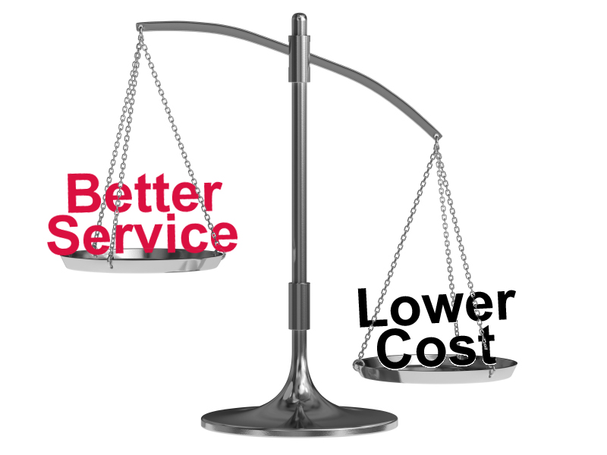
Basic Value for Money
Getting high benefits for low cost
Is obviously good value for money
And if high cost produces low benefits
This is obviously poor value for money
But most schemes have intermediate costs/benefits
So we need to establish a ratio showing how much it is worth spending for 1 unit of benefit
The cost benefit ratio of acceptable cost/benefits

Slide 4
Cost /Benefit Analysis
High benefit
Cost /benefit
Ratio
√
Low cost and
high benefit
?
High cost and
high benefit
Low cost
High cost
?
X
Low cost and
low benefit
High cost and
low benefit
Cost /benefit
Ratio
Low benefit
Notes:
4

Slide 5
Cost /Benefit Ratio
£30,000
per QALY
Cost /Benefit
Ratio
High benefit
√
£20,000
per QALY
Low cost
X
High cost
Cost /Benefit Ratio
Low benefit
Notes:
5

Slide 6
Cost Benefit/ Value for money
Value for Money may mean:
Cost Offset ~ cost per £ saved
Cost effectiveness ~ cost/ outcome
Cost consequences ~ cost/ multiple outcome
Cost-utility ~ cost/weighted outcomes
Cost benefit ~ cost/ £ economic value
Social Return on Investment ~ total social cost per value to society (wellbeing) improved.

Slide 7
How was Social Return on Investment developed?
Developed in USA in late 1990s
To evaluate social enterprises with non profit aims
A European Network formed in 2004
To develop consistent approach and methodology
New Economic Foundation UK 2004/5
SROI Primer and Methodology published 2004
Cabinet Office supports guide and network 2009
Guide to SROI for Wellbeing Programmes 2013/2015
Legislative Framework
Health and Social Care Act 2012
Public Services (Social Value Act) 2012
Care Act 2014

Slide 8
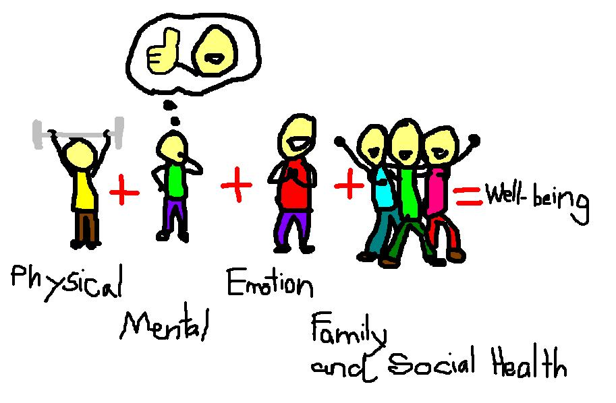
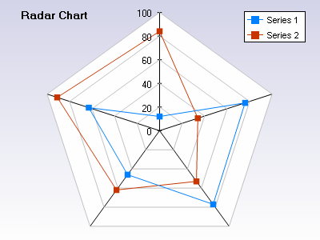
What is Wellbeing /Social Value?
No simple definition*
Physical, mental, emotional and community wellbeing enables every individual to manage lifestyle health risks, cope with normal stresses of life, find purpose and happiness, work productively and fruitfully, make a contribution to and draw support from family, community and their home and natural environment.
Many dimensions
Local issues and priorities
Defined with stakeholders
As basis for action
To address key issues
Evaluated in terms of SROI
Health
Housing
Community
Environment
Employment

Slide 9
Developing Social Value/ Wellbeing Strategy
Long term strategy starts with a local definition
Engage LA, NHS and Community organizations
Develop an agreed framework of targets for wellbeing
Co production with stakeholders to improve social value
Build trust and mutual understanding
Delegate with agreed actions and performance targets
Measure outcomes and SROI e.g. in terms of:
Physical and Mental Health Outcomes (QALYs e.g. EuroQol 5D)
Self Efficacy Measures (Generalized Self-Efficacy Scale (GSE))
Mental Wellbeing (WEMWBS scale)
Social Capital Measures (Bonding, Bridging and Linking (ONS))
Environmental Impact, Employment, Housing, Crime etc..

Slide 10
Social impact matrix for a wellbeing project
Objectives > Stakeholders ˅ | Improved Health and Wellbeing | Reduced inequality | Improved social capital | Reduce long term costs
1. Local Authorities | Improved wellbeing health gain | Disadvantaged and Hard to reach % | Membership of community groups | Reduced social care and other service costs
2. NHS | Improved health status health gain | Reduce health inequity % | Better use of NHS services more participation | Reduced NHS costs from associated conditions
3. Other Government | Improved health and wellbeing | Reduced health and wellbeing inequity | Improved employment | Tax, benefit, excise and VAT impacts
4. Clients | Improved personal health and wellbeing | Access for disadvantaged and hard to reach | Better family life More opportunities to participate and community support | Employment income Less expenditure on addictive products and informal care
5. Community | Better access to health and care | Wider participation | Increased volunteering | Opportunities for cost sharing
6. Employers | Reduced sickness and absenteeism | Less long term sickness | Improved staff relations | Less costs of replacing staff better productivity
VfM | 29/09/2011 | www.thensmc.com

Slide 11
What does Social Return on Investment involve?
Consult stakeholders
Understand their perspectives and values
Describe the process of behaviour change
Consider intended and unintended consequences
Establish a baseline or alternative for comparison
Assign values to social outcomes in a defensible way
Not just financial impacts but social values
Demonstrate a range of outcomes and values
Show sensitivity of results to key assumptions
Show the assumptions and evidence used
Create a dialogue to review outcomes

Slide 12
Who’s values
Social Return on Investment
Must reflect stakeholder values
This means engaging with stakeholders from the start
Identifying the groups affected (Clients and agencies)
Perceptions of themselves, their health, their wellbeing
Understanding the change from their perspective
But also informing and offering options
It is essential to involve stakeholders in SROI process

Slide 13
The Process of Behaviour Change: How, where and when do we change
Information Advice
Support
Group support
Social Capital
Self efficacy
Persistence
Awareness
Interest
Desire
Behaviour change support
Health/ wellbeing recovery
Long term health and wellbeing
Prices
Regulation
Availability
Environment
Desistance
Negative Social Pressures Marketing
Low self esteem

Slide 14
Intended and Unintended Outcomes
Intended
Unintended
Weight, diet and activity awareness
Reduced drinking due to price controls
Better social integration through volunteers
Early cancer detection and prevention
Reduce smoking in young women
Stigma for people who do not conform to norms
More preloading or maybe switch to drugs
Existing community leaders feel bypassed
Increased patient anxiety and pressure on GPs
Smoking becomes a signal of identity for some
Notes:
14

Slide 15
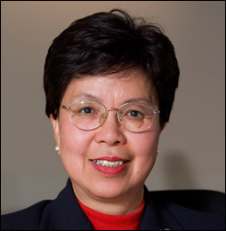
Measuring Health Benefits
QALYs = quality adjusted life years
Years of life are weighted between 0-1
Depending on the quality of life
As seen by patients but
It depends who you ask and when
It varies with the age of the patient
There are many different QALY tables
DALYs = disability adjusted life years
Used by WHO for burden of disease
DALYs = Years of Life Lost + Years Lived with Disability weighted by experts 0-1
QALYs gained ~ DALYs reduced
But original version included age weights
Margaret Chan
NICE now suggest a value of between £20,00 & £30,000 per QALY as the basis for evaluation and SROI
Notes:
15

Slide 16
What is social capital? Is it part of wellbeing?
Social capital is the framework of values and norms that fosters bonds within community groups, bridges between groups and links with formal and informal organisations*
Behaviour both depends on and builds social capital
By recognising and influencing existing group norms
By forming social groups to support behaviour change persistence
By providing links to social support from community and services
Social capital is essential to wellbeing and equity
Most care (70%) is from community resources
Most behaviour is determined by community norms
* Rosalyn Harper (2002) “The Measurement of Social Capital in the UK” National Statistics

Slide 17
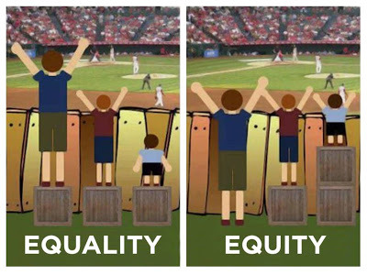
Why is improving equity important for wellbeing?
It is morally wrong to allow disadvantage to determine outcomes - so equity is an objective of health and wellbeing
People in the most deprived areas, have a life expectancy 3-4 years less than those in the least deprived areas, about 2 years less than the average they also score lower wellbeing
Reducing inequality in health and wellbeing is also a social value and a target for Local Authorities and NHS.

Slide 18
Is Integrated Health and Social Care Important for Wellbeing?
Integrated care creates social value and wellbeing
See LGA resources http://www.local.gov.uk/health-wellbeing-and-adult-social-care/-/journal_content/56/10180/4060433/ARTICLE
This goes further than LA/NHS cooperation
It requires community engagement in co-production of advice, support and neighbourhood schemes
Thoughtful redesign of: housing, advice and support services, community spaces, transport, access to the high street and shops.
Community, communication and contact

Slide 19
SROI Describes, Measures and Values Outcomes and Costs
SROI requires clarity of goals, outcomes and measures
Describe, measure and value costs and impacts
Relate interim impacts to long term wellbeing measures
Consider uncertainties and risks
Relate costs to current value of social gains
By applying a social time preference rate (discount rate)
To produce a cost per unit value of social wellbeing

Slide 20
Recognising Uncertainty
Most health data is uncertain
Behaviour change is particularly difficult to predict, and
Long term future projections even more so
With many causes and consequences
Often based on assumptions, so
Recognise uncertainty and estimate ranges of values
Establish confidence interval (probability of outcome)
Perform sensitivity analysis
Test outcomes when assumptions change
Don’t pretend precise knowledge

Slide 21
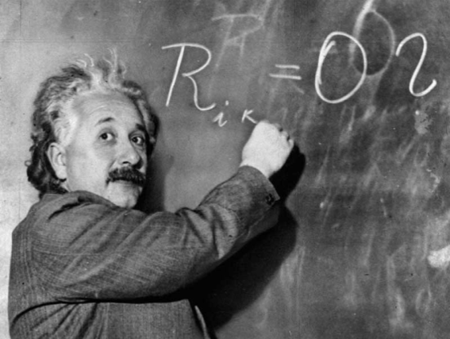
Value for Money in Health and Wellbeing
Is not an exact science
Long term impacts are mostly expert consensus
Outcomes always depend upon assumptions
It requires both descriptions and measures
Qualitative and quantitative methods
But most importantly a shared understanding
Of what health and wellbeing means for people
So engagement must be part of the process
Value for money provides a common language

Slide 22
Further reading
For definitions of wellbeing visit National Wellbeing Institute Australia
See http://nwia.idwellness.org/2011/02/28/definitions-of-wellbeing-quality-of-life-and-wellness/
Investigate the New Economic Foundation resources and network for SROI
See http://www.neweconomics.org/publications/entry/a-guide-to-social-return-on-investment
And http://www.neweconomics.org/publications/by/well-being
Review National Wellbeing Measures for the UK at ONS web site
http://www.ons.gov.uk/ons/dcp171766_377786.pdf
Scottish Government Guide to Measuring Wellbeing for Young Persons
See http://www.scotland.gov.uk/Topics/People/Young-People/gettingitright/background/wellbeing
Look at the National Social Marketing Centre Value for Money resources at
See http://thensmc.com/resources/vfm
My web site provides learning sessions and tools for VfM
See http://www.building-leadership-for-health.org.uk
See page “Evaluating Behaviour Change” for downloadable resources

Slide 23
Further reading
Croydon Councils guidelines on creating social value: https://www.croydon.gov.uk/sites/default/files/articles/downloads/socialvalue.pdf
Liverpool Clinical Commissioning Group Social Value Strategy and Action Plan http://www.liverpoolccg.nhs.uk/Library/About_us/Publications/Social_Value_Strategy_LCCG_2014.pdf
The NICE evaluation tools for tobacco, activity and alcohol http://www.nice.org.uk/About/What-we-do/Into-practice/Return-on-investment-tools/Tobacco-return-on-investment-tool http://www.nice.org.uk/About/What-we-do/Into-practice/Return-on-investment-tools/Physical-activity-return-on-investment-tool http://www.nice.org.uk/About/What-we-do/Into-practice/Return-on-investment-tools/Alcohol-return-on-investment-tool
The NAVCA report on Measuring social value can be downloaded from http://www.navca.org.uk/localvs/lcp/research
The ASH toolkit for measuring the cost of tobacco to the local economy http://www.ash.org.uk/localtoolkit/
NHS Guides and Tools at http://www.institute.nhs.uk/quality_and_service_improvement_tools/quality_and_service_improvement_tools/Return_on_Investment_%28ROI%29_calculator.html https://www.gov.uk/government/uploads/system/uploads/attachment_data/file/215895/dh_122354.pdf http://www.thesroinetwork.org/publications/doc_details/224-guide-to-commissioning-for-maximum-value http://www.nhsconfed.org/~/media/Confederation/Files/Publications/Documents/building-social-value.pdf
The HACT (Housing Associations Charitable Trust) Guides and Measures of social value http://www.hact.org.uk/social-value-publications

