Slide 1
The British – Canadian and Global Health, All Party Parliamentary Groups
Graham Lister Rapporteur

Slide 2

Global health refers to trans border health issues
Infectious diseases – travel
NCD lifestyle diseases – global marketing
Climate disruption – uncontrolled industrialisation
Poverty and under-nutrition – spread by political neglect
Threats to global public goods such as antimicrobial resistance
These are both health and foreign policy concerns
Health security at home and abroad
A market worth £ 4 trillion
Source of soft power and women’s development
A response to conflict and failed states
Basis for mutual learning
Test of global governance for sustainable development

Slide 3
Changing health issues
Zoonotic diseases and antimicrobial resistance
Most poverty and poor health in MICs and LIC Fragile states
Rise of NCDs in Lower and Middle Income Countries
Need for whole society response to health causes and outcomes
Changing landscape of diplomacy for health
Health aid doubles from £10 billion to £20 billion, but
Shift from MDGs to post 2015 agenda could challenge this
Rise of PPPs, NGOs and CSOs (source of ~ £6b)
Emerging powers as both health aid recipients and donors
Need to focus on failed states
International laws and obligations (FCTC, IHR)

Slide 4
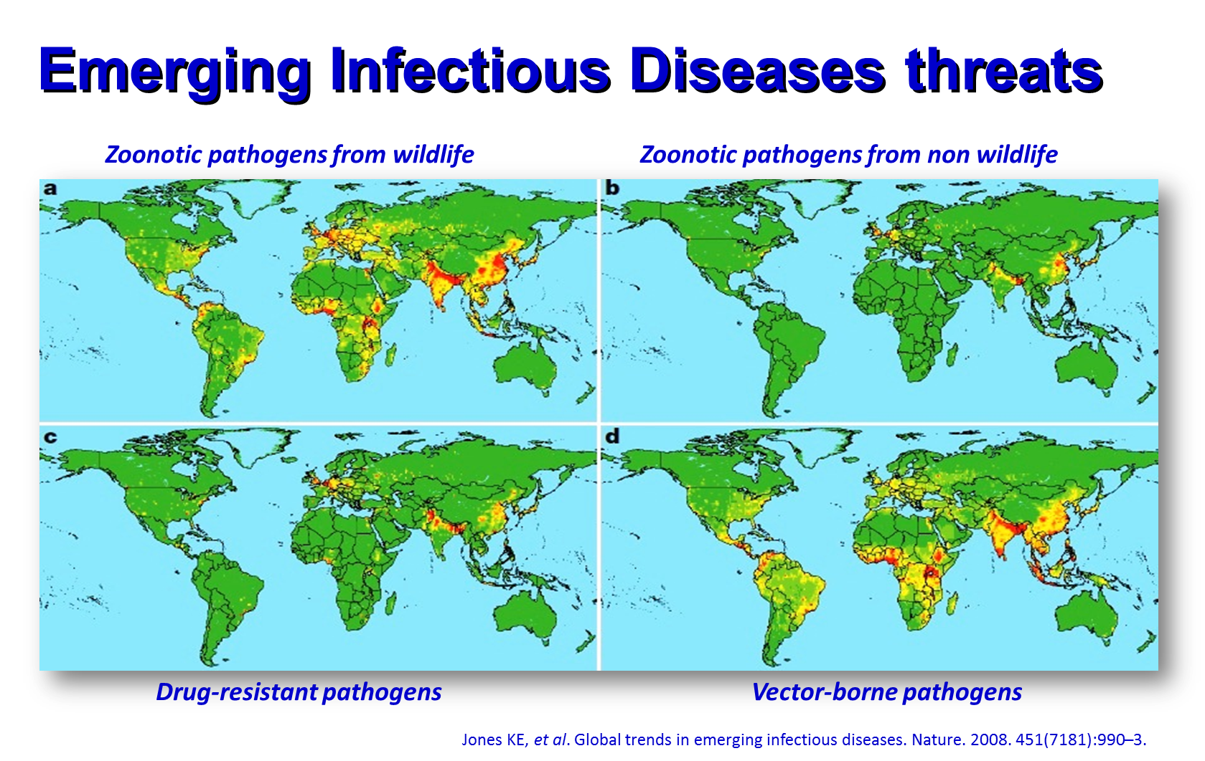

Slide 5
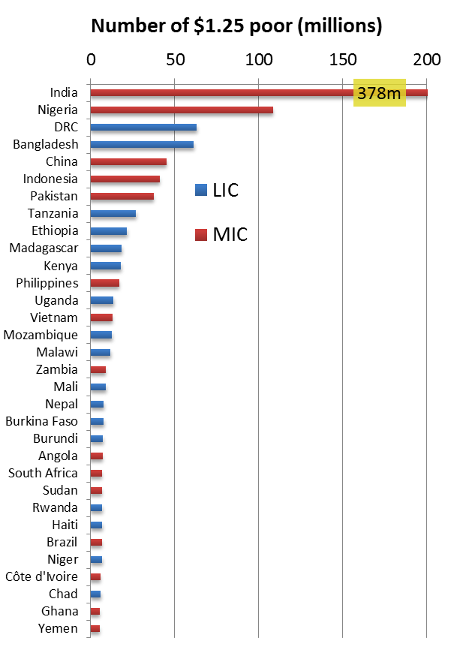
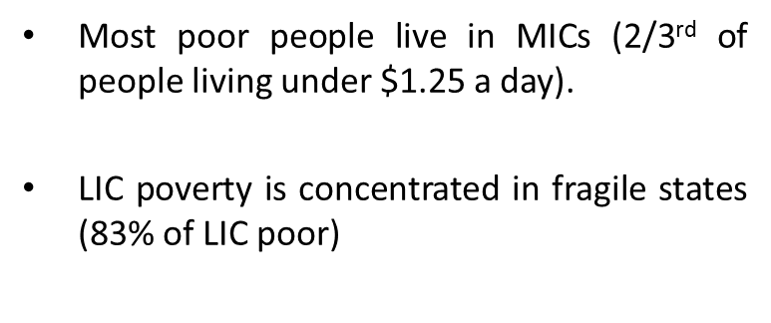
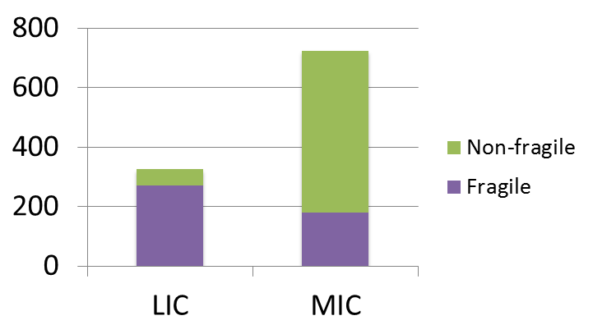

Slide 6
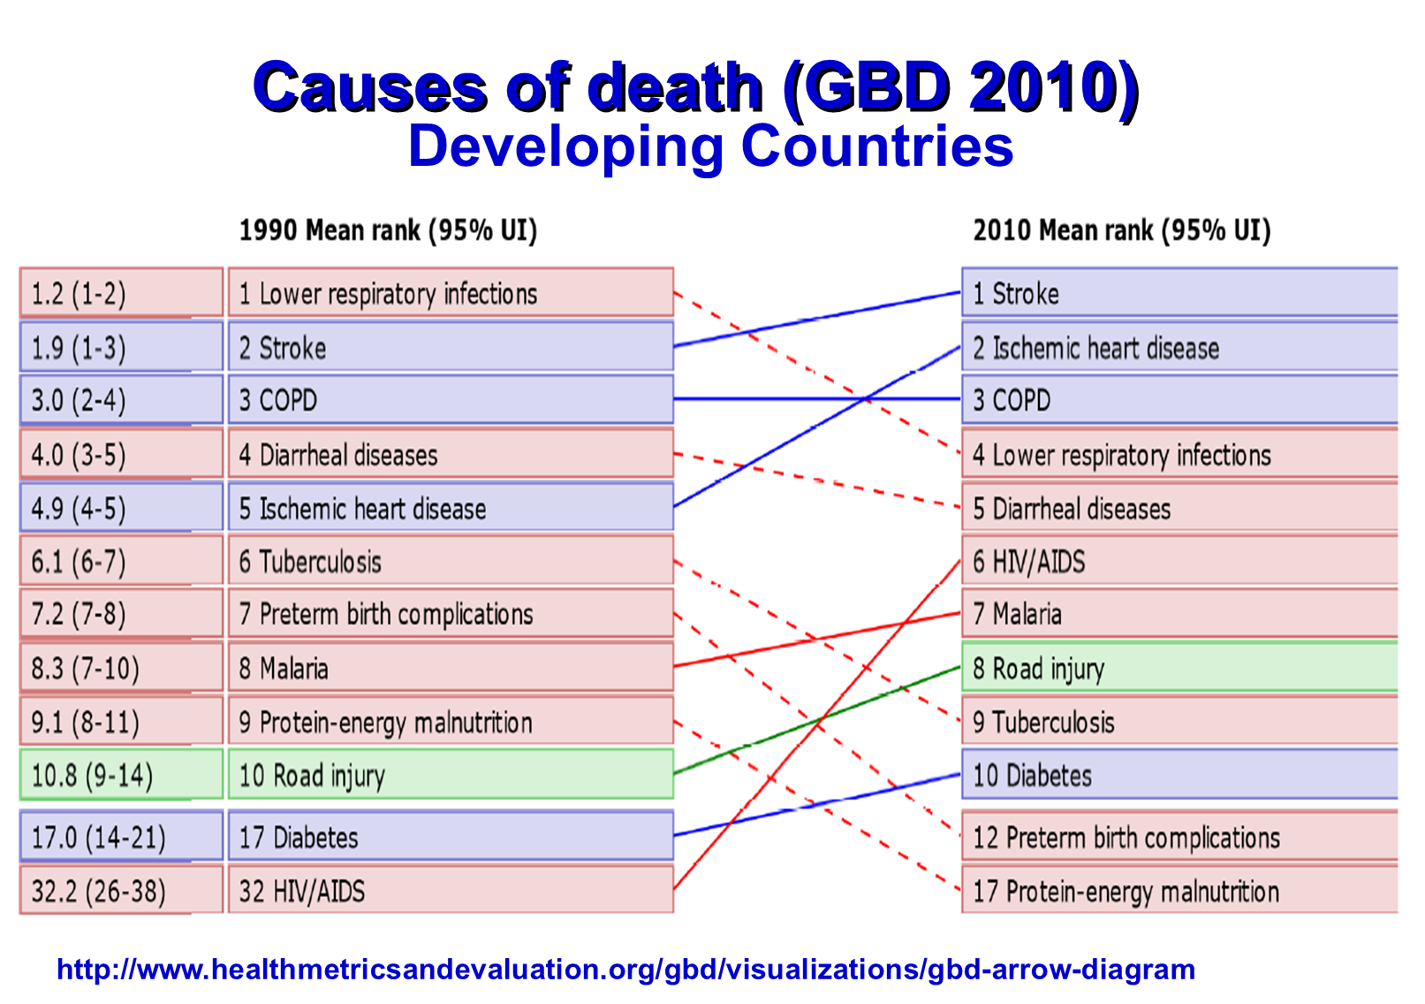

Slide 7
For both Canada and UK our health systems represent cherished values. Our recommendations: build on these values, our history of collaboration in global health and our common interests and concerns:
Renewal/extension of Maternal Child Health Programme
Partnerships for non-communicable chronic diseases
Research cooperation on whole society health solutions
Measures to strengthen global governance for health:
Renewal of global health protection collaboration
Renewal of the Neglected Tropical Diseases programme,

Slide 8
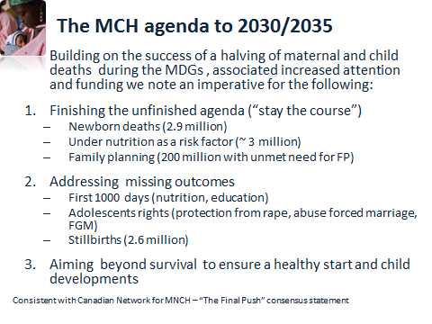

Slide 9


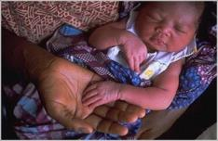
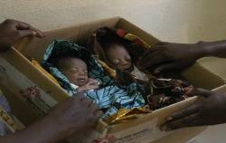
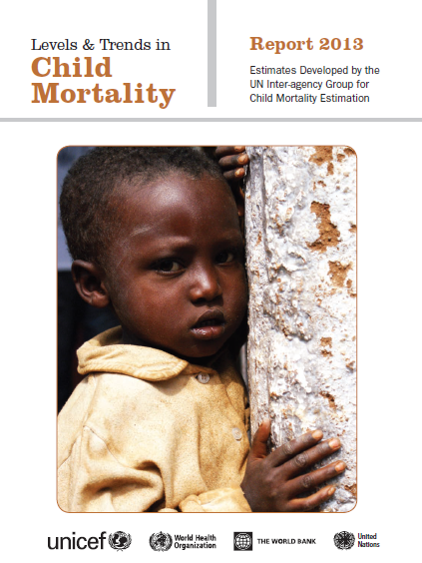

No newborn is born to die
Our delivery goal
No
baby
stillborn
No
child
dying or
stunted
~ 250,000 die
2.9 million die
2.6 million die
3.7 million die
4.2% per yr
1.8% per yr
~1% per yr
2.5% per yr
~9 million deaths
3.5 million within a few days of birth
Missing adolescents

Slide 10
Global Partnerships to address NCDs
Action on Dementia to increase research and delivery
Learning networks to addressing the behavioural causes of NCDs including lack of activity, poor diet, alcohol abuse, smoking.
Grand Challenges programme to support innovative partnerships between public sector, civil society groups and the private sector
Three 100’s programme to support cost effective action by 2025 for
100 countries to develop reliable representative data on causes of death
100 million current smokers to quit smoking,
100 million vascular disease patients to access low-cost polypills.
This proposal supports the 2013-2020 Global Action Plan for the Prevention and Control of Non-Communicable Diseases.

Slide 11
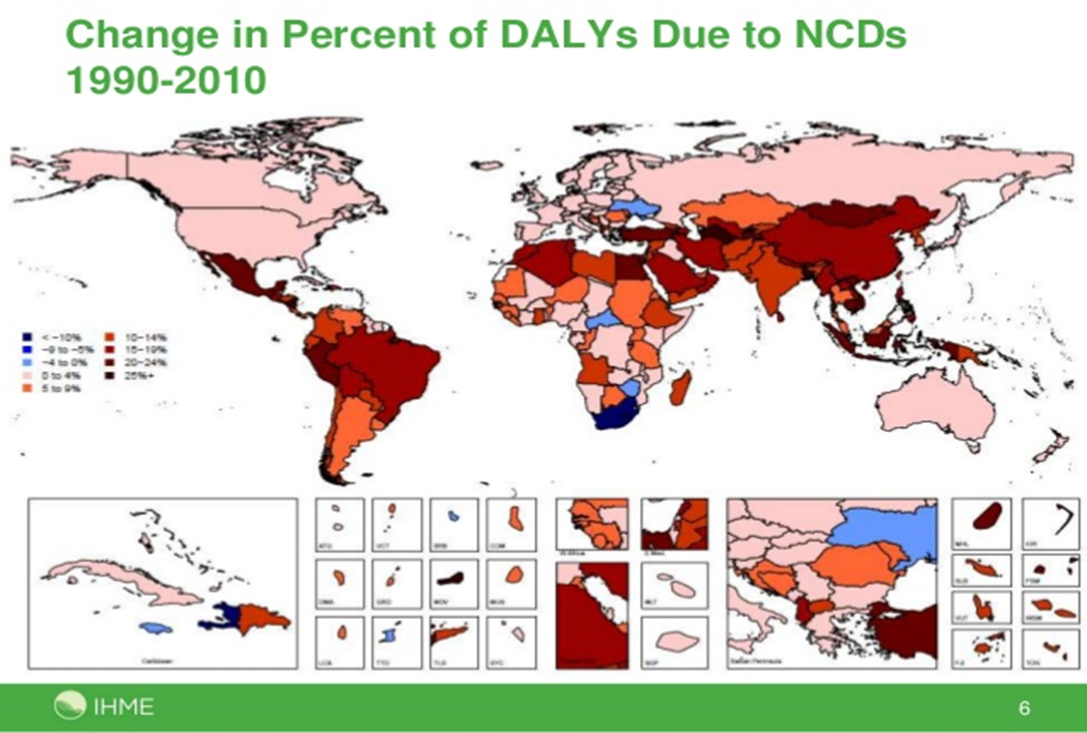

Slide 12
Research for whole society health solutions
A global learning network to share ideas for whole society approaches to health and wellbeing.
Sharing ideas for cross society approaches to global health based on experience of “Health is Global” and approaches in countries like Indonesia, Thailand and Brazil.
Support for leadership development for community based approaches to health systems e.g. village based “woreda” healthcare systems in Ethiopia and Health Trainers in the UK
A Grand Challenges programme to support social innovation for health.
These proposals respond to calls by Margaret Chan and Lord Crisp for greater focus on research into whole society systems approaches to health.

Slide 13
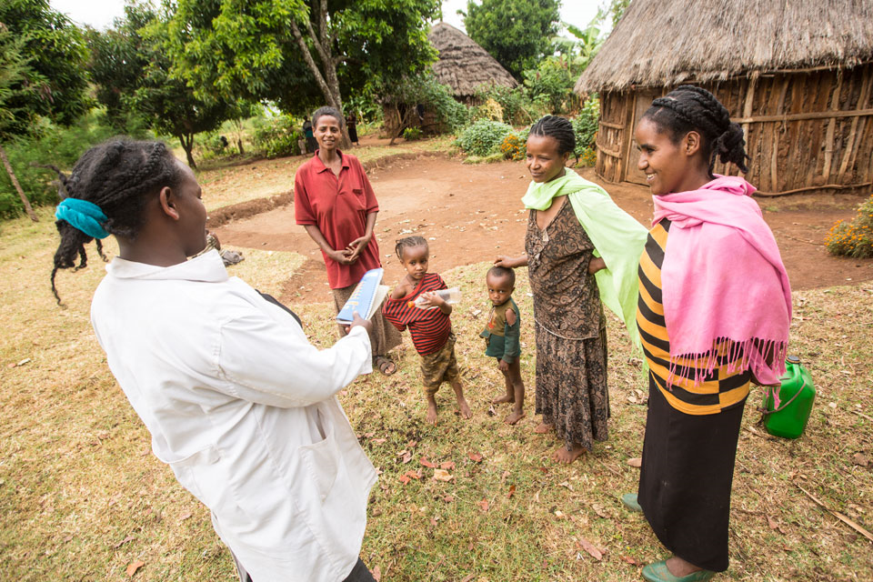

Women take the lead in village health
Woreda health led by women in Ethiopia
Health Trainers England

Slide 14
Support for global governance for health
Recognising the need to improve and extend capacity for global governance for global public goods, our recommendations are:
UK /Canada learning networks for global health diplomacy to help diplomats /health experts to develop and share knowledge and skills
Extension to support for global health diplomacy networks for Commonwealth and other partner countries partners.
Development of similar networks in relation to other Sustainable Development Goals.
These proposals are in line with United Nations Resolutions on Global Health and Foreign Policy (UNGA, 2008, 2009 and 2010) which stress the need to train diplomats and health officials in global health diplomacy.

Slide 15
Global Health Diplomacy
Governance for Global Health
Between government departments
With international aid agencies
With NGOs and CSOs
With business interests
Global Health Governance
Within regions – EU
Sub regions - SEEHN
At WHA and UNGA
Global Governance for Health
At WTO, WEF
Across Regions – G77
At UN: ECOSOC , ILO, UNEP …..
GLOBAL GOVERNANCE FOR HEALTH
GLOBAL HEALTH GOVERNANCE
GOVERNANCE FOR GLOBAL HEALTH
Notes:
At national level governance for global health requires cross sector engagement to address global health issues. For example a programme to address child obesity might engage agencies responsible for: health, education, parks and recreation, sports, food sales, taxation and wellbeing. These could include national and local government international, national and local NGOs and CSOs as well as food and retail business interests.
Global health governance is focussed on regional and sub regional action as well as global agreements. For example agreement on regional action on food labelling at the EU. At global level the "Global action plan for the prevention and control of NCDs 2013-2020” agreed at the World Health Assembly provides a framework of norms and measures to guide national and regional action” (see http://www.who.int/nmh/en/). The 2011 UN “Political declaration of the High-level Meeting of the General Assembly on the Prevention and Control of Non-communicable Diseases” provides political backing for international action ( see http://www.ncdalliance.org/node/3521) . But as you will see if you follow the link, it also provides a forum for NGOs and CSOs. The NCD Alliance unites a network of over 2,000 civil society organizations in more than 170 countries.
Governance for global health refers to the need to exercise global health diplomacy with the many other international agencies and agreements that influence global health. The World Trade Organisation influences the determinants of health to promote free trade. The UN has a system for negotiating food safety standards (Codex Alimentarius) but has no system for regulating the impact of global companies on the determinants of health or other global public goods.

Slide 16
Renewal of global health protection collaboration
The UK and Canada participate in many collaborations to improve global health security. Extension of such partnerships is recommended together with further action to build public health capability in Commonwealth and other partner countries steps recommended are:
Participation with other Commonwealth Countries in the International Consortium for Urban Health and Sustainability.
Canada/UK partnership for training and career development for public health laboratory staff.
A Grand Challenge programme to encourage innovative ways of improving the capture of basic birth and death data.
These proposals respond to the needs of countries to meet the International Health Regulation signed in 2005.

Slide 17
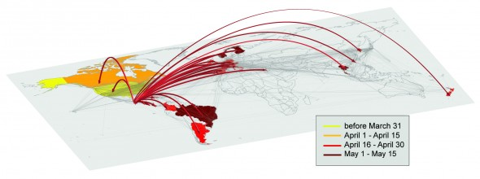
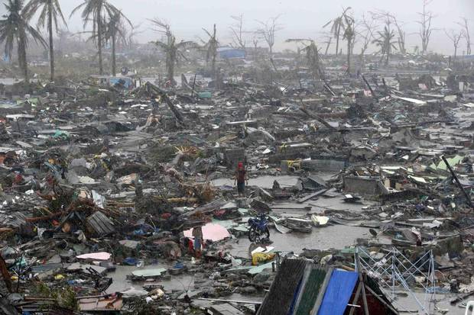

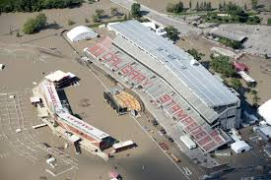
Why Global Health Protection?
Self-interest

Slide 18
Partnership action on Neglected Tropical Diseases
Addresses key issues raised by the colloquium.
Highly prevalent affecting one 6th of global population, where science capability of UK/Canada can make an effective contribution
Diseases of poverty where market mechanisms fail to deliver solutions
Whole society approach engaging pharmaceutical companies and civil society organisations and building on existing collaboration.
Recommendations include:
Financial support to close the funding gap, for the delivery of NTD drugs.
Greater recognition and support for companies providing free drugs and the CSOs that deliver them.
Support for the ongoing Dengue Fever vaccines and treatment research programmes and collaboration in Trachoma research.

Slide 19
NTD coverage 2003 - 2016
Nigeria CC and DFID ?
And Yemen
With World Bank funds
Mauritania
Mali
Senegal
Niger
Burkina Faso
Nigeria
Ethiopia
Ghana
Uganda
Cote D’Ivoire
and Liberia
Cameroon
DRC
Kenya (CIFF)
Burundi and Rwanda
Tanzania
Proposed expansion into DRC, Ethiopia, Mauritania Senegal and Zimbabwe
Malawi and
Mozambique
Zambia
Zim
Implemented by the countries supported by WHO, USAID grantees, NGO’s, SCI and CNTD Liverpool
With financial support from the Gates Foundation
USAID/NTD, Geneva Global and DFID, UK

Slide 20
These proposals address recent APPG concerns
What could the UK learn from low, middle and high income countries in the way it empowers patients to play an active role in their healthcare?
What more could the UK be doing globally to promote and enable the empowerment of patients abroad (particularly in low and middle income countries)?
How can the UK’s capability in health extend soft power?
How can partnership in health improve health at home and abroad?
How should UK-Canada cooperation noted in the 2011 Declaration “A Stronger Partnership for the 21st Century” be extended?
How can the performance of international cooperative and governance mechanisms for global public goods be strengthened?

